Slide 1
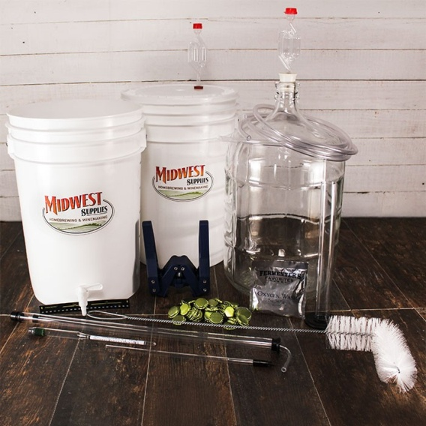
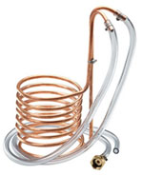
Chemistry of Home Beer Brewing
Paul J. Yanisko
www.LinkedIn.com/In/PaulYanisko
for the Chemical Consultants Network
11 January, 2017

Slide 2
Who is Paul?
Career:
Process Industry Consultant, Process Industries (Current)
Business Development, Rembe Inc. (2015 – 2016)
Air Products & Chemicals, Inc. (1988 – 2015)
Technical / Business Development, Gas Applications, Asia + LA
Process Development, PVOH / Polymer Emulsions
Capital Project Management, Cryogenic Air Separation and Hydrogen SMRs
Product Development, In-situ Fluorination of Blow Molded PE
Industry Org’s:
AIChE Philly
Chemical Heritage Foundation
Chemical Consultants Network
Academic:
B.S. Chemical Engineering, Lafayette College
M.S. Chemical Engineering, Univ. of Connecticut
Beer Brewing as a hobby

Slide 3
Objectives
Learn and share (technology transfer)
Inspire you to begin, or resume, brewing (network)
Drink your beer ! (Have fun !)

Slide 4
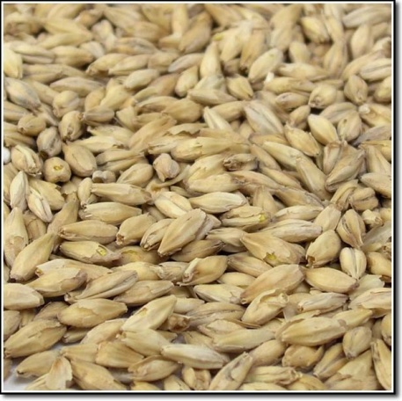
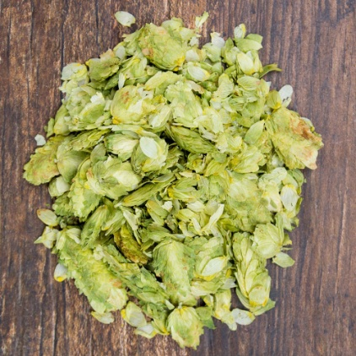
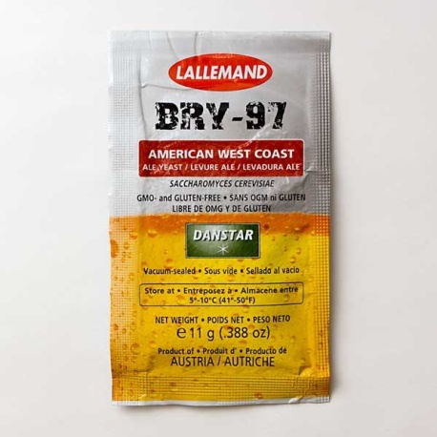
Agenda
Why home brew beer?
What is beer?
Key ingredients
Brewing process
Home brewing approaches
Let’s make beer!
Questions

Slide 5
Why Brew Beer at Home?
Drive your spouse crazy
Learning opportunity for yourself / others
Camraderie with the “homebrew mafia”
“Clone” your favorite styles, commercial beers
Practice chemistry / engineering at home
Enjoying my beer with my favorite foods

Slide 6
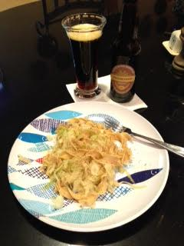
Dunkel Weizen with Halushki !

Slide 7
What is Beer?
A beverage produced by:
enzymatic conversion of starches to sugars
fermentation of sugars to ethanol & carbon dioxide
Beer classification:
Ales:
Top-fermenting yeast, 60 - 70 F, “hoppy” flavor/aroma
“beer” ~3 weeks (quick), easier for home brewing
Lagers (“lagern”, to store):
Bottom-fermenting yeast, 50 – 60 F, lager ~40 F, malty flavor
“beer” >6 weeks, more challenging for home brewing

Slide 8
What beer style do you want to brew?
Ales
Pale Ale
IPA (India Pale Ale)
ESB (extra special bitter)
Lambic
Belgian Dubbel/Tripel
Brown Ale
German Alt (Old Ale)
Porter
Stout
Weizen, Dunkel Weizen
Belgian Wit
Lagers
Mexican Cerveza
American lager
Czech Pilsener
Dortmunder
Oktoberfest
Vienna Lager
Bock
Doppelbock
Dunkel / Dark

Slide 9
Diversity of “Beer”
German Beer Purity Law of 1516 (“Rheinheitsgebot”) allows 4 beer ingredients: water, barley, hops, yeast
On the other hand……
Others (notably Belgians) produce an array of beers including many other add’l ingredients (wheat, fruit, spices, etc.)
…….brew / drink what you prefer.

Slide 10
Water
Purpose:
Solvent in which sugar extraction, color extraction, flavor / aroma extraction, fermentation take place
Aspects:
5 – 5.5 pH ideal for best enzyme activity (mashing)
“Hard” water best for English ales (my well-water)
“Soft” water best for Pilsener styles (distilled)
Critical – remove chlorides if present (boil)
Fermentation: pH decreases as sugar is consumed
use clean, drinkable water with no off-flavor

Slide 11
Barley (Malted and Kilned)
Purpose:
Source of enzymes (produced during “malting”) which convert resident starches to sugars (during “mashing”)
Source of flavors, color, and “body” (“kilning”)
Aspects:
2-row barley: highest fermentable sugars
6-row barley: preferred for multi-grain brewing
Brewing raw material. No brewer (home or commercial) malts their own barley.
Cost ~$2/lb.

Slide 12
Malting and Kilning of Barley
Purpose:
production and optimization of enzyme composition in barley for subsequent conversion of starch to sugar
Desired enzymes:
Alpha-amylase
Beta-amylase
Process:
Malt: moisten (40 % H2O) to sprout roots, ~1 week
Kiln: dry (4 % water) to lock-in enzyme composition

Slide 13
Hops
Purpose:
Source of bittering, flavor, and aroma components
Source of anti-oxidants which enhance storage life
Aspects:
Alpha-acids:
bitter flavor and anti-bacterial properties
Not water soluble. Require boiling for extraction.
Beta-acids:
Highly volatile essential oils. Best added near end of boil.
“Dry hopping” – add during fermentation
Tremendous spectrum of varieties. Several key growing areas (Czech, Bavaria, Britain, US NW)
Dried whole leaf and pellet forms
Cost: $1 to $4 / ounce (type, quantity)

Slide 14
Yeast
Purpose:
Consume the fermentable sugars, produce ethanol and carbon dioxide
Aspects:
Saccharomyces cerevisiae, single cell life, fungus
By-products: esters, alcohols, diacetyl
Esters: complex fruit, higher fermentation temp
Fusel alcohols: spicy, low concentration desirable
Diacetyl: generally undesirable, minimized by end of fermx
Dried and liquid forms
Cost: $2 to $10 (amt. for 5 gallon fermentation)

Slide 15
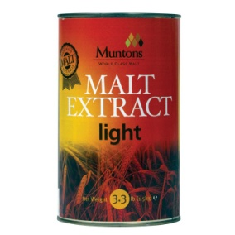
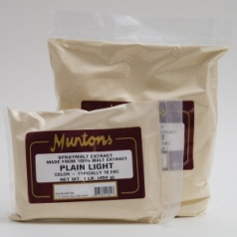
3 Home Brewing Approaches
No-grain, no mash brewing:
Minimizes steps and equipment
Partial-grain, partial-mash brewing:
Peek at “full” brewing, some of the “art”
All-grain, full-mash brewing:
Ideally, requires improved temperature control (mashing), quick cooling (post boil)

Slide 16
Let’s Make Beer!
Step | Water (gal.) | Barley Malt | Hops (oz.) | Yeast | Temp (F) | Time (hr) | Purpose
Mash | 2 | 10 lbs |  |  | 155 | 1 | Starch → sugar
Sparge | 1 |  |  |  | 155 | <0.5 | Sugar recovery, spent grain removal
Boil |  |  | 2 - 6 |  | 212 | 1 | Sterlize, extract hop components
Cool Wort |  |  |  |  | 70 | ASAP | Prep for yeast pitch
Adjust O.G. | ~3 |  |  |  | 70 | < 0.5 | Adjust sugar to achieve target % alcohol
Pitch Yeast and Aerate |  |  |  | add | 70 | <0.5 | Activate yeast and Initiate fermentation,
Primary Ferm |  |  |  |  | 60 – 70 | 1 wk | Rapid fermx w/in 2 days,
2nd Fermx |  |  |  |  | 60 – 70 | 1 wk | Rate decreases and stops.
Priming |  |  |  |  |  | <0.5 | Add sugar for carbonation.
Bottling |  |  |  |  |  | 2 | Carbonation development, flavor maturation (1 wk)

Slide 17
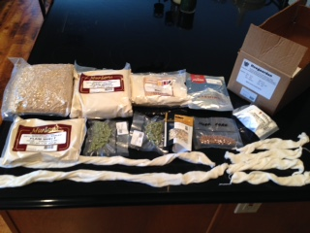
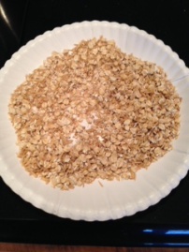
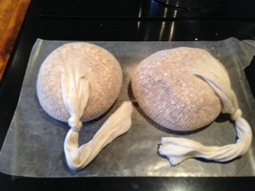
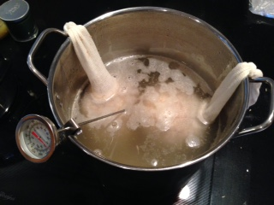
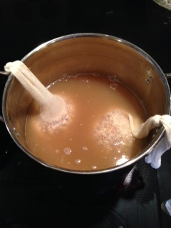
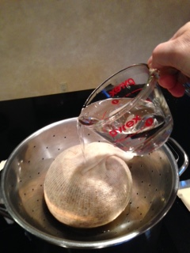
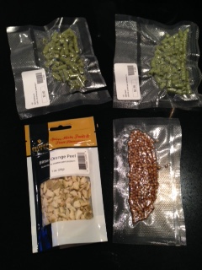
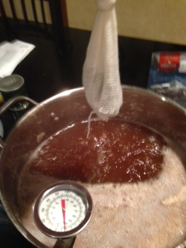
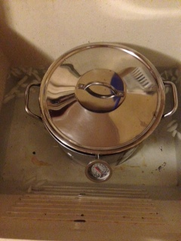
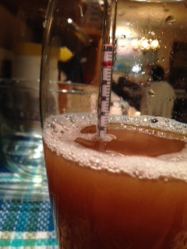
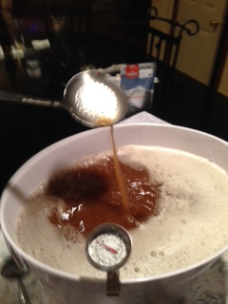
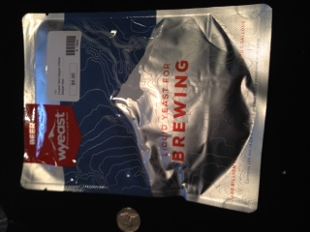
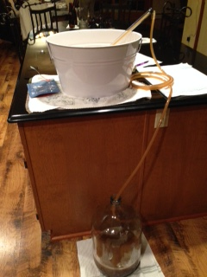
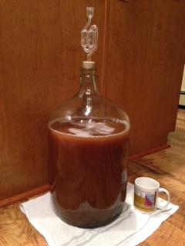
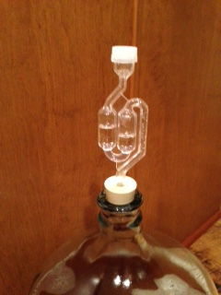
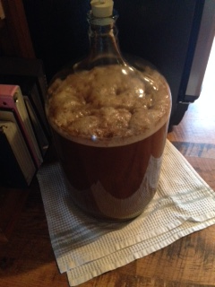
Let’s Make Beer !
Mashing
Sparging
Boiling
Wort Cooling
Adjust O.G.
Pitch Yeast
Aerate
To be continued:
2nd Fermx
Priming
Bottling
Enjoying !
Xfer to Primary
Primary Fermentation
Yield 2.5 cases, total ingredient cost $25 - $50.

Slide 18
Suggestions
Clean kitchen, sanitize surfaces and sink
Clean and sanitize all equipment
Begin with a “kit”, read brewing instructions
Have fun !

Slide 19
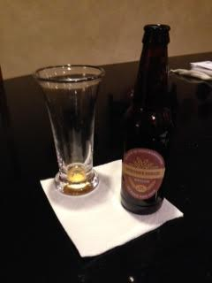
Every Ending is a New Beginning
“The search for the perfect pint should last a lifetime.”
- Michael Jackson

Slide 20
Resources / Info: Books
“The Complete Joy of Home Brewing”, Charlie Papazian, Avon Books, New York, 1983.
“Home Brew Beer”, Bob Bridle ed., Dorling-Kindersley, New York, 2013.
“Beer and Wine Production: Analysis, Characterization and Technological Advances”, Barry Gump editor, ACS Symposium Series, 1992. Esp. “Ch. 13: Home Beer Making; Chemistry in the Kitchen”, R.P. Bates.
“Pennsylvania Breweries”, Lew Bryson, Stackpole Books, Mecanicsburg PA, 2010.
“The New World Guide to Beer”, Michael Jackson, Running Press, Philadelphia, 1988.

Slide 21
Resources / Info: Web
On-line course (free !):
Chemistry of Beer, Dr. Mark Morvant, U. Oklahoma, www.Janux.ou.edu
Brewing org’s:
www.BrewersAssociation.org
Beer Style Guidelines, Charlie Papazian
Evolution of Barley Malt and Beer Flavor, Chris Sweeney
www.BrewersOfPA.org
www.CMBTC.com
Brewing suppliers:
www.northernbrewer.com
www.midwestsupplies.com
www.keystonehomebrew.com
www.weakkneehomebrew.com

