Slide 1
Mixing-sensitive reactions:
Recognizing them and
Dealing with them
Aaron Sarafinas
Principal
Sarafinas Process & Mixing Consulting LLC
Chemical Consultants Network – September 11, 2019

Slide 2
Raise your hand if you…
Are a chemist… An engineer… Other scientist… Other…
Ever took a process to a different scale
(Scaled up or scaled down)
  And never had a problem with scaling a process up or down
Ever “set the mixing” for your process
  Using the Goldilocks (“this looks just right”) method
  Using another non-visual method to get the right process response
Process Development is a dialogue between disciplines,
so expect to share your opinions tonight

Slide 3

Why listen to me talk about mixing and process development?
Over 35 years experience with Dow / Rohm and Haas
Really a process development person, specializing in mixing
  “Good mixing” is impossible
  without the proper process context.
  Use the right tools in the right way at the right time
  to build process understanding and achieve commercial success.
Process developer who was bitten by the mixing bug…
  Development, scale-up, commercialization, and troubleshooting for many products and processes for a variety of businesses
    Starting with scale-up of suspension polymerization reactors
    Many different multiphase contacting and reaction systems
    Expertise in building process understanding and simplifying processes
  Developed and delivered training on scale-up and mixing technology
  Technical presentations at various AIChE meetings
  Contributor to the NAMF handbook Advances in Industrial Mixing
Much taller in person

Slide 4
Sarafinas Process &
Mixing Consulting LLC
Elected to retire from Dow in May 2018
Started consulting company enabling clients to
  Achieve faster process development and scaling, and
  Leverage advantaged mixing technology
Services:
  Experienced Problem Solving
  Faster Process Development / Faster Troubleshooting
  Does Mixing Matter?
  Simpler and Improved Processes
  Managing Technical Capabilities
  Delivering Technical Training
For more info: http://sarafinasprocess.com
Notes:
So, what am I doing now? I elected to retire from Dow in May 2018, and I’ve started Sarafinas Process & Mixing Consulting LLC to enable clients to achieve faster process development and scaling and to leverage advantaged mixing technology. There are a variety of services the company offers to solve process problems, develop processes faster, simplify and improve processes, manage technical capabilities, and deliver technical training, but today I will be focusing on the question “does mixing matter to my process?”
If you want more information about my consulting, check out sarafinasprocess.com.

Slide 5
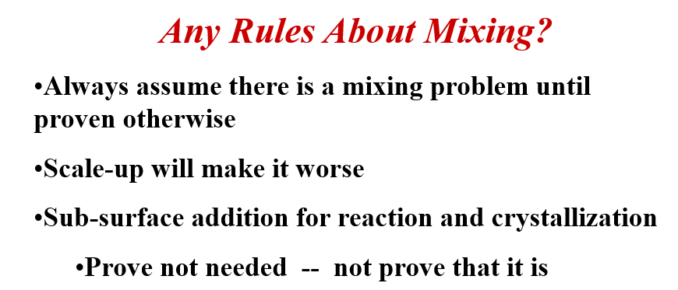
Does Mixing Matter?
Prove it doesn’t matter…
From Ed Paul’s presentation at the 2003 Process Development Symposium
Reference: E. L. Paul, “Notes on Process Development: Pharmaceutical Intermediates and API’s,” AIChE Process Development Division Symposium, Pocono Mountain, PA, June 2003.
Notes:
OK, how do we know if mixing matters? Well, prove that it doesn’t matter.
In this webinar, I’ll be drawing on a number of different publicly presented and published materials that are listed in the references.
I have gone back to two of the talks from the session that I chaired at the inaugural AIChE Process Development Symposium in 2003 to pull out a few key points. The first example from 15 years ago is from Ed Paul’s talk on the process development of pharmaceutical intermediates and API’s. Ed is one of the world’s experts on the impact of mixing on industrial reaction systems and is one of the editors of the Handbook of Industrial Mixing. In his talk, Ed presented his three rules about mixing:
Always assume there is a mixing problem until proven otherwise,
Scale-up will make it worse, and
Sub-surface addition for reaction and crystallization…prove that it is not needed
I used to have those three rules as a tag line in my signature in emails. Today, I’ll be talking about an efficient way to find the types of mixing issues that may exist in your process.

Slide 6
This presentation will…
Start with a simple competitive reaction
Discuss relative mixing rates and reaction rates
Look at a sanitized process and express our concerns
Consider some reactions from the literature where mixing intensity can drive reaction selectivity
Discuss a simple experimental method (“The Bourne Protocol”) which can indicate when mixing matters
  Identifying the critical mixing environment early in process development
  With some quick examples where this protocol was applied to other competitive rate systems (like precipitation and crystallization) to enable successful scaling
Wrap up with some thoughts about future needs

Slide 7
This presentation will…
NOT be an overview of mixing technology
  If you want that, check out my three-part webinar series for DynoChem, available at DynoChem Resources
  (https://dcresources.scale-up.com/#q=Sarafinas+Talking+Mixing)
  But I will mention some excellent mixing references
NOT be a detailed review of the Bourne Protocol
  If you want that, check out two webinars I did in 2018
  for Scientific Update and DynoChem
  But I will describe how the Bourne Protocol should be used to efficiently understand mixing sensitivities early in development
Start with a quiz…

Slide 8

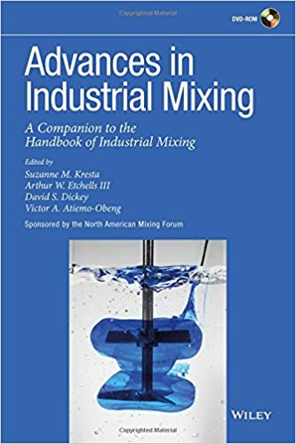
You studied these, right?
(“HIM”) Paul, E.L., V.A. Atiemo-Obeng, S.M. Kresta, Handbook of Industrial Mixing: Science and Practice, John Wiley and Sons, 2004.
(“AIM”) Kresta, S.M., A.W. Etchels III, D.S. Dickey, V.A. Atiemo-Obeng, Advances in Industrial Mixing: A Companion to the Handbook of Industrial Mixing, John Wiley and Sons, 2016.
Bourne J.R., “Mixing and the Selectivity of Chemical Reactions”, Org. Process Res. Des. Dev.; 2003; 7(4) pp. 471-508.
Hope you all studied for the quiz…

Slide 9
A quiz? I came for dinner and networking…
In scaling mixing systems,
what are the three scales of interest?
  _______________________________
  _______________________________
  _______________________________

Slide 10
Consider this reaction system
A + B → R (desired product)
R + B → S (undesired impurity)
Competitive-Consecutive
or Series-Parallel Reactions
How can we minimize losses to S?
  Get the charges to be stoichiometrically appropriate
    Excess B will make S
  Order of addition
    Add A to B?
    Add B to A?
  Having more B around leads to more S
OK, that’s rather elementary
(even for an engineer), but
what does this have to do
with mixing?
A
B
B
A
R
S

Slide 11
So, what is “mixing?”
My favorite definition of “mixing”
  A process operation where
  mechanical energy
  induces fluid motion in a volume of fluid
  in order to
  reduce inhomogeneities of the fluid’s properties
  to achieve a desired process result
Concentration
Temperature
Density
Viscosity
Suspension
Drop size

Slide 12
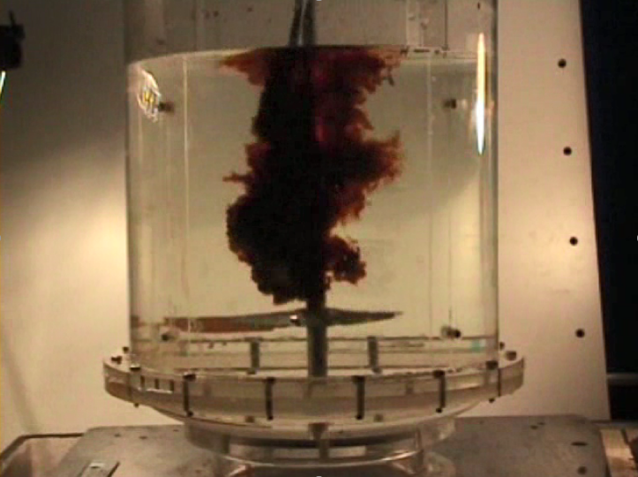
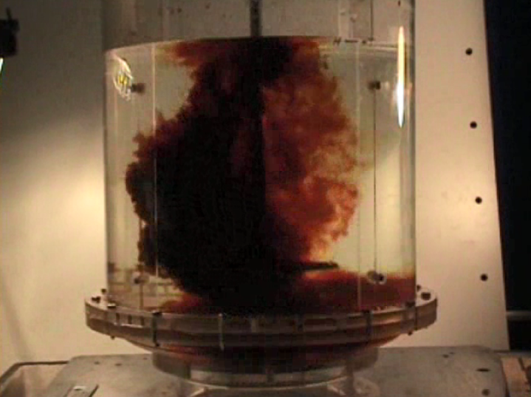
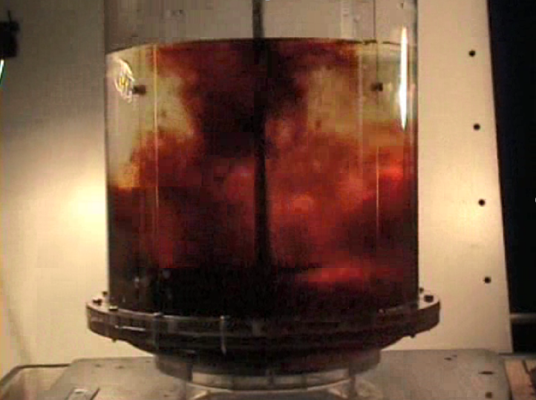
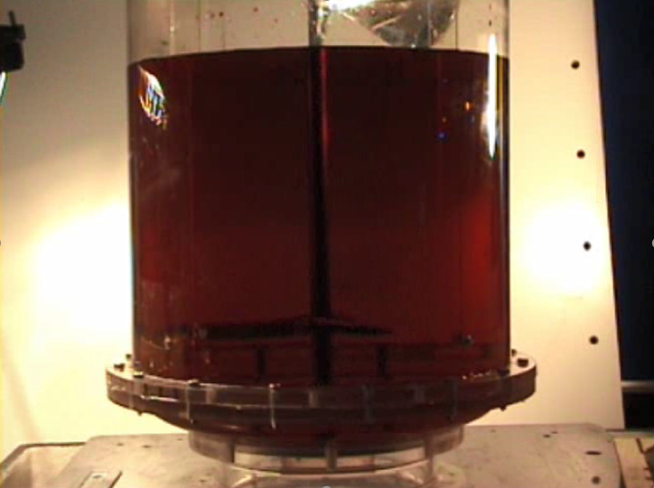
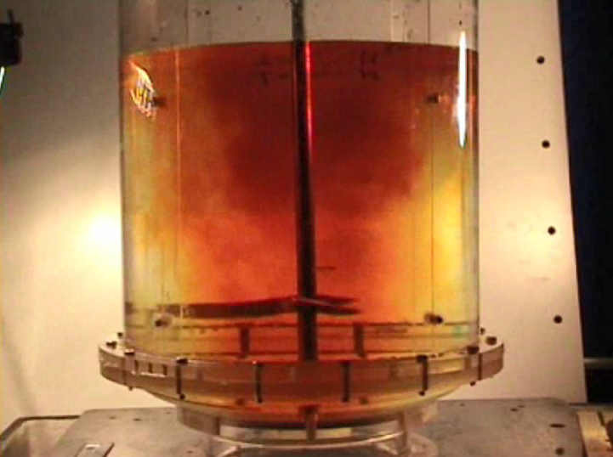
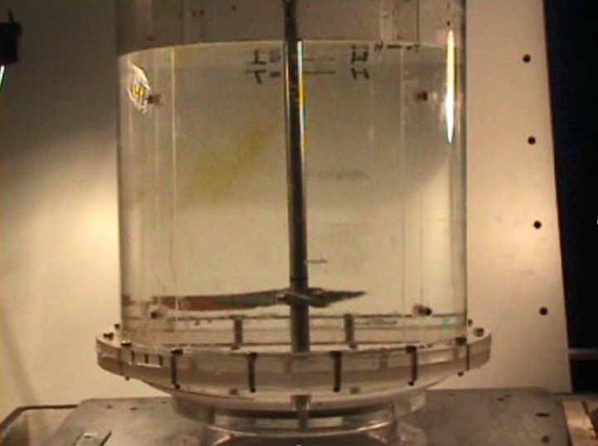
Snapshots from the video
Colorization with an indicator dye
Decolorization of the dye with reagent
t = 1.0 s
t = 1.8 s
t = 0.5 s
t = 8 s
t = 16 s
t = 0 s
From “Talking Mixing: Basics of Mixing” (Sarafinas 2019)
Images from FMP

Slide 13
Complexity of flow patterns
t = 0.5 s
t = 1.0 s
From “Talking Mixing: Basics of Mixing” (Sarafinas 2019)
Simple 2D streamlines
do not adequately represent the concentration gradients or the details of the flows.
Images from FMP
t = 1.8 s

Slide 14
What does it look like at “halftime?”
t = 0 s
t = 16 s
From “Talking Mixing: Basics of Mixing” (Sarafinas 2019)
How is your process affected by the time it takes for the concentration gradients to disappear?
Images from FMP
t = 8 s

Slide 15

Does mixing affect reactions? Sometimes
Consider only the first reaction A+B→R
with the rate expression r_{R} = k₁[A][B]
Does mixing affect the reaction rate?
  “But since the composition is uniform throughout…”
  (Levenspiel, 1972, Chapter 5 “Steady-State Mixed-Flow Reactor”)
  Does mixing affect the tank-average rate constant?
  Does mixing affect the tank-average concentrations of A and B?
Mixing can affect the local reaction rate
  How can mixing affect the local rate constant?
    Temperature gradients in the vessel
  How can mixing affect local concentrations?
    Miscible liquid blending, as shown in the video
    Mass transfer
Notes:
Does mixing affect chemical reaction? Well, it depends. Let’s start by considering a simple bimolecular irreversible reaction A+B→R with the rate of generation of R = k[A][B]. Chemists and engineers will look at this simple reaction differently. If the engineers and chemists collaborate to build a Process Scheme like we discussed in the last webinar, we may see that they believe that different things are important, including mixing.
If we look at this simple reaction, does mixing affect the reaction rate? Looking at the rate expression, will mixing affect the average rate constant k? No. Does mixing affect the average concentrations of A and B? No, mixing does not affect the concentration of the reagents averaged across the whole tank. Too often, people think in terms of averages across the whole tank, when in fact it is the local conditions that drive the process responses.
Mixing DOES affect the local reaction rate. How can mixing affect the local rate constant? If there are temperature gradients in the vessel, then the rate constant will likely be higher in regions of the tank that are hotter. Local concentrations are also affected by mixing. We saw that in the videos in the first two webinars regarding miscible liquid blending. Mass transfer can also be affected by mixing, which will drive local concentrations. But we really need to think a little differently about this to consider how mixing affects competitive rate processes.

Slide 16
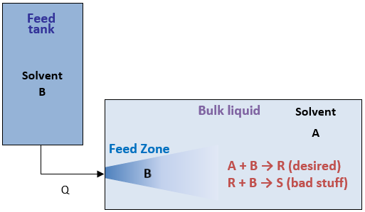


Back to the competing reactions…
Process Scheme:
Reactions
What happens if:
  k2 >> k1? Only S
  k1 >> k2? R is favored
But what happens in the feed zone, where [B] is high?
  Doesn’t matter if k2 >> k1, still getting S
  But if k1 >> k2, then the mixing probably will matter
Competitive-Consecutive
(Series-Parallel) Reactions
$$A+B \underset{→}{k1} R$$
$$R+B \underset{→}{k2} S$$
Notes:
Let’s consider a more complex system with a competitive-consecutive (or series-parallel) reaction system shown in this process scheme. In this we have a bulk liquid containing a solvent and reagent B (B is for “bulk) and we are feeding a solution of solvent with reagent A (A is for “added”). When A and B get together they react according to: A+B→R with a rate constant of k1 and A+R→S with a rate constant of k2. Naturallly, R is our desired product and S is an undesired impurity (or “bad stuff”). So let’s consider what happens if the second reaction is much faster than the first reaction. In that case the A that is fed reacts with B to form R, but any A reacts quickly with R to form S, giving us only the undesired impurity. Now if the first reaction is fast and the second reaction is slow, I think that we’d all agree that R would be favored, but we may make some S. Looking at the process scheme, the point where the feed enters the vessel will be locally high in the concentration of A. That really doesn’t matter when k2>>k1, we’ll still get S. However, if k1>>k2, the mixing in the feed zone will probably be important for our reaction selectivity and how much of reagent A goes to the impurity.

Slide 17
A Sanitized Example
Suppose you want to make this molecule:
From these materials
“C”
“C”
From Sarafinas, 2011

Slide 18
First reaction: A+B→R
Acid Chloride reacting with Amine…
  “A” + “B” → “R”
HCl
What’s missing?
Heat effects?
From Sarafinas, 2011

Slide 19
…but R+B→S
Acid Chloride reacting with Amine…
  “R” + “B” → “S”
HCl
What’s missing?
Heat effects?
From Sarafinas, 2011

Slide 20
Consider the by-products
By-products in the reaction
  Series-parallel or competitive-consecutive reactions
    A + B → R
    R + B → S (diacylated impurity)
  Aqueous base fed to consume HCl by-product
  Hydrolysis
    Acid chloride + water or base → Acid
      Use organic solvent
    Organic solvents can hydrolyze (with base or acid)
Don’t forget the HCl
From Sarafinas, 2011

Slide 21
Consider the by-products
By-products in the first amidation reaction
  R has an isomer from reacting on substituted amine
    A + B → R’
    R’ + B → S (diacylated impurity)
  Operating conditions affect selectivity
    Temperature
    Feed rates and concentrations
    Mixing (competitive-consecutive reaction plus mass transfer)
Is R or R’ favored?
Don’t forget the HCl
From Sarafinas, 2011

Slide 22

Conceptually, what goes on with fast competitive reactions
Competitive-Consecutive
(Series-Parallel) Reactions
Component B Added to
Bulk Component A
Initial State
(Completely Segregated)
A A A A
A A A A
B B B B
B B B B
A + B → R (very fast)
R + B → S (slower)
Notes:
Let’s pictorially look at how mixing can affect selectivity in fast competitive reactions. We are interested in making R, which is made by reacting A and B in a very fast reaction. However, R can react with A to form the impurity S. This type of reaction system is called “Competitive-Consecutive” by Bourne and Ed Paul, but some of the engineers in the audience may recall this type of reaction system described by the term “Series-Parallel” from Levenspiel’s textbook on Chemical Reaction Engineering. No matter what term you use to describe it, consider the initial state where the components A and B are completely segregated, and then look at two limiting cases. In the case of poor or slow mixing where we have the completely segregated state, the A reacts with B to form R, but then the R sees plenty of A around it and gets consumed to make S. If we call the fraction of added material that goes to the impurity as Xs, we see that Xs→1 for poor or slow mixing.

Slide 23

Conceptually, what goes on with fast competitive reactions
Competitive-Consecutive
(Series-Parallel) Reactions
Component B Added to
Bulk Component A
Initial State
(Completely Segregated)
A A A A
A A A A
B B B B
B B B B
A + B → R (very fast)
R + B → S (slower)
The fraction
of B that goes to “bad Stuff”
Poor or Slow Mixing:
τ_{M}>>τ_{R}
first reacts, then mixes
A A A A
R R R R
B B B B
A A A A
S S S S
X_{S}→1 (undesirable)
Notes:
Let’s pictorially look at how mixing can affect selectivity in fast competitive reactions. We are interested in making R, which is made by reacting A and B in a very fast reaction. However, R can react with A to form the impurity S. This type of reaction system is called “Competitive-Consecutive” by Bourne and Ed Paul, but some of the engineers in the audience may recall this type of reaction system described by the term “Series-Parallel” from Levenspiel’s textbook on Chemical Reaction Engineering. No matter what term you use to describe it, consider the initial state where the components A and B are completely segregated, and then look at two limiting cases. In the case of poor or slow mixing where we have the completely segregated state, the A reacts with B to form R, but then the R sees plenty of A around it and gets consumed to make S. If we call the fraction of added material that goes to the impurity as Xs, we see that Xs→1 for poor or slow mixing.

Slide 24
Conceptually, what goes on with fast competitive reactions
Competitive-Consecutive
(Series-Parallel) Reactions
Component B Added to
Bulk Component A
Initial State
(Completely Segregated)
A A A A
A A A A
B B B B
B B B B
A + B → R (very fast)
R + B → S (slower)
The fraction
of B that goes to “bad Stuff”
Ideal Mixing:
τ_{M}<<τ_{R}
first mixes, then reacts
A B A B
B A B A
A B A B
B A B A
R R R R
R R R R
X_{S}→0 (desirable)
Poor or Slow Mixing:
τ_{M}>>τ_{R}
first reacts, then mixes
A A A A
R R R R
B B B B
A A A A
S S S S
X_{S}→1 (undesirable)
Notes:
Let’s pictorially look at how mixing can affect selectivity in fast competitive reactions. We are interested in making R, which is made by reacting A and B in a very fast reaction. However, R can react with A to form the impurity S. This type of reaction system is called “Competitive-Consecutive” by Bourne and Ed Paul, but some of the engineers in the audience may recall this type of reaction system described by the term “Series-Parallel” from Levenspiel’s textbook on Chemical Reaction Engineering. No matter what term you use to describe it, consider the initial state where the components A and B are completely segregated, and then look at two limiting cases. In the case of poor or slow mixing where we have the completely segregated state, the A reacts with B to form R, but then the R sees plenty of A around it and gets consumed to make S. If we call the fraction of added material that goes to the impurity as Xs, we see that Xs→1 for poor or slow mixing.

Slide 25
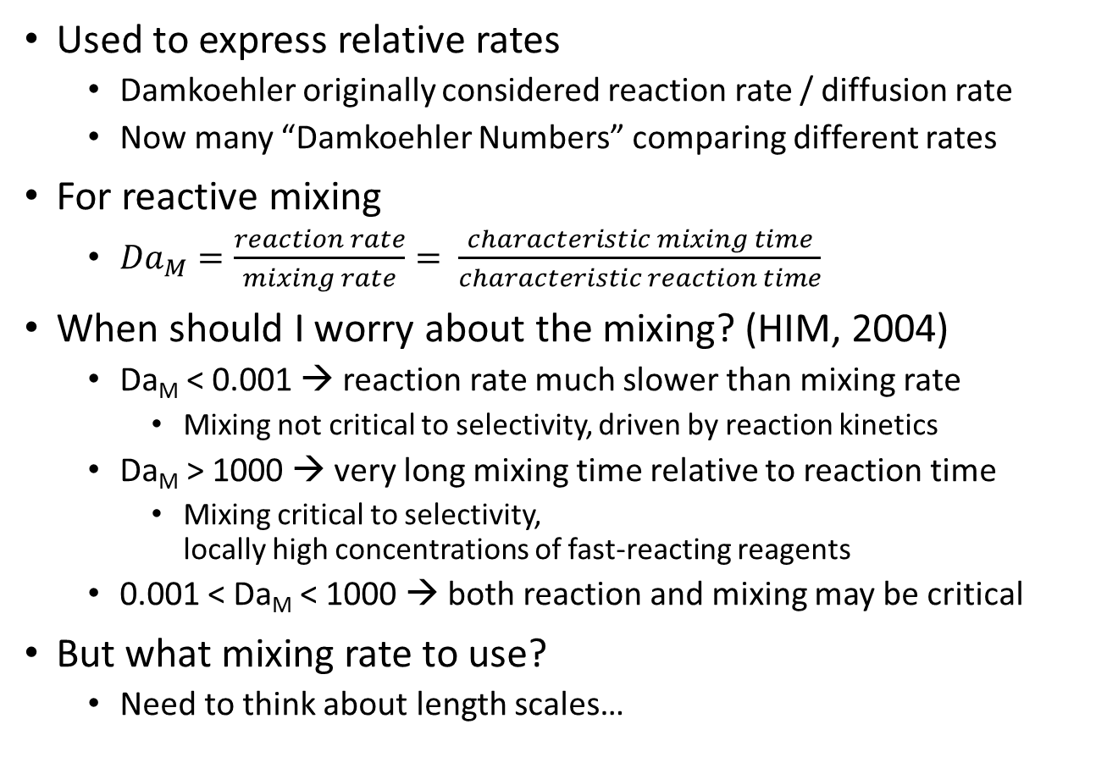
Compare Rates: Damkoehler Numbers
Used to express relative rates
  Damkoehler originally considered reaction rate / diffusion rate
  Now many “Damkoehler Numbers” comparing different rates
For reactive mixing
  ${Da}_{M}=\frac{reaction rate}{mixing rate}= \frac{characteristic mixing time}{characteristic reaction time}$
When should I worry about the mixing? (HIM, 2004)
  Da_{M} < 0.001 → reaction rate much slower than mixing rate
    Mixing not critical to selectivity, driven by reaction kinetics
  Da_{M} > 1000 → very long mixing time relative to reaction time
    Mixing critical to selectivity,
    locally high concentrations of fast-reacting reagents
  0.001 < Da_{M} < 1000 → both reaction and mixing may be critical
But what mixing rate to use?
  Need to think about length scales…
Notes:
The literature talks about comparing rates using “Damkoehler Numbers.” Damkoeler was a chemist in the early 20th century and he considered reaction rates relative to diffusion rates. The term “Damkoehler Number” is commonly used when looking at ratios of rates, and there are a number of Damkoehler Numbers. For reactive mixing, the mixing Damkoehler Number is the reaction rate over the mixing rate. Since rates are the reciprocal of the characteristic time constants in a system, we can also define the mixing Damkoehler number as the characteristic mixing time relative to the characteristic reaction time.
The Handbook of Industrial Mixing gives the following guidance on Damkoehler Numbers and when to worry about mixing. When the characteristic reaction time is about 1000x slower than the characteristic mixing time, then mixing is not critical to the selectivity of the reaction. However, when the characteristic reaction time is about 1000x FASTER than the characteristic mixing time, then mixing will be critical to the selectivity of the reaction because of locally high concentrations of the fast-reacting reagents. For Damkoehler numbers in-between, both reaction rates and mixing rates may be critical for the reaction selectivity. We can estimate half-lives of reactions, but what mixing rate should we use? To answer that, we need to think a little more about length scales in our process.

Slide 26
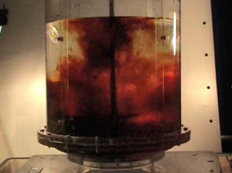

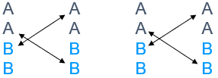
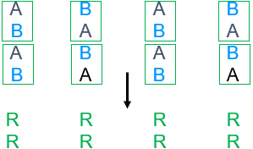
How did you do on the quiz?
In chemical reaction scale-up, what are the three scales of interest?
Not the lab, pilot plant, and plant.
  One person’s lab is another’s production unit.
The three scales: macroscale, microscale, and mesoscale
  Macroscale – Scale of the vessel and impeller
  Microscale – Scale of the molecule, flow is no longer convective
  Mesoscale – Scale of the fresh feed stream
These three scales allow us to think about
mixing rates relative to reaction rates.
Notes:
This is my favorite quiz that I always give when teaching about competitive rate processes. In chemical reaction scale-up, what are the three scales of interest?
(build) It is not the lab, pilot plant, and plant.
(build) The three scales of interest for scale-up are the macroscale, microscale, and mesoscale.
(build) The macroscale is the size of the vessel or the impeller, and when we talk about macromixing we are referring to our efforts to approach homogeneity in composition or temperature or phase volume fraction across the whole vessel.
(build) The microscale is the scale of the molecule, where flow is no longer convective. Micromixing, in this context, refers to mixing at or near the molecular level.
(build) The mesoscale is the scale of the fresh feed stream, and so mesomixing refers to the gradual disintegration of a feed stream in a turbulent environment down to the length scales where micromixing occurs.
(build) These three scales allow us to consider mixing rates relative to reaction rates.

Slide 27
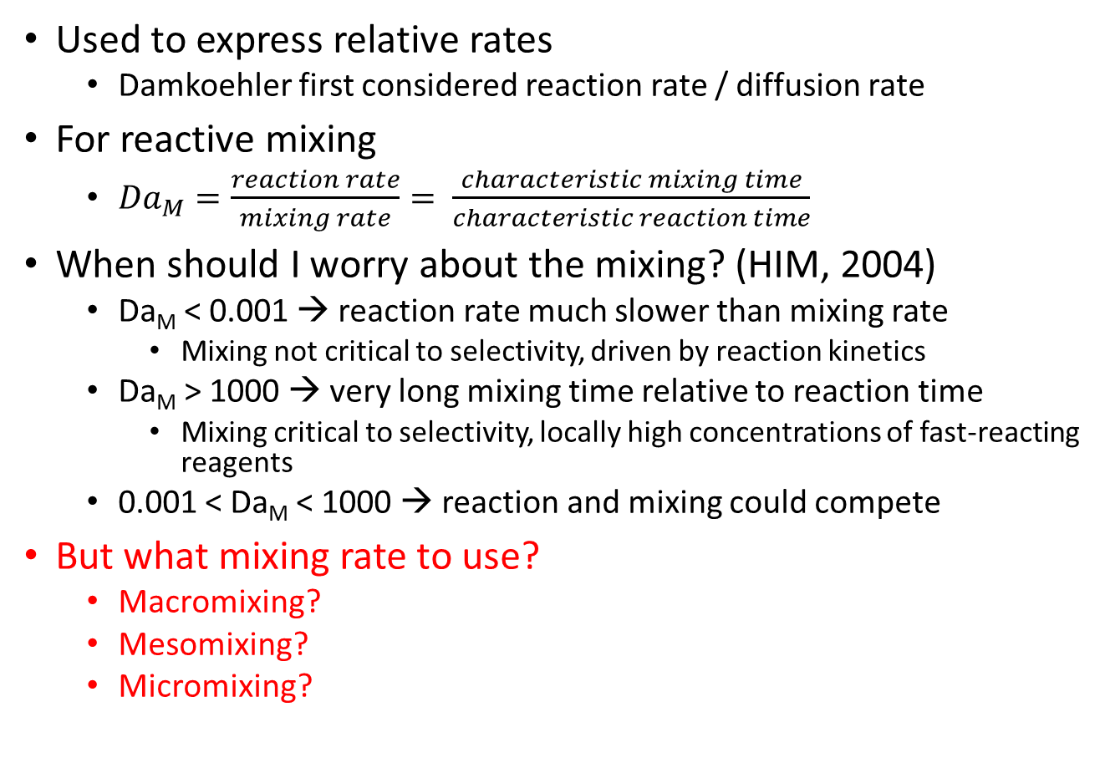
Damkoehler Numbers…ok…fine…
Used to express relative rates
  Damkoehler first considered reaction rate / diffusion rate
For reactive mixing
  ${Da}_{M}=\frac{reaction rate}{mixing rate}= \frac{characteristic mixing time}{characteristic reaction time}$
When should I worry about the mixing? (HIM, 2004)
  Da_{M} < 0.001 → reaction rate much slower than mixing rate
    Mixing not critical to selectivity, driven by reaction kinetics
  Da_{M} > 1000 → very long mixing time relative to reaction time
    Mixing critical to selectivity, locally high concentrations of fast-reacting reagents
  0.001 < Da_{M} < 1000 → reaction and mixing could compete
But what mixing rate to use?
  Macromixing?
  Mesomixing?
  Micromixing?
What if I don’t know my reaction or other rates? How can I determine what my competitive rate process needs?
}How?
Notes:
So I still have not answered the question about what mixing rate to use: macromixing, mesomixing, or micromixing.
(build) I have not even told you how to estimate mesomixing or micromixing times, let alone which characteristic time to use.
(build) And what if I don’t know my reaction or other rates? Isn’t there an easier way to find out if I need to worry about this for my competitive rate system? How can I determine what my competitive rate system needs?

Slide 28
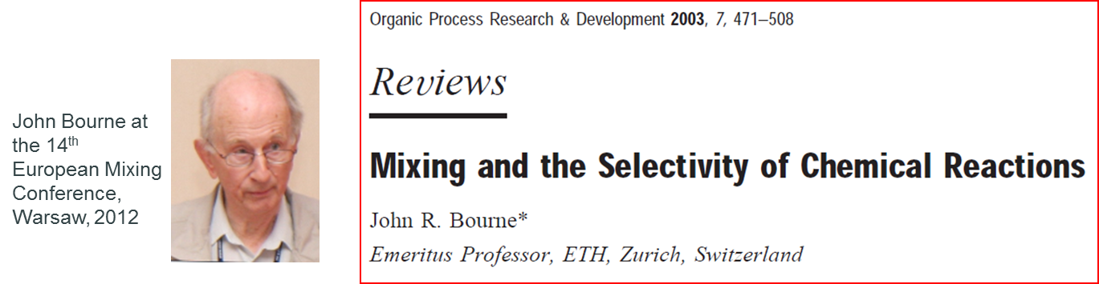
How can we find mixing sensitivities more efficiently for my process?
The “Bourne Protocol” is not a film…
Experimental protocol to determine mixing resistance
  Reference:
  The most comprehensive review article on the characterization of the influence of mixing on reaction selectivity.
  Many examples of single phase and multiphase systems with mixing effects.
Notes:
How can I efficiently find out if mixing matters for my process? I recommend using the “Bourne Protocol.” John Bourne published a paper in 2003 which remains, in my opinion, the most comprehensive review article on the influence of mixing on reaction selectivity. Bourne presented many examples of how mixing affects reaction selectivity in single phase and multiphase systems. One feature of the paper which I found most particularly useful is an experimental protocol that can be used to determine mixing resistances in a process. Even for systems where we have no reaction selectivity issues, but have other competing rate processes, we have applied the protocol to characterize our key mixing sensitivities. Understanding the key mixing sensitivities enables us to properly design and scale-up mixing systems for our process, or at the very least to understand how we would need to incorporate further mixing studies in our process development program.

Slide 29
Mixing sensitive reactions in the literature
Bourne (2003) lists some common single phase and two-phase reaction systems that show mixing sensitivities.
The four “Bourne Reactions” are mixing-sensitive reactions that have been used to characterize mixing systems.
  Diazo coupling between 1-naphthol and diazotized sulfanilic acid
  Simultaneous diazo coupling between 1- and 2-naphthols and diazotized sulfanilic acid
  Competitive neutralization of hydrochloric acid and alkaline hydrolysis of monochloroacetate esters with sodium hydroxide
  Competitive neutralization of sodium hydroxide and acid hydrolysis of 2,2-dimethoxypropane with hydrochloric acid
    Three papers at NAMF MIXING XXVI in June 2018 used the 4th Bourne reaction to characterize their reactor configuration
Other reactions have been used including the Villermaux-Dushman reactions (boric acid, iodine, iodate system)
Notes:
Bourne lists some common single phase and two-phase reaction systems that show mixing sensitivities. Four “Bourne Reactions” listed here have been used in the literature to characterize mixing systems. These reactions continue to be used, as evidenced by the three papers at the most recent NAMF mixing conference which used the 4th Bourne reaction to characterize reactor configurations. Others in the literature have used the Villermaux-Dushman reactions involving the boric acid, iodine, iodate system. Different model reactions in the literature have their advantages and disadvantages. It is important to note in the third and fourth Bourne reactions we have neutralization competing with hydrolysis occurring because of the neutralizing reagent. These seemingly simple neutralizations can be mixing sensitive!

Slide 30
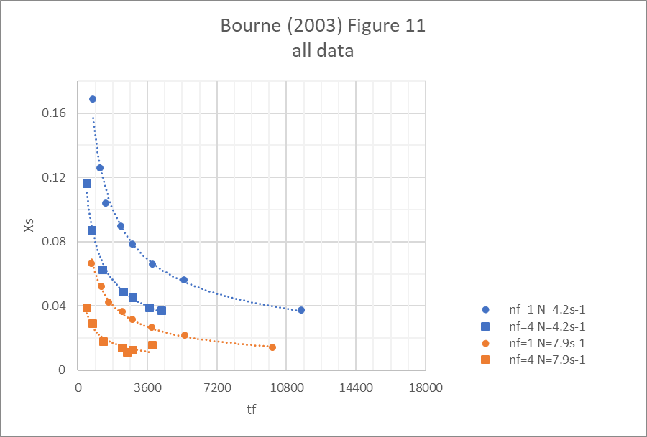
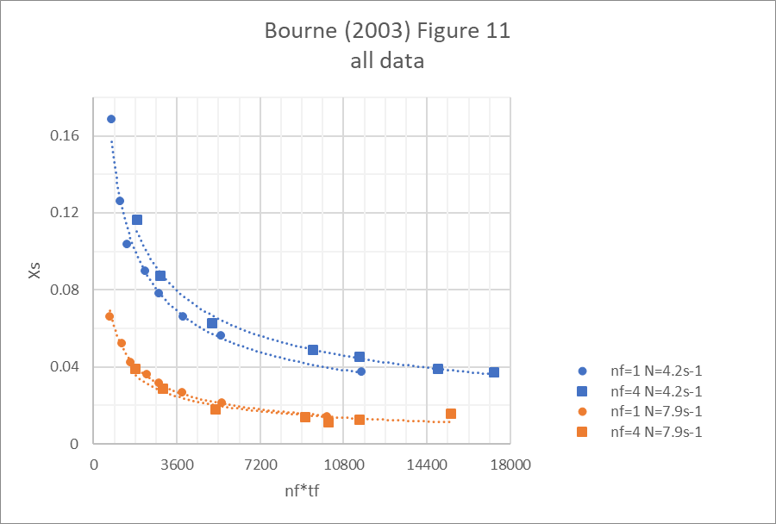
Typical results from Bourne (2003)
A + B → R (very fast)
R + B → S (slower)
Mesomixing control
  Xs sensitive
  to feed rate
  (local feed velocity)
Micromixing control
  Xs insensitive
  to feed rate
  (local feed velocity)
The fraction of added B
that goes to
“bad Stuff”
Notes:
So, with our scales of interest in mind, let’s consider some results that Bourne obtained using one of those model reactions. Here he is plotting the yield loss of A that goes to S against feed time, with lines of different impeller speeds (250 and 475 rpm) and number of feed points (1 and 4). On the bottom plot, he’s plotting Xs vs the product of the number of feed points and the feed time, which is inversely proportional to the local feed rate. The feed rate dependent region is very clear and indicates mesomixing control, while the feed rate insensitive region indicates micromixing control. So how can we determine whether our process is micromixing or mesomixing controlled? Do we need all those datapoints or runs with model reactions?

Slide 31
Mixing sensitive reactions in the literature
Competitive-Consecutive (Series-Parallel) Reactions
Competitive Reactions
Reaction System
A + B → R (fast, desired)
R + B → S (slower, undesired)
Examples
  1st Bourne Reaction
  Villermaux-Dushman
Reaction System
A + B → R (fast, desired)
C + B → S (slower, undesired)
Examples
  3rd Bourne Reaction
  4th Bourne Reaction
The 2nd Bourne Reaction is an interesting hybrid of the Competitive-Consecutive and Competitive Reactions
Practical aspects of using the Bourne Reactions (along with typical rate constants) are discussed in HIM (2004)
Notes:
Some of the model reactions in the literature are competitive-consecutive (series-parallel, if you prefer Levenspiel) while others are simply competitive reactions. Here we see that the 1st Bourne reaction and the Villermaux-Dushman reaction have a competitive-consecutive structure, while the 3rd and 4th Bourne reactions are strictly competitive. The 2nd Bourne reaction is an interesting hybrid of the Competitive-Consecutive and Competitive reactions. One of the challenges in using model reactions from the literature is knowing if they appropriately model your actual reaction system in terms of relative reactions rates as well as fluid properties. Practical aspects of using the Bourne reactions, along with typical rate constants) are discussed in the Handbook of Industrial Mixing.

Slide 32
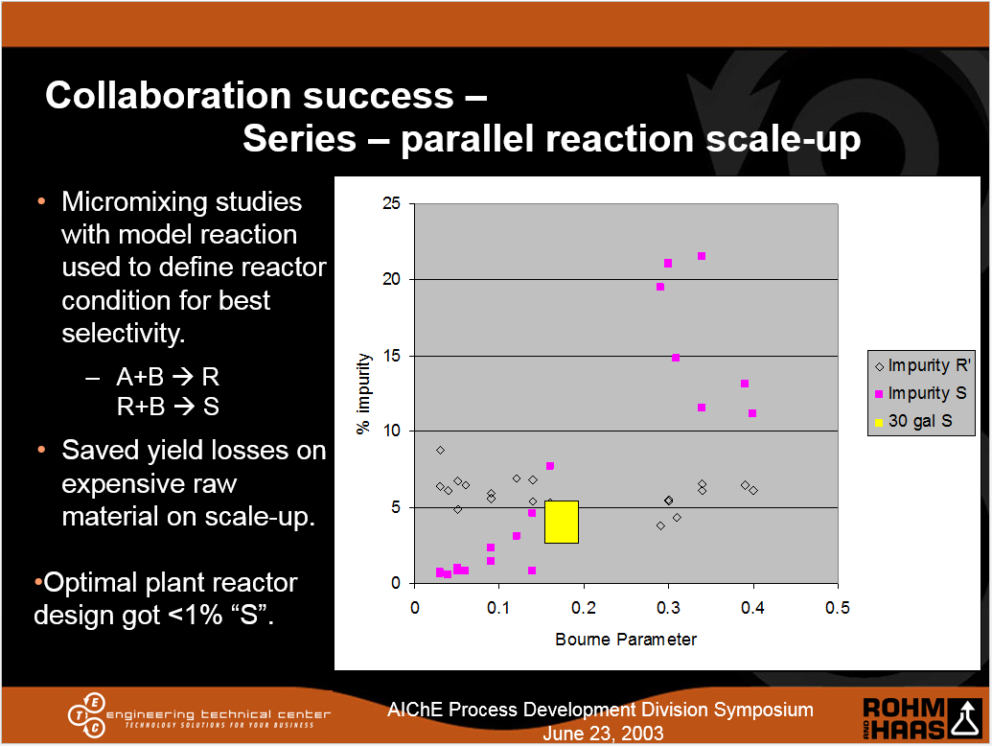
“Sanitized” Project Team Studied Mixing Effects
Bourne Parameter
The fraction of added B
that goes to
“bad Stuff”
Reference: A. Sarafinas, “Successful Process Development: Profitable Specialty Chemical Products Using Winning Work Practices,” AIChE Process Development Division Symposium, Pocono Mountain, PA, June 2003.

Slide 33
“an interesting hybrid…”
2nd Bourne Reaction (Bourne 2003)
  A+B→ o-R k= 12000 m³ mol⁻¹ s⁻¹
  A +B→ p-R k= 900 m³ mol⁻¹ s⁻¹
  B+o-R→ S k= 2 m³ mol⁻¹ s⁻¹
  B+p-R→ S k= 22 m³ mol⁻¹ s⁻¹
  B+C → Q k= 125 m³ mol⁻¹ s⁻¹
+B
o-R
p-R
Q
+B
A
C
S
+B
+B
+B
Practical aspects of using the Bourne Reactions (along with typical rate constants) are discussed in HIM (2004)
How well do you know your process rate constants?
Why use a model reaction system when you can test mixing sensitivities with your own reaction system?
What if the competing rate process is a physical rate process (like a phase change) instead of a reaction?
Notes:
The 2nd Bourne reaction is indeed an interesting hybrid of the Competitive-Consecutive and Competitive reaction systems. As you can see there are both competitive-consecutive and competitive characteristics in this system. The Handbook of Industrial Mixing does discuss how to apply these model reaction systems, but why use a model reaction system which may not be representative of your process when you can test mixing sensitivities with your own reaction system? And what if the competitive rate process shown here as A+C→Q was really a physical rate process that could be sensitive to high local concentrations of A or reaction products instead of a competing reaction?

Slide 34
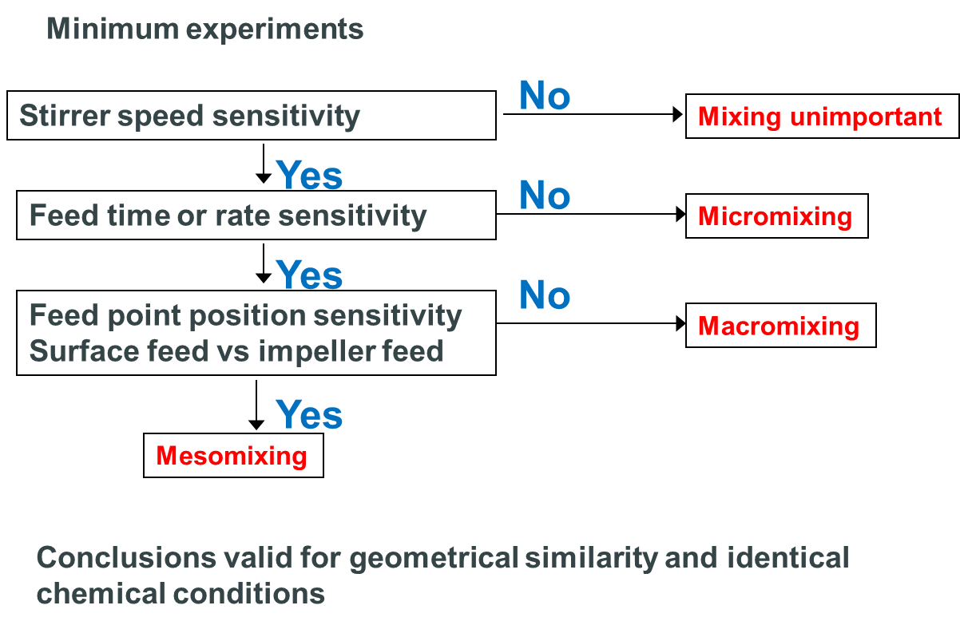
Bourne (2003) Experimental Protocol
The feed time for a semibatch reactor is usually so long that macromixing is not controlling. –Bourne (2003)
Notes:
The Bourne Protocol allows us to assess the effect of macromixing, mesomixing, and micromixing on our process at the small scale. Bourne’s minimum set of experiments are shown in the block diagram. Though this is shown for a stirred tank, it can be adapted for mixing in alternative equipment.
The most basic experiment involves assessing the process response at various agitator speeds. Ideally in the first experiment, I like to use an impeller speed range that gives me about a 100x change in power per unit volume. If no effect is seen on the process responses from a 100x change in power per unit volume, then we can conclude that mixing is not critical to this process over that range and terminate the protocol. (I’ll say more about reasonable values of each operating parameter in a moment.) However, if we do see an impact of impeller speed on the process responses, then we can move to assess which of the mixing scales is critical.
The next step in the protocol is to assess the impact of feed time or feed rate. Recall those plots of Xs versus feed time from the earlier slide. If changes in feed rate have no impact on the process responses at a given impeller speed, then Bourne says we can conclude that the process is micromixing controlled and we can leave the protocol. If there is a feed rate sensitivity, then we can compare the process responses with different feed locations (surface feed versus impeller region feed) to assess whether macromixing or mesomixing controls the process response. If the process response is insensitive to changes in feed location, then Bourne says that we can conclude the process is macromixing controlled. (Though Bourne (2003) also says, “The feed time for a semibatch reactor is usually so long that macromixing is not controlling.”) If the process response is sensitive to feed location, then we can conclude that how the feed plume disintegrates is critical to the process, and it is mesomixing controlled. Bourne points out that the conclusions from the study will be valid for geometric similarity and identical chemical conditions.

Slide 35
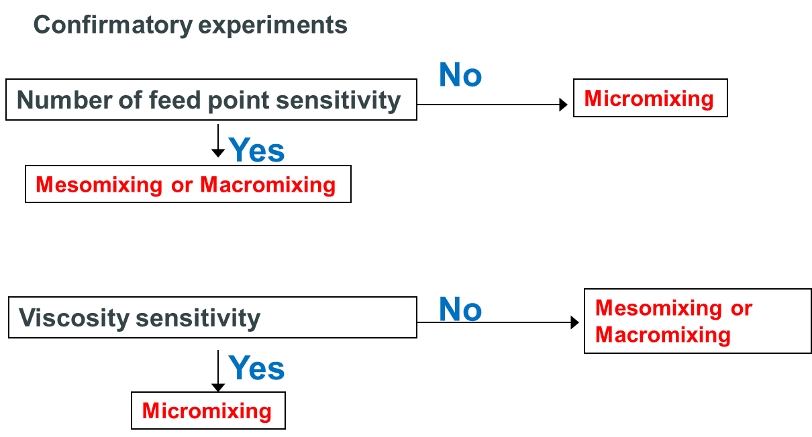
Bourne (2003) Experimental Protocol
Notes:
Bourne provided a couple of confirmatory experiments to supplement the minimum set of experiments on the previous slide. If the feed rate experiment is inconclusive in determining if micromixing is controlling or to confirm the result of the feed rate experiment, one of two experiments could be run.
The first confirmatory experiment looks at the sensitivity of the process to the number of feed points. If the process responses are not sensitive to the number of feed points, then Bourne says micromixing controls.
The second confirmatory experiment can be run if the viscosity of the bulk liquid can be changed, which is not always practical for an industrial process. If the process responses are sensitive to the change in viscosity, we can conclude that micromixing controls.

Slide 36
Typical results from Bourne (2003)
A + B → R (very fast)
R + B → S (slower)
Sensitivities studied
  Impeller speed
    N ↑, Xs ↓
  Feed rate
    Rate sensitive regime (mesomixing control)
    Rate insensitive regime (micromixing control)
  Feed location
    ε_{loc} ↑, Xs ↓
  Number of feed points
    Local feed velocity effects
      Lower local velocity, Xs ↓
      More feed points at same local velocity, same Xs at shorter feed time
The fraction of A
that goes to
“bad Stuff”
Notes:
So, let’s revisit those earlier results from Bourne, from the perspective of the protocol, and consider the sensitivities studied.
(build) First, we can see from the blue arrows, that as the impeller speed increased, the yield on A that was lost to to S went down. So, we would proceed to the next step of the protocol and test the feed rate sensitivity.
(build) Depending what values we choose for our feed rate (and number of feed points), we could be in the mesomixing regime (the red arrow) or the micromixing regime (the green arrow). I will speak more about the proper choices for our experimental factor settings in a few minutes.
(build) In general, regarding feed location, as we increase the local power per unit mass, we will decrease Xs.
(build) Finally, consider the number of feed points and the local velocity effects.
(build) The upper dashed purple arrow shows the improvement in Xs with more feed points at the same feed time, if we’re in the mesomixing controlled regime.
(build) Similarly, the lower dashed purple arrow shows that a single feed point with a 1800s feed time gives the same Xs as four feed locations (all at the same “relative influence” of the impeller) at a feed time of about 450s, if you are in the mesomixing controlled regime. In both cases, lower local velocity gave lower Xs.
The point of the Bourne protocol is that we can get a quick view of the mixing sensitivities of our process without having to get all these data points.

Slide 37
Bourne (2003) recommendations on how to scale
For constant reaction selectivity, constant Xs,
or constant yield of “bad stuff”:
  Micromixing control
    Hold energy dissipation (local power per unit volume) constant where the mixing and reaction occur.
  Mesomixing control
    Keep impeller speed constant ($$$$)
    Or extend the feed time (maybe $$$)
    Crystallization literature suggests constant feed time / mesomixing time (Torbacke and Rasmusson, 2004)
  Macromixing control
    High blending efficiency
      Hydrofoil impellers
      Static mixers
Notes:
Bourne discussed how to scale up for constant reaction selectivity. For micromixing control, we would hold the local energy dissipation (local power per unit volume) constant where the mixing and reaction occur. For mesomixing control, Bourne suggested keeping the impeller speed constant (which is a rather expensive proposition on scale-up) or extending the feed time (which could also adversely affect economics). There is evidence that those approaches to mesomixing control lead to conservative designs. Macromixing control would require using high efficiency impellers or other means to efficiently maintain the blend time in the vessel on scale-up.

Slide 38
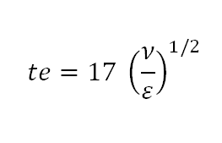
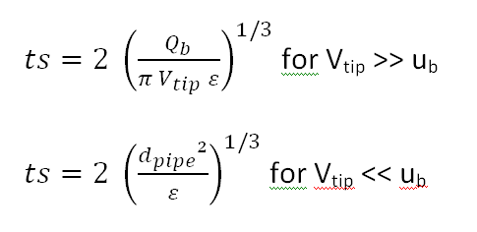
What’s really going on inside this protocol
Controlled experiments to balance mixing time constants
  Micromixing
  Mesomixing
  Macromixing
    Blend time = f(ε_{avg}, fluid properties, geometry)
Protocol in Bourne (2003)
Stirrer speed sensitivity
No
Mixing Unimportant
Yes
Feed Rate sensitivity
No
Micromixing Controlled
Yes
Feed Location sensitivity
No
Macromixing Controlled
Yes
Mesomixing Controlled
Notes:
Let’s take a look at what is going on inside this protocol. The Bourne Protocol is really looking at defining some controlled experiments to balance some mixing time constants.
Shown here, we have what has been called the “engulfment time” for micromixing, which is proportional to the square root of the kinematic viscosity divided by the local power per unit mass where our feed is coming into the tank.
Mesomixing is influenced by the feed rate, and there are two expressions for the mesomixing time based on whether the stirrer dominates the flow in the vessel, or if the feed rate of the added fluid dominates the flow. Both forms of the mesomixing equation shows the importance of the local power per unit mass in the vicinity of the feed on the mesomixing time.
Macromixing is characterized by the blend time. As we discussed in the first webinar, blend time is a function of the average power per unit mass in the tank, the fluid properties, and the geometry of the tank, impeller, and internals.

Slide 39
What’s really going on inside this protocol
Revised Bourne Protocol
Controlled experiments to balance mixing time constants
  Micromixing
  Mesomixing
  Macromixing
    Blend time = f(ε_{avg}, fluid properties, geometry)
My Revision of the
Protocol in Bourne (2003)
Stirrer speed sensitivity
No
Mixing Unimportant
Yes
Feed Rate sensitivity
No
Not meso-
Likely micro-
Yes, meso-
mixing matters!
Execute Level 3 Anyway!
Feed Location sensitivity
No
Yes
Unlikely
Result
Better Process Response?
Notes:
I suggest using my revision of the Bourne Protocol to look at the effect of local energy dissipation and feed rate your process. Coupled with your process scheme, you can evaluate how your process responses and the rate processes that drive them are affected by fluid mixing.

Slide 40
Does Mixing Matter?
Prove it doesn’t matter…
From Ed Paul’s presentation at the 2003 Process Development Symposium
Reference: E. L. Paul, “Notes on Process Development: Pharmaceutical Intermediates and API’s,” AIChE Process Development Division Symposium, Pocono Mountain, PA, June 2003.
Notes:
OK, how do we know if mixing matters? Well, prove that it doesn’t matter.
In this webinar, I’ll be drawing on a number of different publicly presented and published materials that are listed in the references.
I have gone back to two of the talks from the session that I chaired at the inaugural AIChE Process Development Symposium in 2003 to pull out a few key points. The first example from 15 years ago is from Ed Paul’s talk on the process development of pharmaceutical intermediates and API’s. Ed is one of the world’s experts on the impact of mixing on industrial reaction systems and is one of the editors of the Handbook of Industrial Mixing. In his talk, Ed presented his three rules about mixing:
Always assume there is a mixing problem until proven otherwise,
Scale-up will make it worse, and
Sub-surface addition for reaction and crystallization…prove that it is not needed
I used to have those three rules as a tag line in my signature in emails. Today, I’ll be talking about an efficient way to find the types of mixing issues that may exist in your process.

Slide 41
We’ve had successes using this protocol for MANY competitive rate processes.
It’s not just for reactions anymore…but applicable any time concentration gradients can drive parallel physical processes.
  Reactive precipitation / controlled crystallization showed sensitivity to impeller speed, feed rate, and feed location on particle size and filterability (Sarafinas and Teich in AIM 2016)
  Understood critical process conditions for scalable coagulation and agglomeration processes using the Bourne Protocol, enabling pilot scale troubleshooting to resolve production scale issues. (Sarafinas, 2017)
Benefits of the Bourne Protocol
  Running the real process
  Efficient - step out when conclusion reached
  Can be adapted to flow systems
“Sanitized” process would have gotten better process understanding sooner if we had the Bourne Protocol
Notes:
We have had many successes using this protocol for many competitive rate processes, not just for series/parallel reaction systems. The protocol is applicable anytime concentration gradients can drive parallel physical processes.
In our example in the NAMF handbook Advances in Industrial Mixing, our conclusion from the Bourne Protocol at the 2-liter scale was that we would need to pay careful attention to mixing on scale-up. Our reactive crystallization process was sensitive to all three parameters tested in the protocol: impeller speed, feed time, and feed location. Even though we had no reaction selectivity issues to consider, the Bourne Protocol gave us an efficient means to screen the critical mixing parameters and identify the importance of the mixing environment in the feed region. This sensitivity gave us strong incentive to study mixing carefully at the larger scales.
Recently we have had successes in understanding the process conditions for coagulation and agglomeration processes using the Bourne protocol. Quite literally, for the first time we were able to scale down a particularly challenging plant problem to our pilot scale. This enabled proper process studies at the pilot scale to arrive at a scalable resolution of the plant problem.
The Bourne protocol enabled efficient study of the actual process, and we could step out of the protocol when we achieved our conclusions.

Slide 42
Where do we go from here?
Competitive-Consecutive (Series-Parallel) and Competitive reactions can be mixing sensitive.
Multiphase systems can be mixing sensitive.
Use the Bourne Protocol to understand mixing sensitivities early in process development.
  “Always assume there is a mixing problem until proven otherwise”
  “Scale-up will make it worse”
  Bourne Protocol factor settings based on scale-down from plant
Process Development is a dialogue between disciplines
What’s next
  How best to characterize the micromixing-mesomixing space for process scaling? (Paper at AIChE National Meeting Nov 2019)

Slide 43
Thank you!

Slide 44
Appendix
References
Other back-up slides for further discussion

Slide 45
Three Key References
Bourne J.R., “Mixing and the Selectivity of Chemical Reactions”, Org. Process Res. Des. Dev.; 2003; 7(4) pp. 471-508.
(“HIM”) Paul, E.L., V.A. Atiemo-Obeng, S.M. Kresta, Handbook of Industrial Mixing: Science and Practice, John Wiley and Sons, 2004.
(“AIM”) Kresta, S.M., A.W. Etchels III, D.S. Dickey, V.A. Atiemo-Obeng, Advances in Industrial Mixing: A Companion to the Handbook of Industrial Mixing, John Wiley and Sons, 2016.

Slide 46
Other References
Davies, J.T., “A physical interpretation of drop sizes in homogenizers and agitated tanks…”, Chem. Eng. Sci., 42, pp. 1671-1676 (1987).
Levenspiel, O., Chemical Reaction Engineering, John Wiley and Sons, 1972.
Paul, E.L., “Notes on Process Development: Pharmaceutical Intermediates and APIs,” AIChE Process Development Symposium, Poconos-Lake Harmony, PA, 2003
Sarafinas, A. “A further look at the Bourne Protocol for efficient investigation of mixing sensitivities during process development,” AIChE 2017 Process Development Symposium, Toronto, Canada, June 2017.
Sarafinas, A. “The evolution of process understanding through micromixing and mass transfer studies in the successful development of a specialty chemical process,” AIChE 2011 Annual Meeting, Minneapolis MN, October 2011.

Slide 47
Other References
Sarafinas, A. “Successful Process Development: Profitable Specialty Chemical Products Using Winning Work Practices,” AIChE Process Development Symposium, Pocono Mountain, PA, June 2003.
Teich, C.I., A. Sarafinas, P.M. Morton, AIChE 2010 Annual Meeting, Salt Lake City, UT, November 2010 (2 papers):
  “Can this process be saved? A search for understanding using the Bourne Protocol and advanced process development tools”
  “Taking the min to the max: a case study in small scale process development using on-line reaction calorimetry and in-situ particle characterization”
Torbacke, M., A.C. Rasmusson, “Mesomixing in Semi-Batch Reaction Crystallization and Influence of Reactor Size” AIChE Journal 50 (2004) 3107-3119.

Slide 48
Estimates of mixing parameters – a brief word of caution…
All mixing calculations that any software provides are estimates of mixing parameters.
  Based on your inputs
    Geometry
    Physical properties
  Based on the validity of the approaches used in the software
    Engineering correlations based on experimental results
    Other physical models
  Use of any software does not allow the user to turn one’s brain off
  This is an ideal time for chemist-engineer collaboration!
Use the estimates of mixing parameters for comparative purposes
Notes:
I need to give my usual word of caution about the estimates of mixing parameters. I don’t have time to dive into detail on this, but I want to point out that all mixing calculations that any software provides are estimates of mixing parameters. These estimates are based on your inputs on the vessel and impeller geometry and your knowledge of your phase properties. Consider carefully how your phase properties change during your process and do multiple calculations to understand the impact of those property changes on the estimated mixing parameters. The estimates are also affected by the validity of the approaches used in the software. Some software uses engineering correlations based on experimental results, while other software uses other physical models. Just because “the software said so” is no reason to not think about the reasonableness of the answers and if the models that are being used are appropriate for your particular system. This is an ideal time for engineer-chemist collaboration.
Today I’ll be showing how the mixing parameter estimates should be used for comparative purposes.

Slide 49
If your process response is better at higher ε Then you may need a different device…
Consider higher power per unit mass
if appropriate for your plant equipment and process requirements
Static Mixer
Colloid mill
Liquid Whistles
Agitated Tank
Centrifugal pumps
Rotor-stator
Ultrasonics
Turbulent jet
Empty tube
Valve Homogenizers
At a given impeller speed, local power per unit mass in an agitated tank can vary by a factor of 20x or more!
Notes:
If the Bourne Protocol indicates that you get better process responses when you increase the local energy dissipation in the vicinity of the feed, then you may want to consider a different processing device than a stirred tank. In the first two webinars, I showed my interpretation of the “Davies Plot.” Davies looked at a wide variety of liquid-liquid dispersion data from different devices in the literature, corrected for interfacial tension and drop size distribution, and plotted the maximum drop size as a function of the local energy dissipation that the droplet experienced. He obtained this line, which is consistent with the model we discussed in the second webinar. Note that we can change the drop size by four orders of magnitude as we increase the energy dissipation by 9 orders of magnitude (by using different devices). If your Bourne Protocol results suggest that higher power per unit mass can deliver better process results, you may need to consider other mixing devices.

Slide 50
Bourne Level 1 Experiment:
How do I choose my impeller speeds?
Remember, we’re really changing the power per unit mass
If considering existing plant equipment,
use the plant condition as the center point
Use a limiting condition
  For minimum impeller speeds
    Solid-liquid systems → Njs
    Liquid-liquid systems → Njd
    Gas-liquid systems → flooding condition
  For maximum impeller speed
    Surface aeration
Default centerpoint
  Vessel average power per unit mass = 0.2 W/kg (1 HP/1000 US gal)
  Set upper and lower vessel average power per unit mass at 10x and 0.1x the centerpoint power per unit mass.
Notes:
But, how do I choose my impeller speeds to be “meaningful” for the plant scale? It’s important to remember that we’re really looking at how the changes in power per unit mass affects those mixing time constants, which in turn drives the process response.
If we have existing plant equipment that we’re considering for this process, then use the plant condition as a centerpoint, and use two limiting conditions for the higher and lower impeller speeds. So, we’re looking at a minimum of three experiments at this level. Examples for the upper and lower speeds will depend on your process and what you observe in your Process Scheme. If you have a multiphase system, you could consider some appropriate criteria, such as the “just suspended” speed for solid-liquid systems, the “just dispersed” speed for liquid-liquid systems, and the flooding condition for gas-liquid systems. As we discussed in the last webinar, all of these can be estimated using correlations or they can be determined experimentally at the lab scale for your specific system. For example, you can observe what rpm is required to have no solid particles resting on the bottom of the vessel for more than a second and run that as your “just suspended” speed condition. On the high impeller speed limit, from a physical perspective, consider the onset of surface aeration. That is also estimable by correlations or experimentally determined.
If you have no specific plant design, consider a default centerpoint of about 0.2W/kg (1HP/1000 US gal), a very common mixing condition, and set your upper and lower power input at 10x and 1/10x the centerpoint. OK, that’s power per unit mass, but we’re setting impeller speed. Correlations can be used to determine the rpm for your pilot unit to deliver that power per unit mass for your system. (For a turbulent system, the impeller speed range would be about 2.15x and 1/2.15x the centerpoint impeller speed. So, if the centerpoint is at 100 rpm for a turbulent system, consider the upper limit at 215 rpm and the lower limit at 46 rpm, for example.)

Slide 51
Bourne Level 2 Experiments:
How do I choose my feed rates?
Fastest safe and practical plant scale feed rate as midpoint
  For pumping and piping limits
  Heat transfer limitations for exothermic reactions or heat of dilution
Use as midpoint to assess potential effect of higher and lower feed rates
  Are we on the left-hand side of that Xs vs tf curve?
How does mesomixing scale up?
  Bourne considers constant ts, but that’s too conservative.
  Some crystallization literature suggests scaling on
  (feed time) / (mesomixing time)
    Mentioned in a paper at NAMF MIXING XXVI
    Key reference Torbacke and Rasmusson (2004)
      Not comfortable with their definition of mesomixing time
  Under study by the FMP consortium
Notes:
We need to consider the plant scale capabilities as well as any insights from the Process Scheme to evaluate which feeds could influence our process responses if the feeds are not quickly dispersed. Or in other words, could high concentrations in the feed plume lead to “bad stuff?” What feed times should I choose to determine if we have a mesomixing sensitivity? Certainly, the process chemist defined a feed time that delivers acceptable material in the lab. If you are evaluating the fit of your process to an existing plant, then consider the fastest safe and practical plant scale feed time as the centerpoint. That could be defined by pumping and piping limits, or it could be due to heat transfer limitations for exothermic reactions or heats of dilution. What I typically like to do, within the bounds of safety, is consider an 9x range on flow rates, taking feed times of 1/3x and 3x the centerpoint. Again, this is just a guideline to see the effect, and any safety implications need to be carefully taken into account.
I mentioned earlier that in Bourne’s paper he considers what is required to achieve constant mesomixing time on scale-up. There is some evidence that this is too conservative. Crystallization is a process with many competing rate processes. Some of the crystallization literature suggests scaling on (feed time) / (mesomixing time). That was noted in a paper at the recent NAMF mixing conference and they referred to a paper by Torbacke and Rasmusson (2004). However, that reference used a different definition of mesomixing time that emphasized feed pipe dimensions and local bulk fluid velocity effects and lumped other factors (including local energy dissipation) into a single parameter. I am not comfortable generalizing mesomixing time exactly as they did, but (feed time)/(mesomixing time) is worth consideration as a more suitable scaling parameter than Bourne’s use of mesomixing time. Even so, feed time will need to be longer on scale up, but not as long as with constant mesomixing time. Further work is needed to better characterize how to scale mesomixing controlled systems. The Fluid Mixing Processes (FMP) consortium is studying the scalability of mixing sensitive model reactions and have been determining the appropriate scaling criteria for mesomixing.

Slide 52
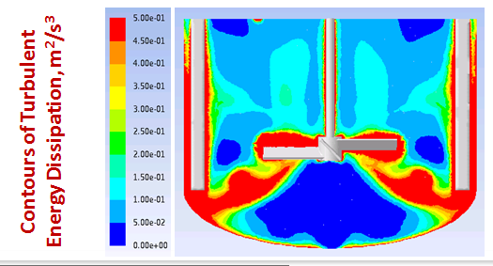
Bourne Level 3 Experiment:
How do I choose my feed location?
Local power per unit mass
vs average power per unit mass
  Consider literature resources
  Consider rules of thumb (DynoChem)
    Surface feed → ε_{loc}/ε_{avg} = 0.1
    Sub-surface feed → ε_{loc}/ε_{avg} = 1
    Impeller zone feed → ε_{loc}/ε_{avg} = 2
  Consider quick CFD analysis
How to choose?
  Consider the plant configuration
  Consider the consequences of feed-pipe backmixing
  Consider Ed Paul’s 3rd rule of mixing:
  Subsurface addition for reaction and crystallization
  – prove it’s not needed!
Notes:
So, how do we choose the feed location? There are many examples in the literature which shows the distribution of energy dissipation in a stirred tank. Energy intensity is greater near the impeller, but the magnitude can be different for different impellers. The literature examples lead to some rules-of-thumb like these from DynoChem, where the impeller zone feed is about 20x higher in intensity than a surface feed. Computational fluid dynamics can be used to show regions of higher intensity (red) and lower intensity (blue). So, with such a range of possible feed locations, what is the best to choose? First, if you’re looking at the fit of a process into an existing plant, consider the existing feed configurations. The biggest concern about subsurface feeds is that submerged feed ports can plug. Feed pipe backmixing can lead to conditions where the tank contents contact locally high concentrations of fresh feed in a locally low mixing intensity environment, leading to severe selectivity issues or unacceptable phase behavior that can result in feed pipe plugging. There are approaches in the literature to characterize the necessary feed velocity to avoid backmixing (Jo et al (1994), Vicum and Baldyga (2004)). So, don’t be afraid if the results of the Bourne Level 3 experiment points to the advantages of the subsurface feed. Design the optimal solution.

Slide 54
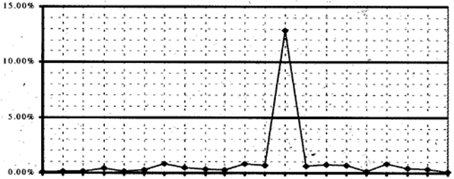
“Sanitized” Production start-up results
Plant design formed minimal S
Only out of spec lot was when the 50% NaOH feed pump broke
From Sarafinas, 2011
Notes:
So what happened at the plant? In the first 21 batches from the start-up, we made minimal S impurity, except for this one batch. This batch had high S due to a failure of the 50% NaOH pump, which supports the idea that when you don’t have enough base that you’re going to make much S impurity.

Slide 55
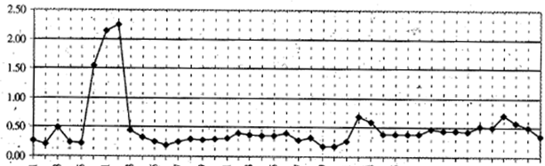
Similar “Sanitized” reaction system introduced to the same equipment
Minimal S formation
  Note scale difference from previous slide
  Deviations in batches 6-8 from mis-matched feed rates
  Long-term drift of [S] may be due to impurities in recycle solvent
From Sarafinas, 2011
Notes:
(review bullet points without much embellishment, except maybe to reinforce studying with actual plant materials and establish recycled solvent effects)

Slide 56
Applications of micromixing design concepts to multiphase systems for “Sanitized” process
Fortunately, both micromixing and interfacial area scale with power per unit mass
Feed dispersed phase to impeller region to maximize area generation
Avoid feedpipe backmixing
From Sarafinas, 2011
Notes:
So how do we use some of these principles to come up with a design that seems to work at the plant? Fortunately both micromixing and interfacial area scale with power per unit volume. (Personally, I think that the mass transfer effect was neglected over the excitement on the S-Bourne Parameter trends.) That’s all well and good, but why do we need to feed to the high energy region (which was a micromixing-driven outcome)? It’s not just reagent B, which is what you’d think if you just looked at the Bourne reactions. What we chose to do was to feed both the dispersed phase and the continuous phase to the impeller region to just above the glass-lined retreat curve impeller to maximize area generation and also get reagent B into the region of highest turbulent intensity (hedging our micromixing bet). Another micromixing principle that we used was to avoid feedpipe backmixing. We don’t want the velocity in the feed pipe to be so low that some of the reaction mixture works its way up into the feed pipe (a region where there is very low intensity) which would prompt much S formation (due to high Bourne Parameter and lack of complete dispersion). We used the method of Penny and Fasano to avoid feedpipe backmixing.

