Slide 1
Keeping Yourself Consulting Business Relevant (or How To Not Become a Ghost)
CCN/IMC-Philadelphia Joint Meeting
Panelists: Laura Dallas Burford and Joshua Greenberg
Program Producers: Charles Dormer and Ellen Marshall, IMC-Philadelphia and Michael Michalczyk, CCN
April 10, 2018

Slide 2
What Did Employees Look Like In 2018?
Traditional employment
“W-2” employment
Alternative employment
Independent contractors (includes consultants)
Contract firm workers
Temporary help
“On-call” workers
Source: Brookings June 2018
Notes:
Employee
“internal consultant”
W2 vs. 1099
Full time vs. part time
Groups = community
Value prop of IMC-Philly and CCN
Socialization ----- solopreneur
Local ecosystem

Slide 3
2018 Facts - Independent Workers
41.8 million Americans pursue independent work
63 % of Full-Time Independents said that working independently was by choice
6 out of 10 list control of schedule and flexibility as motivators.
Millennials and Boomers Dominate
21% of Full-Time Independents report earning $100,000 or more
72% are very satisfied (8-10 on 10 point scale) with being an independent worker
64 % of Full-Time Independents said they will continue to work as an independent worker
$1.1 trillion dollars of revenue for the U.S. Economy (more than the annual revenue of Walmart, ExxonMobil, and Apple) or 6% of the GDP. (2016 Numbers)
Source MBO Partners
Notes:
6 out of 10 independent workers have specialized skills that require certification, special training, or education
these are 2018 facts based on the annual study performed by MBO Partners. MBO has been performing the study longer than anyone else and although they service independent workers, the study is fairly level handed and it is only US Based.

Slide 4
The New Reality - Future of Work
What Do We Call “Work”?
What Do We Call “Workers”?
GIG
Independent
1099
Freelancer
Alternative
On-Demand
Network
Contingent
Uber
Shared
Notes:
If you are here you are contemplating Consulting as a Career. By necessity or choice, you are part of the new reality – the New World Economy. – This is my term
This new world of work has many different names and the names are being used interchangeably. However, name has a different meaning and none of the them completely fit the new reality.
A commonly used name is the GIG Economy because a short-term engagement for a temporary worker is known as a gig.
Platform and Networked Economy are used because of the reliance on the digital technology.
Shared Economy refers to the reallocation of resources and labor to fit the changing needs of the organization. Some other terms are
On-Demand Economy
Peer Economy
Bottom-Up Economy
1099 Economy
Uber Economy
Access Economy
The Next: Economy
I simply refer to the new reality as the New World Economy Why? It is generic. Maybe someone has already coined it but the New World Economy works for me and this presentation.

Slide 5
Reasons for the New Economy
Economic Downturn of 2008
Commitment to Employees
Personal Preference
Project Oriented
Work
Emerging Technologies
AI - Data Analytics
Improved Communication
Increased Innovation
4th Industrial Revolution
Notes:
I’ve listed 5 reasons why
But what is key is there is a push to project oriented work
Businesses have up’s and down’s and need people with experience and expertise at the right time.
The move to the 4th Industrial Revolution has resulted in more project work.

Slide 6
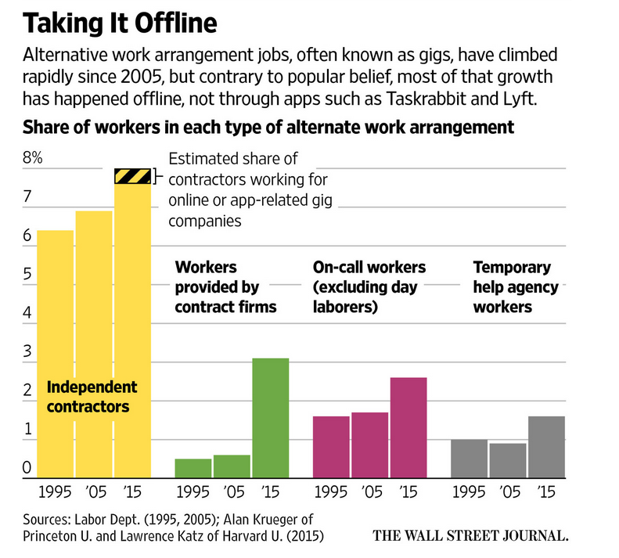
staff aug
stand-by
paid
The Rise and Nature of Alternative Work Arrangements in the United States from 1995 to 2015.
Notes:
The number of people working as independent workers has been steadily increasing since 1995.
In March of 2016, Alan Kruger of Princeton University and Lawrence Katz of Harvard University conducted a version of the Contingent Worker Survey and published their findings. Workers were classified into one of four alternative work categories. Although there was a slight increase in independent workers between 1995 to 2005, there was over a 5% increase between 2005 and 2015 - 10.1% to 15.8%.
Temporary help agency workers are workers that are paid by a temporary help agency.
On-call or on-demand workers are workers who are on stand-by.
Contract workers are the individuals who work for a company such as a staff augmentation company that is contracting out services and they might refer to their work as a “Gig”.
Finally, independent contractors or freelancers provide a product or service and obtain their own customers or clients. This is the independent consultant who is the trusted advisor.
Note, the category with the sharpest increase is that of the contract worker.
The Rise and Nature of Alternative Work Arrangements in the United States from 1995 to 2015.

Slide 7
Trends
Traditional jobs aren’t going away.
Full-time independence continues to be an option for many professionals.
The need for and interest in part-time independent work continues to grow.
The new norm for an individual is a mix of traditional and independent experience.
Work itself is becoming more project oriented.
Over 50% of Global companies plan on hiring independent workers.
This new way of work is impacting business and society as well as individuals.
Notes:
I listed trends which are I think self explanatory – The one that might not be clear is business is trying to figure out how to deal with the changing – society is trying to address the change – health care, insurance, legal (i.e. Freelance Isn't Free Law). We are meeting to discuss individuals.

Slide 8
The Future of Consulting Businesses?
How do consultants respond to this new normal?
How do consultants navigate this messy situation?

