Slide 1
CREATIVITY FOR CONSULTANTS Presented at the Chemical Consultants Network
Roman Bielski
John Newport
January 14, 2015

Slide 2
OUTLINE
Introduction
Some comments on creativity
Helpful Methodologies (if you are not a genius)
Lateral thinking (parallel thinking, thinking outside the box, brainstorming)
Oblique strategies
Mind maps
Personal Idea Pads
Personal Reflections and Examples of creativity
Ours and yours

Slide 3
A DEFINITION
Creativity is a phenomenon whereby something new and in some way valuable is created (such as an idea, a joke, a literary work, painting or musical composition, a solution, an invention etc)
creativity comes from the Latin term creō "to create, make
Notes:
Definitions from Wikipedia

Slide 4
SIX STAGES OF CREATIVITY
Posits that the Creative Process has six phases…
Inspiration: In which you research and generate many ideas Clarification: In which you focus on your goals Evaluation: In which you review your work and learn from it Distillation: In which you decide which of your ideas to work on Incubation: In which you leave the work alone Perspiration: In which you work determindedly on your best ideas

Slide 5
CREATIVITY NEEDS
As Consultants we need to be creative in:
Finding work (networking ,advertising , differentiating ourselves, promoting ourselves, preparing proposals etc.)
Keeping the pipeline full
Time management (feast or famine)
Solving the Client’s problems effectively

Slide 6
Being Creative
Gauss, Einstein, Helmholtz, Poincare, Kekule and others have reported viewing entire solutions with "sudden spontaneity” or in a dream.
Often inspiration comes when you are not specifically concentrating on the problem (but have been highly focussed on it for days). For me walking and driving are key activities.
There are some helpful methodologies for the “genius challenged” like most of us!

Slide 7
LATERAL THINKING
Lateral thinking is solving problems through an indirect and creative approach using reasoning that is not immediately obvious and involving ideas that may not be obtainable by using only traditional step-by-step logic.
The term was coined in 1967 by Edward de Bono

Slide 8
SOME LATERAL THINKING TECHNIQUES
Random Entry Idea Generating Tool: choose an object/word at random and associate it with the problem.
Challenge Idea Generating Tool: A tool which is designed to ask the question "Why?" in a non-threatening way: why something exists, why it is done the way it is. The result is a very clear understanding of "Why?" which naturally leads to fresh new ideas.

Slide 9
SOME LATERAL THINKING TECHNIQUES
Provocation Idea Generating Tool: The use of any of the provocation techniques —wishful thinking, exaggeration,reversal, escape, distortion, etc. The thinker creates a list of provocations and then uses the most outlandish ones to move their thinking forward to new ideas.

Slide 10
SOME LATERAL THINKING TECHNIQUES
Challenge Idea Generating Tool: A tool which is designed to ask the question "Why?" in a non-threatening way: why something exists, why it is done the way it is. The result is a very clear understanding of "Why?" which naturally leads to fresh new ideas. These are but 4 lateral thinking techniques

Slide 11
BRAIN STORMING
Brainstorming is a group or individual creativity technique by which efforts are made to find a conclusion for a specific problem by gathering a list of ideas spontaneously contributed by its member(s).
The term was popularized by Alex Faickney Osborn in the 1953 book Applied Imagination.

Slide 12
(TYPICAL) BRAIN STORMING
Osborn claimed that two principles contribute to "ideative efficacy," these being :
Defer judgment,
Reach for quantity.^{[3]}
Following these two principles were his four general rules of brainstorming, established with intention to :
reduce social inhibitions among group members,
stimulate idea generation
increase overall creativity of the group.

Slide 13
TYPICAL BRAIN STORMING
Focus on quantity
Withold criticism
Welcome unusual ideas
Combine and improve ideas

Slide 14
BRAIN STORMING VARIANTS
Nominal group technique
Participants are asked to write their ideas anonymously. Then the facilitator collects the ideas and the group votes on each idea. The vote can be as simple as a show of hands in favor of a given idea. This process is called distillation.

Slide 15
BRAIN STORMING VARIANTS
Group passing technique Each person in a circular group writes down one idea, and then passes the piece of paper to the next person, who adds some thoughts. This continues until everybody gets his or her original piece of paper back. By this time, it is likely that the group will have extensively elaborated on each idea.

Slide 16
BRAIN STORMING VARIANTS
Question brainstorming This process involves brainstorming the questions, rather than trying to come up with immediate answers and short term solutions. (Doesn’t inhibit participation)
The answers to the questions form the framework for constructing future action plans.
Notes:
Also called questorming

Slide 17
BRAIN STORMING VARIANTS
Other variants include:
Guided brainstorming
Directed brainstorming
Team mapping method
Individual brainstorming

Slide 18
OBLIQUE STRATEGIES
Oblique Strategies is a deck printed cards in a black container box
Each card offers an aphorism intended to help artists (particularly musicians) break creative blocks by encouraging lateral thinking
created byBrian Eno and Peter Schmidt and first published in 1975.^{[2]}

Slide 19
OBLIQUE STRATEGIES
Each card contains a phrase or cryptic remark which can be used to break a deadlock or dilemma situation. Some are specific to music composition; others are more general.
No reason we can’t use a similar technique in a more general way.

Slide 20
OBLIQUE STRATEGIES
Examples include:
Use an old idea.
State the problem in words as clearly as possible.
Only one element of each kind.
What would your closest friend do?
What to increase? What to reduce?
Are there sections? Consider transitions.
Try faking it!
Honour thy error as a hidden intention.
Ask your body.
Work at a different speed.

Slide 21
MIND MAPS
A mind map is a diagram used to visually organize information.
Usually a mind map is created around a single concept, drawn as an image in the center of a blank landscape page.
Associated representations of ideas such as images, words and parts of words are added.
Major ideas are connected directly to the central concept, and other ideas branch out from those.

Slide 22
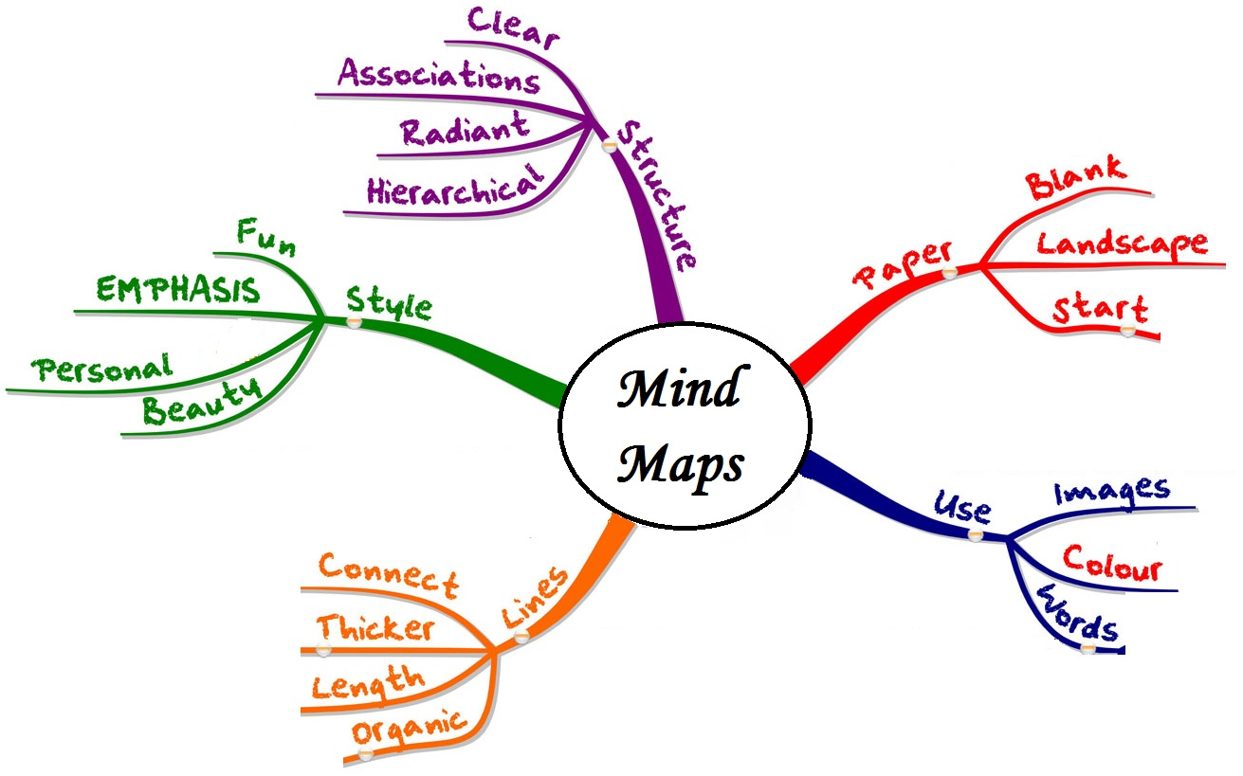
SOME MINDMAP GUIDELINES

Slide 23
Mind Map Background
The term Mind Map was coined by Tony Buzan
They are an example of a “Spider diagram”
Pictorial representations go back to the ancient Greeks
Mind maps are similar in radial structure to concept maps, developed by learning experts in the 1970s, but differ in that they are simplified by focusing around a single central key concept.
Notes:
Some of the earliest examples of such graphical records were developed by Porphyry of Tyros, a noted thinker of the 3rd century, as he graphically visualized the concept categories of Aristotle. Philosopher Ramon Llull (1235–1315) also used such techniques.

Slide 24
Personal Idea Pad
Developed by Todd Henry, CEO of Accidental Creative, a company that helps creative people and teams generate brilliant ideas.
No “magic bullet” that will ensure great ideas when you need them. There are, however, practices that can better position you to have the energy, focus, and time you need to zero in on a problem effectively

Slide 25
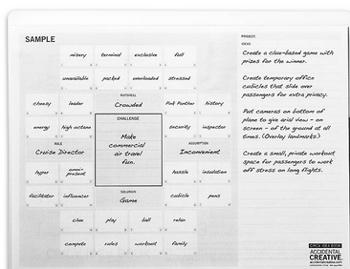
Notes:
4 Quadrants:

Slide 26
What to do when you must be creative: practical advice – part 1
Be alone (get rid of her or him for 45 minutes)
Be relaxed and without any stress (take her/him for a magnificent dinner with wine)
Disregard the devil telling you it is impossible (tell him to FO)
Concentrate (she/he can wait)

Slide 27
What to do when you must be creative: practical advice – part 2
1. Combine two (or more) ideas
2. Use an approach from somewhere else
3. Try to defend opposite or competitive ideas (to ones you consider or existing ones)
4. Try to defend the existing solution(s)
5. Explain the problem (and your solution) to somebody who knows nothing.

Slide 28
HOW WE AND YOU HAVE YOU BEEN CREATIVE AS A CONSULTANT
?
We will record all responses in the slides that will be published on the website

Slide 29
APPENDIX
Some extra links and quotes

Slide 30
Asimov Quote
Here is a most interesting quote from the essay: "My feeling is that as far as creativity is concerned, isolation is required. The creative person is, in any case, continually working at it. His mind is shuffling his information at all times, even when he is not conscious of it. (The famous example of Kekule working out the structure of benzene in his sleep is well-known). The presence of others can only inhibit this process, since creation is embarrassing. For every new good idea you have, there are a hundred, ten thousand foolish ones, which you naturally do not care to display." Note: Asimov's view here seems both personally true and contrary to two more recent trends/findings: 1] The trend in team-based scientific production (i.e., research teams verses individual researchers), and, 2] The 'Group Intelligence Factor' (Woolley et al); see: http://planetsave.com/2010/12/13/group-intelligence-factorrevealed-

Slide 31
Creativity, Innovation, and Entrepreneurship Study (2013-2016)
Critical questions include:
To what extent do innovation and entrepreneurship drive economic prosperity?
Can imagination and creativity be sparked in ways that lead to innovation and entrepreneurship?
What accounts for the dramatic variation in rates and types of entrepreneurship and innovation?
How do new firms and new industries differ in their structure, rewards, stability and other features? Do entrepreneurial ventures provide “good jobs” or “bad jobs,” and under what conditions?
CORNELL UNIVERSITY STUDY

Slide 32
Some More Quotes
“You can't use up creativity. The more you use, the more you have.” ― Maya Angelou
There is a fountain of youth: it is your mind, your talents, the creativity you bring to your life and the lives of people you love. When you learn to tap this source, you will truly have defeated age.” ― Sophia Loren

Slide 33
More quotes
That's the great secret of creativity. You treat ideas like cats: you make them follow you.” ― Ray Bradbury, Zen in the Art of Writing
“Chance favors the prepared mind.” ― Louis Pasteur
Imagination is the beginning of creation. You imagine what you desire, you will what you imagine and at last you create what you will.” ― George Bernard Shaw

Slide 34
More Quotes
“The criminal is the creative artist; the detective only the critic.” ― G.K. Chesterton, The Blue Cross: A Father Brown Mystery
I like to listen. I have learned a great deal from listening carefully. Most people never listen.” ― Ernest Hemingway
“Creativity is a continual surprise.” ― Ray Bradbury

Slide 35
More Quotes

Slide 36
IdeaPads
Similar to concept maps (see wikipedia)
A concept map or conceptual diagram is a diagram that depicts suggested relationships between concepts.^{[1]} It is a graphical tool thatdesigners, engineers, technical writers, and others use to organize and structure knowledge.
A concept map typically represents ideas and information as boxes or circles, which it connects with labeled arrows in a downward-branching hierarchical structure. The relationship between concepts can be articulated in linking phrases such as causes, requires, orcontributes to.^{[2]}
The technique for visualizing these relationships among different concepts is called concept mapping. Concept maps define the ontologyof computer systems, for example with the object-role modeling or Unified Modeling Language formalism.

Slide 37
Links
A previously unpublished (1959) essay on Creativity by ISAAC ASIMOV! link:http://www.technologyreview.com/view/531911/isaac-asimov-asks-how-do-people-get-new-ideas/
Wikipedia entries on creativity, lateral thinking , oblique strategies, brainstorming
Creativity_and_Innovative_Business_Models.pdf can be found at http://www.google.com/url?sa=t&rct=j&q=&esrc=s&source=web&cd=5&ved=0CDcQFjAE&url=http%3A%2F%2Fwww.researchgate.net%2Fprofile%2FThierry_Burger-Helmchen%2Fpublication%2F230634379_ENTREPRENEURSHIP__CREATIVITY_AND_INNOVATIVE_BUSINESS_MODELS%2Flinks%2F0fcfd502393aa2b77e000000&ei=2RWBVIWRB8rSoAT3hYGoAQ&usg=AFQjCNFOOVBvZ99FqT08fJWOSYYSZbiVDg&sig2=X_V3EaktWL6to9K9ktXsZg a book

Slide 38
Links
http://www.jamestaylor.me/creative-process-five-stages/ james taylor 5 stages
http://www.greenfields.u-net.com/docs/ 6 stages
http://socialsciences.cornell.edu/entrepreneurship/
THE CREATIVE ENTREPRENEUR: A STUDY OF THE ENTREPRENEUR’S CREATIVE PROCESSES
Robert Beattie, University of Abertay Dundee
http://fusionmx.babson.edu/entrep/fer/papers99/III/III_B/IIIB.html interesting on entrepreneurship
http://www.accidentalcreative.com/
http://www.levenger.com/Circa-Idea-Book-12553.aspx

