Slide 1
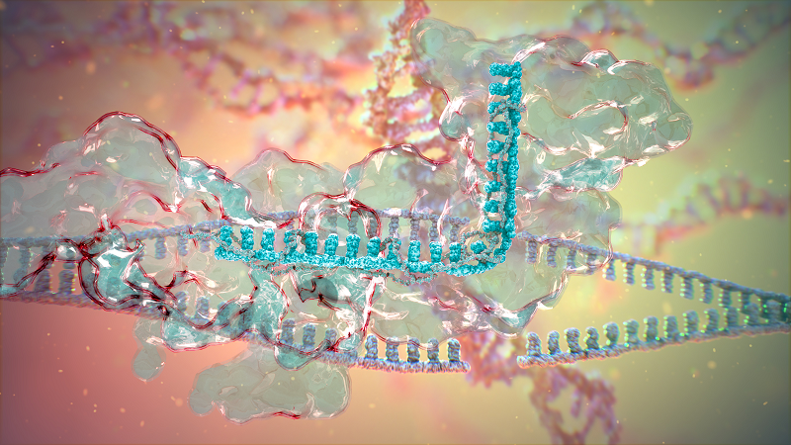
The Gene Editing Patent War
Meg Baker, PhD, Registered Patent Agent
Nov 14, 2018
Notes:
<number>

Slide 2
CRISPR – Cas 9
CRISPR stands for Clustered Regularly Interspaced Short Palindromic Repeats
Cas-9 is an enzyme capable of
  Binding an RNA strand containing a PAM sequence
  Binding an RNA strand which targets the enzyme to “precise” sequences in the DNA
  Making double strand cuts in DNA
  The portion of the RNA sequences hybridizing with DNA are ~20 nucleotides which give it high specificity.
CRISPR: Gene editing and beyond (video)

Slide 3
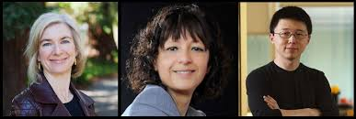
Who owns “CRISPR”
Inventors at U Cal Berkeley
  Jennifer Doudna or her company, Caribou Biosciences
  Emmanuelle Charpentier or CRISPR Therapeutics
  U Cal
  U Vienna or Sweden?
Inventors at Broad Institute (MIT)
  Feng Zhang or George Church
  MIT’s licensee company - Editas
Everybody - Law of Nature
Notes:
<number>

Slide 4
Caribou Biosciences
Co-Founded in 2011 by Jennifer Doudna and scientists from the University of California, Berkeley
Mission: to drive the commercialization of applications based on the potential for nucleic acid modification capabilities found in prokaryotic CRISPR systems.

Slide 5
CRISPR Therapeutics
Founded by Rodger Novak, Emmanuelle Charpentier and Shaun Foy in November 2013 with initial funding from Versant Ventures and the mission of developing gene-editing based therapeutics for serious diseases. The company was established in Switzerland and subsequently opened R&D operations in Cambridge, Massachusetts.

Slide 6
Editas Medicine
Founded in 2013 with funding from 3 venture capital firms: Third Rock Ventures, Polaris Partners and Flagship Ventures.
Licensed CRISPR patents from the Broad Institute's Feng Zhang, patents from Harvard's David Liu and George Church and patents from Partners Healthcare-MGH's J. Keith Joung.
Jennifer Doudna was an advisory board member until shortly after the company went public on 2 Feb 2016.

Slide 7
Intellia Therapeutics
Founded in May 2014 to develop biopharmaceuticals using CRISPR.
Intellia in-licensed patents from Caribou Biosciences, which had licensed patents from Univ of California.
Backed by Atlas Ventures and Novartis.
Novartis interests were in applying CRISPR in CAR-T, and in January 2015 Novartis obtained rights to use CRISPR for its CAR-T program, and the companies agreed to collaborate on ways to use CRISPR to treat diseases involving hematopoietic stem cells including beta thalassemia and sickle cell disease.
Intellia formed a division called eXtellia Therapeutics to manage the CAR-T collaboration with Novartis

Slide 8
> $1 B already invested
From Contreras & Sherkov 2017

Slide 9
Doudna v Zhang
13/842,859 filed 3-15-2013
  Earliest priority data 05-25-12
  Article published 08-17-2012 showing a way to connect the targeting RNA sequence to the enzyme binding sequence to form a gene editing system.in a cell-free system.
14/104,990 filed 10-15-2013
  Earliest priority date 12-12-2012 (61/736,527 )
  Cong et al. article published online 2013 Jan 3 in Science
  Abandoned 08-17-2016
  US 8,697,359 was 1st patent issued on April 15, 2014

Slide 10
Doudna et al.
13/842,859 filed 3-15-2013

Slide 11
Zhang
US Patent
8,697,359

Slide 12
Zhang US Patent 8,697,359 Fig. 21

Slide 13
Leahy-Smith American Invents Act : Biggest Patent Reform since 1952
America Invents Act was signed by Obama into law Sept 15, 2011 but implemented over 18 months
As of Mar 16, 2013, U.S. is a “first-inventor-to-file” patent system
  No more interference proceedings
  No “swearing back” of references using notebooks, etc.
  HOWEVER, inventor retains 1 year grace period
    Has 1 year to file after public disclosure of her work by the inventor herself or someone who obtained it from her
UC Berkeley filed prior and MIT had a priority date prior to 3-16-2013 … perhaps the last interference proceeding to be declared.
Notes:
<number>

Slide 14
Declaration of Interference
Filed January 11, 2016
THE BROAD INSTITUTE, INC., MASSACHUSETTS INSTITUTE OF TECHNOLOGY, and PRESIDENT AND FELLOWS OF HAVARD COLLEGE, (Patents 8,697,359; 8,771,945; 8,795,965; 8,865,406; 8,871,445; 8,889,356; 8,895,308; 8,906,616; 8,932,814; 8,945,839; 8,993,233; and 8,999,641),
Junior Party,
v.
THE REGENTS OF THE UNIVERSITY OF CALIFORNIA, UNIVERSITY OF VIENNA, AND EMMANUELLE CHARPENTIER (Application 13/842,859),
Senior Party.

Slide 15
Patent Law Basics
Patentable material is distinguished from previous inventions (prior art), is not anticipated or made obvious
Non-patentable material means that a reference or obvious combination disclosed your invention
OR is not statutory subject matter, e.g. human organism or a “law of nature”
Infringement/interference means that your invention contains all the elements or steps of an existing patent claim
Patentability ≠ Non-infringement
Notes:
<number>

Slide 16
The Heart of the Dispute
Whether Doudna and Charpentier’s original patent application disclosed enough information to enable an ordinary molecular biologist to use the technology in eukaryotic cells, i.e., the cells of higher organisms.
If so, then some or all of the claims in the fourteen Zhang patents covering his iteration of CRISPR maybe struck down.
Berkeley argued that the distinguishing feature of the invention, is that the system is defined by the presence of the RNA molecule, namely, the single guide RNA or sgRNA used by Zhang and not which type of cell it is used in.
HOWEVER, interference is based on the claims (Count) and Count 1 was based on the system in eukaryotic cells.

Slide 17
What went wrong (or right)?
“Predictable” vs “Non-predictable arts”
  For example, just because you can imagine or draw a large genus of chemical compounds does not mean you have made them all or that they will all behave in a predictable way
Written description and enablement
  The bane of the life sciences patenting
  Patent Law 35 U.S.C. §112 1st Paragraph
  Case Law, e.g. Ariad v Lilly, UC v Lilly, Friers v Revel.

Slide 18
USC 35 § 112. 1st Paragraph.
¶1 The specification shall contain a written description of the invention, and of the manner and process of making and using it, in such full, clear, concise, and exact terms as to enable any person skilled in the art to which it pertains, or with which it is most nearly connected, to make and use the same, and shall set forth the best mode contemplated by the inventor of carrying out his invention.”

Slide 19
Disclosed v Claimed
Specification (disclosure)
  May give background/prior art or pose the “problem”
  A written description as required by 35 USC §112
    the “teachings”
    what the applicant considers his invention and BEST MODE
    sets forth examples of the invention
  defines terms used in the claims
  Acts as a public disclosure/publication that destroys novelty for others as of the date of filing
Issued or pending Claims
  Defines the defensible invention
  Gives the metes and bounds of the intellectual property as
  Claims were prosecuted between USPTO examiner and the attorney/inventor
  Enforceable for the term that the patent is in force and maintained
Notes:
<number>

Slide 20
Claim Scope and patent value (?)
Pioneering Technology
Broad concept –many embodiments possible
Improvements
New invention
New subgroups or variations
Value
Time
Unpredicted Embodiment(s)
Limited or unique composition or function
Notes:
BIG Biotech Inventions
Cohen and Boyer (Stanford) - Genetic Engineering
Mullis et al (Chiron/Roche Diagnostics) - PCR
Kohler and Milstein (MRC) – Monoclonal Antibodies
Enabling technology not patented because viewed as having “no value”
Improvement patented by Kaprowski and Croce at the Wistar
<number>

Slide 21
Distinguishing over prior art to achieve patentability but not necessarily avoiding infringement
Antisera
Monoclonal antibodies (Mabs)
Mabs with human sequences
Notes:
(and avoiding anticipatory disclosures)
<number>

Slide 22
Centocor Ortho Biotech v. Abbott Labs
Decision Overturned a $1.6 Billion Verdict
  Despite jury award of $1.6 Billion in damages, on appeal, the CAFC held the patent invalid for failure to have satisfied the "written description" requirement that would have demonstrated that the inventors had "possession" of the biotech invention claimed, at the time the invention was made.

Slide 23
Patent Trial and Appeal Board (PTAB) Decision
Feb 15, 2017

Slide 24
Written or Said
Re Fiers v. Revel, 984 F. 2d 1171 (Federal Circuit 1993) on §112 1st paragraph:
  The goal is to get the right balance, and the written description doctrine does so by giving the incentive to actual invention and not “attempt[s] to preempt the future before it has arrived.”
In this case, expert witnesses on both sides and statements captured from inventor interviews, e.g. Doudna stating “we weren’t sure if it would work in eukaryotes”

Slide 25
Legal Saga Over CRISPR Patents Likely Over
On Sept 10, 2018, the federal appeals court affirmed the conclusion of the U.S. PTAB
  No Interference-in-fact
  Neither cancels or refuses either party’s claims
  Each party may pursue their claims
Probably will NOT go to the Supreme Court

Slide 26
Doudna had allowed claims
Claims 165, 168-184, 224-239, and 242 were allowed on 09/15/2015
Examiner stated that pending the interference, claims 165 -200, 202-222, and 224 -247 were in condition for allowance as of 12/23/2015.
Claims are all “method claims” as are the claims in Zhang’s ‘359 patent

Slide 27
What happens next?
Berkeley sues MIT for patent infringement?
Licenses for patents are voided?
Drugs or treatment methods are developed using the technology.
  Research tool patents – usually not high value
  Method of treatment claim? Is it possible to claim a method of treatment that includes manipulation of cells using a CRISPR system?
  The fat lady sings?

Slide 28
Thank you
Margaret Baker, Reg. Patent Agent
  meg.baker58@gmail.com , 610-649-1840
Notes:
<number>

Slide 29
U.S. Patent Right - 35 USC §154(a)(1)
“Every patent shall … grant to the patentee, his heirs or assigns, of the right to exclude others from making, using, offering for sale, or selling the invention throughout the United States or importing the invention into the United States, and, if the invention is a process, of the right to exclude others from using, offering for sale or selling throughout the United States, or importing into the United States, products made by that process, referring to the specification for the particulars thereof.”
Notes:
<number>
Note “Right to exclude others”
or
“right to fees and royalties”
Enforcement in the U.S. often requires litigation. So a patent award has no value if you do not have the wherewithal to prosecute infringers.

