Slide 1


Patent Law for Technical & Business Professionals: Beyond the Basics
By Peter D. Mlynek
Patent Attorney

Slide 2
Previous Presentations
Patenting Strategies in BRIC Countries for Pharmaceutical Companies
Recent Changes in the US Patent System Affecting Engineers
Consultant Opportunities in Patent Law
Working for Lawyers: Why Scientists and Engineers succeed as Technical Advisors and Experts

Slide 3
Outline
Laws, Regulations, Court holdings
Patent Strategy
Hiring and working with Patent Attorneys
Projecting cash flows

Slide 4
Patent Laws and Court Decisions

Slide 5
Patent Laws and Court Decisions
US Constitution

Slide 6
Patent Laws and Court Decisions
US Constitution

Slide 7
Patent Laws and Court Decisions
US Constitution
  27 words about patents and copyrights

Slide 8
Patent Laws and Court Decisions
US Constitution
  27 words about patents and copyrights

Slide 9
Patent Laws and Court Decisions
US Constitution
  27 words about patents and copyrights
Statutes

Slide 10
Patent Laws and Court Decisions
US Constitution
  27 words about patents and copyrights
  Passed by Congress
  35 U.S.C.
  85,000 words
Statutes

Slide 11
Patent Laws and Court Decisions
US Constitution
  27 words about patents and copyrights
  Passed by Congress
  35 U.S.C.
  85,000 words
Statutes

Slide 12
Patent Laws and Court Decisions
US Constitution
  27 words about patents and copyrights
  Passed by Congress
  35 U.S.C.
  85,000 words
Statutes
Regulations

Slide 13
Patent Laws and Court Decisions
US Constitution
  27 words about patents and copyrights
  Passed by Congress
  35 U.S.C.
  85,000 words
Statutes
  Promulgated by US PTO
  37 C.F.R.
  304,000 words
  Handbooks, guides, …
Regulations

Slide 14
Patent Laws and Court Decisions
US Constitution
  27 words about patents and copyrights
  Passed by Congress
  35 U.S.C.
  85,000 words
Statutes
  Promulgated by US PTO
  37 C.F.R.
  304,000 words
  Handbooks, guides, …
Regulations

Slide 15
Patent Laws and Court Decisions
US Constitution
  27 words about patents and copyrights
  Passed by Congress
  35 U.S.C.
  85,000 words
Statutes
  Promulgated by US PTO
  37 C.F.R.
  304,000 words
  Handbooks, guides, …
Regulations
Court Decisions

Slide 16
Courts System in the US
State Courts
Supreme Court
Superior Court &
Commonwealth Court
  3 locations
Court of Common Pleas
  60 districts
Pennsylvania

Slide 17
Federal Courts
US Supreme Court
  11 Circuits
  DC Circuit
  Federal Circuit
Court of Appeals
District Courts
  94 districts
USA

Slide 18
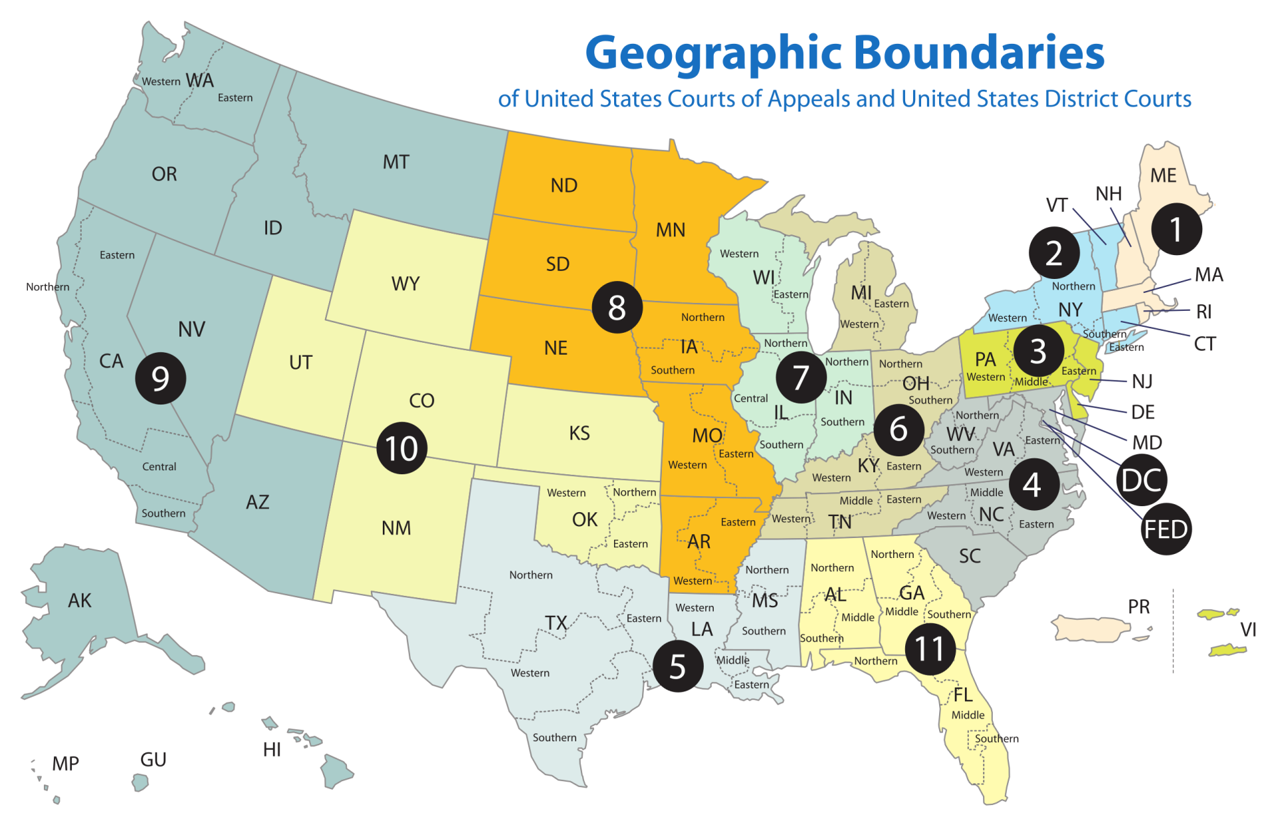

Slide 19
Federal Courts
Too few patent cases
US Supreme Court
  11 Circuits
  DC Circuit
  Federal Circuit
Court of Appeals
District Courts
  94 districts
USA
Too many patent cases

Slide 20
Federal Courts
Too few patent cases
US Supreme Court
US Court of Appeals for the Federal Circuit
District Courts
  94 districts
USA
Too many patent cases

Slide 21
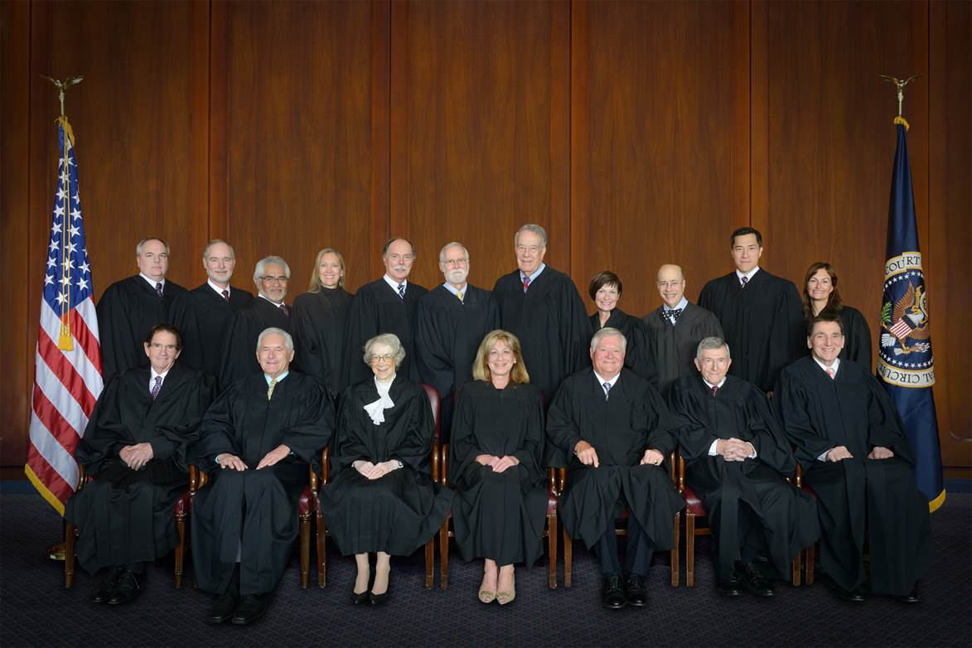
US Court of Appeals for the Federal Circuit

Slide 22
Requirements to Obtain a Patent
Useful

Slide 23
Requirements to Obtain a Patent
Useful

Slide 24
Requirements to Obtain a Patent
Useful
Generally, a low hurdle to overcome in cases of electrical engineering and computer hardware inventions.

Slide 25
Requirements to Obtain a Patent
Useful
Generally, a low hurdle to overcome in cases of electrical engineering and computer hardware inventions.
Questions about patentability with respect to usefulness come up in
Biological technology
Computer programs
- Finance

Slide 26
Requirements to Obtain a Patent
Useful
LAW
35 U.S.C. 101
Whoever invents or discovers any new and useful process, machine, manufacture, or composition of matter, or any new and useful improvement thereof, may obtain a patent therefor, …
Generally, a low hurdle to overcome in cases of chemical, pharma, and mechanical hardware inventions.

Slide 27
Cases relating to § 101

Slide 28
101 Patent Cases
O'Reilly v Morse (1853): patent to transmit telegraph signals over long distances
  An abstract idea, apart from its implementation, is not patent-eligible.

Slide 29
101 Patent Cases
O'Reilly v Morse (1853): patent to transmit telegraph signals over long distances
  An abstract idea, apart from its implementation, is not patent-eligible.
Diamond v Chakrabarty (1980)
  Chakrabarty created a bacterium capable of breaking down crude oil
  Live, man-made organism was an article of manufacture, thus protectable

Slide 30
101 Patent Cases
O'Reilly v Morse (1853): patent to transmit telegraph signals over long distances
  An abstract idea, apart from its implementation, is not patent-eligible.
Diamond v Chakrabarty (1980)
  Chakrabarty created a bacterium capable of breaking down crude oil
  Live, man-made organism was an article of manufacture, thus protectable
Bowman v. Monsanto, 133 S.Ct. 1761 (2012)
  Farmer bought soybean crops under license, but replanted them the next year
  You can't copy a patented article and reuse it.

Slide 31
101 Patent Cases
O'Reilly v Morse (1853): patent to transmit telegraph signals over long distances
  An abstract idea, apart from its implementation, is not patent-eligible.
Diamond v Chakrabarty (1980)
  Chakrabarty created a bacterium capable of breaking down crude oil
  Live, man-made organism was an article of manufacture, thus protectable
Bowman v. Monsanto, 133 S.Ct. 1761 (2012)
  Farmer bought soybean crops under license, but replanted them the next year
  You can't copy a patented article and reuse it.
Bilski v. Kappos, (2010)
  Patent on a method of hedging looses in one segment of the energy industry by making investments in other segments of that industry,
  Not patentable subject matter
  Machine or transformation test is useful

Slide 32
Requirements to Obtain a Patent

Slide 33
Requirements to Obtain a Patent
Useful

Slide 34
Requirements to Obtain a Patent
Useful
Described

Slide 35
Requirements to Obtain a Patent
Described

Slide 36
Requirements to Obtain a Patent
Described
The patent applicant must describe the invention in order to get rights to it
Description
Enablement
Best Mode

Slide 37
Requirements to Obtain a Patent
Described
The patent applicant must describe the invention in order to get rights to it
Description
Enablement
Best Mode

Slide 38
Requirements to Obtain a Patent
Described
The patent applicant must describe the invention in order to get rights to it
Description
Enablement
Best Mode
Unique to the US

Slide 39
Requirements to Obtain a Patent
Described
The patent applicant must describe the invention in order to get rights to it
Description
Enablement
Best Mode
Unique to the US
AIA: Best mode needs to be in the patent,
but if it is not there, the patent is still OK

Slide 40
Requirements to Obtain a Patent
Described
The patent applicant must describe the invention in order to get rights to it
Description
Enablement
Best Mode
Unique to the US
Still need to put Best Mode into the application.
AIA: Best mode needs to be in the patent,
but if it is not there, the patent is still OK

Slide 41
Requirements to Obtain a Patent
Described

Slide 42
Requirements to Obtain a Patent
Useful
Described

Slide 43
Requirements to Obtain a Patent
Useful
Described
New

Slide 44
Requirements to Obtain a Patent
New

Slide 45
Requirements to Obtain a Patent
If it is not new, then it is not patentable.
If some else has a patent on it, then it is not patentable.
New
“Novelty”

Slide 46
Requirements to Obtain a Patent
If it is not new, then it is not patentable.
If some else has a patent on it, then it is not patentable.
The AIA rewrote the entire law on this requirement.
New

Slide 47
102 Cases
Egbert v. Lippmann, 104 U.S. 333 (1881);
  Egbert invented a steel corset spring, his girlfriend used it publicly
  Public use bar
City of Elizabeth v. American Nicholson Pavement Co. (1878).
  Inventor of pavement formulation
  No public use bar, due to public experimental use

Slide 48
Requirements to Obtain a Patent
Useful
Described
New

Slide 49
Requirements to Obtain a Patent
Useful
Described
New
Not Obvious

Slide 50
Requirements to Obtain a Patent
Not Obvious

Slide 51
Requirements to Obtain a Patent
Is the invention obvious over what is known?
Not Obvious

Slide 52
Requirements to Obtain a Patent
Is the invention obvious over what is known?
The MOST difficult of the 4 requirements
  60-80% of attorney’s time during prosecution
Not Obvious

Slide 53
Requirements to Obtain a Patent
Is the invention obvious over what is known?
The MOST difficult of the 4 requirements
  60-80% of attorney’s time during prosecution
Mostly unchanged by AIA
Not Obvious

Slide 54
Tests for Obviousness
KSR v. Teleflex, 550 U.S. 398 (2007)

Slide 55
Tests for Obviousness
KSR v. Teleflex, 550 U.S. 398 (2007)
(A) Combining prior art elements according to known methods to yield predictable results;

Slide 56
Tests for Obviousness
KSR v. Teleflex, 550 U.S. 398 (2007)
(A) Combining prior art elements according to known methods to yield predictable results;

Slide 57
Tests for Obviousness
KSR v. Teleflex, 550 U.S. 398 (2007)
(A) Combining prior art elements according to known methods to yield predictable results;
+

Slide 58
Tests for Obviousness
KSR v. Teleflex, 550 U.S. 398 (2007)
(A) Combining prior art elements according to known methods to yield predictable results;
+

Slide 59
Tests for Obviousness
KSR v. Teleflex, 550 U.S. 398 (2007)
(A) Combining prior art elements according to known methods to yield predictable results;
+
→

Slide 60
Tests for Obviousness
KSR v. Teleflex, 550 U.S. 398 (2007)
(A) Combining prior art elements according to known methods to yield predictable results;
+
→

Slide 61
Tests for Obviousness
KSR v. Teleflex, 550 U.S. 398 (2007)

Slide 62
Tests for Obviousness
KSR v. Teleflex, 550 U.S. 398 (2007)
(B) Simple substitution of one known element for another to obtain predictable results;

Slide 63
Tests for Obviousness
KSR v. Teleflex, 550 U.S. 398 (2007)
(B) Simple substitution of one known element for another to obtain predictable results;

Slide 64
Tests for Obviousness
KSR v. Teleflex, 550 U.S. 398 (2007)
(B) Simple substitution of one known element for another to obtain predictable results;

Slide 65
Tests for Obviousness
KSR v. Teleflex, 550 U.S. 398 (2007)
(B) Simple substitution of one known element for another to obtain predictable results;

Slide 66
Tests for Obviousness
KSR v. Teleflex, 550 U.S. 398 (2007)
(B) Simple substitution of one known element for another to obtain predictable results;
→

Slide 67
Tests for Obviousness
KSR v. Teleflex, 550 U.S. 398 (2007)
(B) Simple substitution of one known element for another to obtain predictable results;
→

Slide 68
Tests for Obviousness
KSR v. Teleflex, 550 U.S. 398 (2007)

Slide 69
Tests for Obviousness
KSR v. Teleflex, 550 U.S. 398 (2007)
(C) Use of known technique to improve similar devices (methods, or products) in the same way;

Slide 70
Tests for Obviousness
KSR v. Teleflex, 550 U.S. 398 (2007)
(C) Use of known technique to improve similar devices (methods, or products) in the same way;

Slide 71
Tests for Obviousness
KSR v. Teleflex, 550 U.S. 398 (2007)
(C) Use of known technique to improve similar devices (methods, or products) in the same way;
Prior
Art:

Slide 72
Tests for Obviousness
KSR v. Teleflex, 550 U.S. 398 (2007)
(C) Use of known technique to improve similar devices (methods, or products) in the same way;
Prior
Art:

Slide 73
Tests for Obviousness
KSR v. Teleflex, 550 U.S. 398 (2007)
(C) Use of known technique to improve similar devices (methods, or products) in the same way;
Prior
Art:

Slide 74
Tests for Obviousness
KSR v. Teleflex, 550 U.S. 398 (2007)
(C) Use of known technique to improve similar devices (methods, or products) in the same way;
Prior
Art:

Slide 75
Tests for Obviousness
KSR v. Teleflex, 550 U.S. 398 (2007)
(D) Applying a known technique to a known device (method, or product) ready for improvement to yield predictable results;

Slide 76
Tests for Obviousness
KSR v. Teleflex, 550 U.S. 398 (2007)

Slide 77
Tests for Obviousness
KSR v. Teleflex, 550 U.S. 398 (2007)
(D) Applying a known technique to a known device (method, or product) ready for improvement to yield predictable results;

Slide 78
Tests for Obviousness
KSR v. Teleflex, 550 U.S. 398 (2007)
(D) Applying a known technique to a known device (method, or product) ready for improvement to yield predictable results;
Prior
Art:

Slide 79
Tests for Obviousness
KSR v. Teleflex, 550 U.S. 398 (2007)
(D) Applying a known technique to a known device (method, or product) ready for improvement to yield predictable results;
Prior
Art:

Slide 80
Tests for Obviousness
KSR v. Teleflex, 550 U.S. 398 (2007)
(D) Applying a known technique to a known device (method, or product) ready for improvement to yield predictable results;
Prior
Art:

Slide 81
Tests for Obviousness
KSR v. Teleflex, 550 U.S. 398 (2007)

Slide 82
Tests for Obviousness
KSR v. Teleflex, 550 U.S. 398 (2007)
(E) "Obvious to try" – choosing from a finite number of identified, predictable solutions, with a reasonable expectation of success;

Slide 83
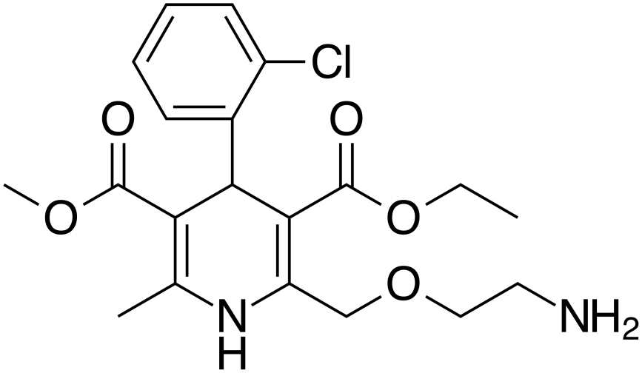
Tests for Obviousness
KSR v. Teleflex, 550 U.S. 398 (2007)
(E) "Obvious to try" – choosing from a finite number of identified, predictable solutions, with a reasonable expectation of success;
Pfizer, Inc. v. Apotex, Inc.,
Amlodipine
(Norvasc)

Slide 84
Tests for Obviousness
KSR v. Teleflex, 550 U.S. 398 (2007)
(E) "Obvious to try" – choosing from a finite number of identified, predictable solutions, with a reasonable expectation of success;
Pfizer, Inc. v. Apotex, Inc.,
Prior art: addition salt, maleate is preferred
Amlodipine
(Norvasc)

Slide 85
Tests for Obviousness
KSR v. Teleflex, 550 U.S. 398 (2007)
(E) "Obvious to try" – choosing from a finite number of identified, predictable solutions, with a reasonable expectation of success;
Pfizer, Inc. v. Apotex, Inc.,
Prior art: addition salt, maleate is preferred
Problem: Maleate salt sticks to the equipment.
Amlodipine
(Norvasc)

Slide 86
Tests for Obviousness
KSR v. Teleflex, 550 U.S. 398 (2007)
(E) "Obvious to try" – choosing from a finite number of identified, predictable solutions, with a reasonable expectation of success;
Pfizer, Inc. v. Apotex, Inc.,
Prior art: addition salt, maleate is preferred
Problem: Maleate salt sticks to the equipment.
Solution: use different salt.
Amlodipine
(Norvasc)

Slide 87
Tests for Obviousness
KSR v. Teleflex, 550 U.S. 398 (2007)
(E) "Obvious to try" – choosing from a finite number of identified, predictable solutions, with a reasonable expectation of success;
Pfizer, Inc. v. Apotex, Inc.,
Prior art: addition salt, maleate is preferred
Problem: Maleate salt sticks to the equipment.
Solution: use different salt.
Claim: Besylate salt of amplodipine
Amlodipine
(Norvasc)

Slide 88
Tests for Obviousness
KSR v. Teleflex, 550 U.S. 398 (2007)
(E) "Obvious to try" – choosing from a finite number of identified, predictable solutions, with a reasonable expectation of success;
Pfizer, Inc. v. Apotex, Inc.,
Prior art: addition salt, maleate is preferred
Problem: Maleate salt sticks to the equipment.
Solution: use different salt.
Claim: Besylate salt of amplodipine
Holding: It's obvious
Amlodipine
(Norvasc)

Slide 89
Tests for Obviousness
KSR v. Teleflex, 550 U.S. 398 (2007)

Slide 90
Tests for Obviousness
KSR v. Teleflex, 550 U.S. 398 (2007)
(F) Known work in one field of endeavor may prompt variations of it for use in either the same field or a different one based on design incentives or other market forces if the variations are predictable to one of ordinary skill in the art;

Slide 91
Tests for Obviousness
KSR v. Teleflex, 550 U.S. 398 (2007)
(F) Known work in one field of endeavor may prompt variations of it for use in either the same field or a different one based on design incentives or other market forces if the variations are predictable to one of ordinary skill in the art;

Slide 92
Tests for Obviousness
KSR v. Teleflex, 550 U.S. 398 (2007)
(F) Known work in one field of endeavor may prompt variations of it for use in either the same field or a different one based on design incentives or other market forces if the variations are predictable to one of ordinary skill in the art;
Prior
Art:

Slide 93
Tests for Obviousness
KSR v. Teleflex, 550 U.S. 398 (2007)
(F) Known work in one field of endeavor may prompt variations of it for use in either the same field or a different one based on design incentives or other market forces if the variations are predictable to one of ordinary skill in the art;
Prior
Art:

Slide 94
Tests for Obviousness
KSR v. Teleflex, 550 U.S. 398 (2007)
(G) Some teaching, suggestion, or motivation in the prior art that would have led one of ordinary skill to modify the prior art reference or to combine prior art reference teachings to arrive at the claimed invention.
Prior
Art:

Slide 95
Patent Strategy
The patent strategy follows the business strategy.
Invention finished

Slide 96
Patent Strategy
The patent strategy follows the business strategy.

Slide 97
Patent Strategy
The patent strategy follows the business strategy.
Invention finished
Marketing
Product Life Cycle
Human Resources
Licensing
Exit Strategy
Ultimate Design
Price points

Slide 98
Working with Lawyers

Slide 99
Where are Lawyers Found?

Slide 100
Where are Lawyers Found?
Law Firms
Companies

Slide 101
Where are Lawyers Found?
Law Firms
Companies
“Private
Practice”
“In House”

Slide 102
Where are Lawyers Found?
Law Firms
Companies

Slide 103
Where are Lawyers Found?
Law Firms
Companies
Big law: General Practice
Boutiques: Specialty firms
Solo practitioners

Slide 104
Where are Lawyers Found?
Law Firms
Companies
Big law: General Practice
  Do everything, solve problems in many areas
  100’s of lawyers, dozen offices
Boutiques: Specialty firms
  Handful to dozens of attorneys
Solo practitioners

Slide 105
Where are Lawyers Found?
Law Firms
Companies
Big law: General Practice
  Do everything, solve problems in many areas
  100’s of lawyers, dozen offices
Boutiques: Specialty firms
  Handful to dozens of attorneys
Solo practitioners
Employees

Slide 106
Where are Lawyers Found?
Law Firms
Companies
Big law: General Practice
  Do everything, solve problems in many areas
  100’s of lawyers, dozen offices
Boutiques: Specialty firms
  Handful to dozens of attorneys
Solo practitioners
Employees

Slide 107
Law Firm Organization

Slide 108
Law Firm Organization:
A Simple Business Model
Partners

Slide 109
Law Firm Organization:
A Simple Business Model
Partners
Other Lawyers

Slide 110
Law Firm Organization:
A Simple Business Model
Partners
Other Lawyers
Support Staff

Slide 111
Law Firm Organization:
A Simple Business Model
Partners
Owners, must be Lawyers
Other Lawyers
Support Staff

Slide 112
Law Firm Organization:
A Simple Business Model
Partners
Owners, must be Lawyers
Other Lawyers
- Non-equity “partners”
- Of Counsel
- Associates
Support Staff

Slide 113
Law Firm Organization:
A Simple Business Model
Partners
Owners, must be Lawyers
Other Lawyers
- Non-equity “partners”
- Of Counsel
- Associates
Support Staff
Secretaries, Paralegals,
Office managers
IT, Finance, Marketing,

Slide 114
Law Firm Organization:
A Simple Business Model
Partners
Owners, must be Lawyers
Other Lawyers
- Non-equity “partners”
- Of Counsel
- Associates
Support Staff
Secretaries, Paralegals,
Office managers
IT, Finance, Marketing,

Slide 115
Law Firm Organization:
A Simple Business Model
Partners
Owners, must be Lawyers
Other Lawyers
- Non-equity “partners”
- Of Counsel
- Associates
Support Staff
Secretaries, Paralegals,
Office managers
IT, Finance, Marketing,

Slide 116
Law Firm Organization:
A Simple Business Model
Partners
Other Lawyers
Support Staff

Slide 117
Law Firm Organization:
A Simple Business Model
Partners
Other Lawyers
Support Staff

Slide 118
Law Firm Organization:
A Simple Business Model
Partners
Other Lawyers
Support Staff

Slide 119
Law Firm Organization:
A Simple Business Model
Partners
Other Lawyers
Support Staff

Slide 120
Law Firm Organization:
A Simple Business Model
Partners
Other Lawyers
Support Staff

Slide 121
Law Firm Organization:
A Simple Business Model
Partners
Other Lawyers
Support Staff

Slide 122
Law Firm Organization:
A Simple Business Model
Partners
Other Lawyers
Support Staff
Health

Slide 123
Law Firm Organization:
A Simple Business Model
Partners
Other Lawyers
Support Staff
Health
Tax

Slide 124
Law Firm Organization:
A Simple Business Model
Partners
Other Lawyers
Support Staff
Drug
Health
Tax

Slide 125
Law Firm Organization:
A Simple Business Model
Partners
Other Lawyers
Support Staff
Drug
Health
Tax
Torts

Slide 126
Law Firm Organization:
A Simple Business Model
Partners
Other Lawyers
Labor
Support Staff
Drug
Health
Tax
Torts

Slide 127
Law Firm Organization:
A Simple Business Model
Partners
Other Lawyers
Labor
Support Staff
Drug
Commercial
Health
Tax
Torts

Slide 128
Law Firm Organization:
A Simple Business Model
Labor
Drug
Commercial
Health
Tax
Torts

Slide 129
Law Firm Organization:
A Simple Business Model
Mechanical
Chemical
Electrical

Slide 130
Law Firm Organization:
A Simple Business Model
Labor
Drug
Commercial
Health
Tax
Torts

Slide 131
Law Firm Organization:
A Simple Business Model
- Billing attorney / originating attorney
- Supervising attorney
- Working attorney
Labor
Drug
Commercial
Health
Tax
Torts

Slide 134
How Much to Get a U.S. Patent?

Slide 135
How Much to Get a U.S. Patent?

Slide 136

How Much to Get a U.S. Patent?

Slide 137
How Much to Get a U.S. Patent?

Slide 138

How Much to Get a U.S. Patent?

Slide 139
How Much to Get a U.S. Patent?

Slide 140

How Much to Get a U.S. Patent?

Slide 141
How Much to Get a U.S. Patent?

Slide 143
Why so much?

Slide 144
Process of Getting a Patent

Slide 145
Process of Getting a Patent

Slide 146
Process of Getting a Patent
Conception

Slide 147
Process of Getting a Patent
Conception

Slide 148
Process of Getting a Patent
Conception

Slide 149
Process of Getting a Patent
Reduction to Practice
Conception

Slide 150
Process of Getting a Patent
Reduction to Practice
Conception

Slide 151
Process of Getting a Patent
Reduction to Practice
Conception

Slide 152
Process of Getting a Patent
Draft
Reduction to Practice
Conception

Slide 153
Process of Getting a Patent
Draft
Reduction to Practice
Conception

Slide 154
Process of Getting a Patent
Draft
Reduction to Practice
Application
Conception

Slide 155
Process of Getting a Patent
Draft
Reduction to Practice
Application
Conception

Slide 156
Process of Getting a Patent
Draft
Reduction to Practice
Application
Conception

Slide 157
Process of Getting a Patent
Draft
Reduction to Practice
Application
Conception
PTO

Slide 158
Process of Getting a Patent
Draft
Reduction to Practice
Application
Conception
PTO

Slide 159
Process of Getting a Patent
Draft
Reduction to Practice
Application
Conception
PTO

Slide 160
Process of Getting a Patent
Draft
Reduction to Practice
Application
Conception
PTO

Slide 161
Process of Getting a Patent
Draft
Reduction to Practice
Application
Conception
PTO

Slide 162
Process of Getting a Patent
Draft
Reduction to Practice
Application
Conception
PTO

Slide 163
Process of Getting a Patent
Draft
Reduction to Practice
Application
Conception
PTO
Prosecution

Slide 164
Process of Getting a Patent
Draft
Reduction to Practice
Application
Conception
PTO
Prosecution

Slide 165
Process of Getting a Patent
Draft
Reduction to Practice
Application
Conception
PTO
Prosecution

Slide 166
Process of Getting a Patent
Draft
Reduction to Practice
Application
Conception
PTO
Prosecution

Slide 167
Process of Getting a Patent
Draft
Reduction to Practice
Application
Conception
Licensing
PTO
Prosecution

Slide 169
Why so much to get a patent?

Slide 170
Why so much to get a patent?

Slide 171
Why so much to get a patent?
$4K - $10K

Slide 172
Why so much to get a patent?

Slide 173
Why so much to get a patent?

Slide 174
Why so much to get a patent?
$380 Filing fee
$620 Search fee
$250 Exam fee
…

Slide 175
Why so much to get a patent?

Slide 176
Why so much to get a patent?

Slide 177
Why so much to get a patent?
$3K - $8K
2-4 years

Slide 178
Why so much to get a patent?

Slide 179
Why so much to get a patent?

Slide 180
Why so much to get a patent?
$1,760
to PTO

Slide 181
Why so much to get a patent?

Slide 182
Why so much to get a patent?

Slide 183
Why so much to get a patent?
$1,130 at 3.5 years
$2,850 at 7.5 years
$4,730 at 11.5 years

Slide 184
Why so much to get a patent?

Slide 185
How Can We Get a Patent Cheaper?

Slide 186
How Can We Get a Patent Cheaper?
Pay less to
the USPTO

Slide 187
How Can We Get a Patent Cheaper?
Pay less to
the USPTO
Pay less for
patent lawyer

Slide 188
How Can We Get a Patent Cheaper?
Pay less to
the USPTO
Pay less for
patent lawyer

Slide 189
How Can We Get a Patent Cheaper?
Pay less to
the USPTO
Pay less for
patent lawyer

Slide 190
How Can We Get a Patent Cheaper?

Slide 191
How Can We Get a Patent Cheaper?
Pay less for the Patent Lawyer

Slide 192
How Can We Get a Patent Cheaper?
Pay less for the Patent Lawyer
• Reality: There are no economies of scale!
  - A patent for a small company costs just as much as for a large company

Slide 193
How Can We Get a Patent Cheaper?
Pay less for the Patent Lawyer
• Reality: There are no economies of scale!
  - A patent for a small company costs just as much as for a large company
• Have all necessary information for lawyer ready
  - Business plan, marketing, etc.
  - Experimental data, procedures, etc.

Slide 194
How Can We Get a Patent Cheaper?
Pay less for the Patent Lawyer
• Reality: There are no economies of scale!
  - A patent for a small company costs just as much as for a large company
• Have all necessary information for lawyer ready
  - Business plan, marketing, etc.
  - Experimental data, procedures, etc.
• Smaller law firm – big firms charge big bucks

Slide 195
How Can We Get a Patent Cheaper?
Pay less for the Patent Lawyer
• Reality: There are no economies of scale!
  - A patent for a small company costs just as much as for a large company
• Have all necessary information for lawyer ready
  - Business plan, marketing, etc.
  - Experimental data, procedures, etc.
• Smaller law firm – big firms charge big bucks
• Flat fee

Slide 196
End of
Presentation

Slide 197
Outline of this Presentation
Overview of Law
and Law Firms
1
Tips on How to Deal
with Lawyers
2
3
4
Opportunities in
Patent Law
Opportunities in
Pre-Trial Litigation
5
Opportunities as
an Expert Witness

Slide 198
Part 1
Overview of Law
and Law Firms

Slide 199
Types of Law

Slide 200
Types of Law
Criminal Law

Slide 201
Types of Law
Criminal Law
Torts

Slide 202
Types of Law
Criminal Law
Torts
Real Estate

Slide 203
Types of Law
Contract
Criminal Law
Torts
Real Estate

Slide 204
Types of Law
Contract
Criminal Law
Family
Torts
Real Estate

Slide 205
Types of Law
Contract
Criminal Law
Family
Torts
Real Estate
Business Law

Slide 206
Types of Law
Contract
Criminal Law
Family
Torts
Real Estate
Commercial
Business Law

Slide 207
Types of Law
Contract
Criminal Law
Family
Torts
Real Estate
Commercial
Business Law
Immigration

Slide 208
Types of Law
Corporate Law
Contract
Criminal Law
Family
Torts
Real Estate
Commercial
Business Law
Immigration

Slide 209
Types of Law
Corporate Law
Contract
Criminal Law
Family
Torts
Real Estate
Commercial
Business Law
Immigration
Constitutional

Slide 210
Types of Law
Corporate Law
Contract
Criminal Law
Family
Torts
Real Estate
Tax Law
Commercial
Business Law
Immigration
Constitutional

Slide 211
Types of Law
Corporate Law
Contract
Criminal Law
Energy Law
Family
Torts
Real Estate
Tax Law
Commercial
Business Law
Immigration
Constitutional

Slide 212
Types of Law
Corporate Law
Contract
Criminal Law
Energy Law
Family
Torts
Real Estate
Tax Law
Commercial
Health
Business Law
Immigration
Constitutional

Slide 213
Types of Law
Corporate Law
Contract
Criminal Law
Energy Law
Family
Torts
Real Estate
Tax Law
Commercial
Health
Business Law
Immigration
Constitutional
Drug

Slide 214
Types of Law
Corporate Law
Consumer Protection
Contract
Criminal Law
Energy Law
Family
Torts
Real Estate
Tax Law
Commercial
Health
Business Law
Immigration
Constitutional
Drug

Slide 215
Types of Law
Corporate Law
Consumer Protection
Contract
Criminal Law
Energy Law
Family
Torts
Real Estate
Tax Law
Commercial
Health
Business Law
Immigration
Banking
Constitutional
Drug

Slide 216
Types of Law
Corporate Law
Consumer Protection
Contract
Criminal Law
Energy Law
Family
Intellectual
Property
Torts
Real Estate
Tax Law
Commercial
Health
Business Law
Immigration
Banking
Constitutional
Drug

Slide 217
Types of Law
Corporate Law
Consumer Protection
Contract
Criminal Law
Energy Law
Family
Intellectual
Property
Torts
Real Estate
Tax Law
Commercial
Health
Business Law
Immigration
Banking
Constitutional
Drug
Insurance

Slide 218
Types of Law
Corporate Law
Consumer Protection
Contract
Criminal Law
Energy Law
Family
Intellectual
Property
Torts
Real Estate
Labor
Tax Law
Commercial
Health
Business Law
Immigration
Banking
Constitutional
Drug
Insurance

Slide 219
Types of Law
Corporate Law
Consumer Protection
Contract
Criminal Law
Energy Law
Family
Intellectual
Property
Torts
Real Estate
Administrative
Labor
Tax Law
Commercial
Health
Business Law
Immigration
Banking
Constitutional
Drug
Insurance

Slide 220
Types of Law
Corporate Law
Consumer Protection
Contract
Criminal Law
Energy Law
Family
Intellectual
Property
Torts
Aviation
Real Estate
Administrative
Labor
Tax Law
Commercial
Health
Business Law
Immigration
Banking
Constitutional
Drug
Insurance

Slide 221
Types of Law
Corporate Law
Consumer Protection
Contract
Criminal Law
Energy Law
Family
Intellectual
Property
Torts
Aviation
Real Estate
Administrative
Labor
Tax Law
Commercial
Health
Admiralty
Business Law
Immigration
Banking
Constitutional
Drug
Insurance

Slide 222
Types of Law
Corporate Law
Consumer Protection
Contract
Bankruptcy
Criminal Law
Energy Law
Family
Intellectual
Property
Torts
Aviation
Real Estate
Administrative
Labor
Tax Law
Commercial
Health
Admiralty
Business Law
Immigration
Banking
Constitutional
Drug
Insurance

Slide 223
Types of Law
Corporate Law
Consumer Protection
Contract
Bankruptcy
Criminal Law
Energy Law
Family
Intellectual
Property
Torts
Aviation
Real Estate
Administrative
Product Liability
Labor
Tax Law
Commercial
Health
Admiralty
Business Law
Immigration
Banking
Constitutional
Drug
Insurance

Slide 224
Types of Law
Corporate Law
Consumer Protection
Contract
Bankruptcy
Criminal Law
Human Rights
Energy Law
Family
Intellectual
Property
Torts
Aviation
Real Estate
Administrative
Product Liability
Labor
Tax Law
Commercial
Health
Admiralty
Business Law
Immigration
Banking
Constitutional
Drug
Insurance

Slide 225
Types of Law
Corporate Law
Consumer Protection
Contract
Bankruptcy
Criminal Law
Human Rights
Environmental
Energy Law
Family
Intellectual
Property
Torts
Aviation
Real Estate
Administrative
Product Liability
Labor
Tax Law
Commercial
Health
Admiralty
Business Law
Immigration
Banking
Constitutional
Drug
Insurance

Slide 226
Types of Law
Corporate Law
Consumer Protection
Contract
Bankruptcy
Criminal Law
Human Rights
Environmental
Energy Law
Family
Intellectual
Property
Torts
Aviation
National
Security
Real Estate
Administrative
Product Liability
Labor
Tax Law
Commercial
Health
Admiralty
Business Law
Immigration
Banking
Constitutional
Drug
Insurance

Slide 227
Tips on How to Deal
with Lawyers

Slide 228

Tip 1

Slide 229

Tip 1

Slide 230
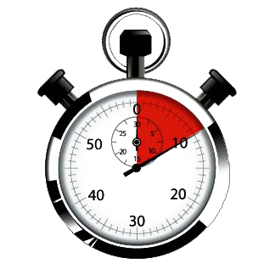
Tip 1

Slide 231
Tip 1

Slide 232
Tip 2

Slide 233

Tip 2

Slide 234
Tip 2
Avoid Conflict of Interest
Address Conflict of Interest

Slide 235
Tip 3

Slide 236

Tip 3

Slide 237
Tip 3

Slide 238

Tip 3

Slide 239
Tip 3
Charge lots of money

Slide 240
Tip 4

Slide 241

Tip 4

Slide 242
Tip 4
Question

Slide 243
Tip 4
Answer
Question

Slide 244
Tip 4
Answer
Question
Answer the question asked
Understand the scope of your engagement

Slide 245
Tip 4
Answer
Question
Answer the question asked
Understand the scope of your engagement

Slide 246
Tip 4
Question
Answer
Answer the question asked
Understand the scope of your engagement

Slide 247
Tip 4
Answer
Question
Answer the question asked
Understand the scope of your engagement

Slide 248
Tip 4
Question
Answer the question asked
Understand the scope of your engagement

Slide 249
Tip 4
What is the meaning of life?
Answer the question asked
Understand the scope of your engagement

Slide 250
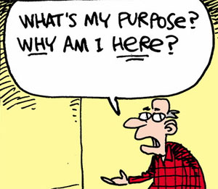
Tip 4
What is the meaning of life?
Answer the question asked
Understand the scope of your engagement

Slide 251
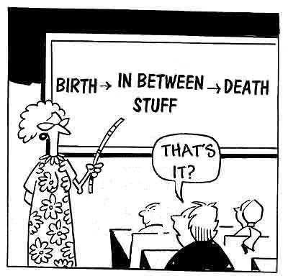
Tip 4
What is the meaning of life?
Answer the question asked
Understand the scope of your engagement

Slide 252
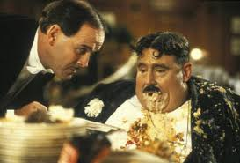
Tip 4
What is the meaning of life?
Answer the question asked
Understand the scope of your engagement

Slide 253
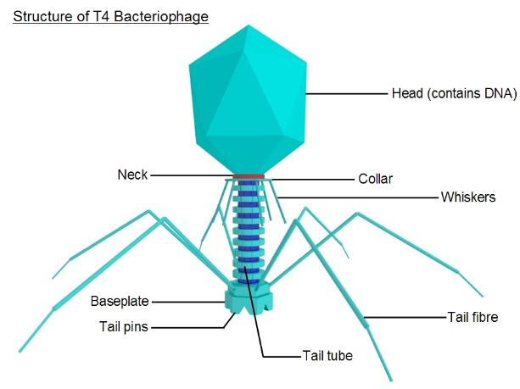
Tip 4
What is the meaning of life?
Answer the question asked
Understand the scope of your engagement

Slide 254
End of Part 2
Tips on Dealing
with Lawyers

Slide 255
Part 3

Slide 256
Part 3
Opportunities in
Patent Law

Slide 257
Two Types of Patent Law

Slide 258
Two Types of Patent Law
Patent Procurement
Patent
Litigation

Slide 259
Two Types of Patent Law
Patent Procurement
Patent
Litigation
Get patents for clients
Patent Attorney
  Law school, state bar,
  BS in sci/eng, patent bar

Slide 260
Two Types of Patent Law
Patent Procurement
Patent
Litigation
Get patents for clients
Patent Attorney
  Law school, state bar,
  BS in sci/eng, patent bar
Litigate matter about the patent in a court
Litigator
  Law school, state bar
  Usually assisted by patent attorney

Slide 261
Two Types of Patent Law
Patent Procurement
Patent
Litigation
Get patents for clients
Patent Attorney
  Law school, state bar,
  BS in sci/eng, patent bar
Patent Agent
  BS in sci/eng, patent bar
Litigate matter about the patent in a court
Litigator
  Law school, state bar
  Usually assisted by patent attorney

Slide 262
Two Types of Patent Law
Patent Procurement
Patent
Litigation
Get patents for clients
Patent Attorney
  Law school, state bar,
  BS in sci/eng, patent bar
Patent Agent
  BS in sci/eng, patent bar
Litigate matter about the patent in a court
Litigator
  Law school, state bar
  Usually assisted by patent attorney

Slide 263
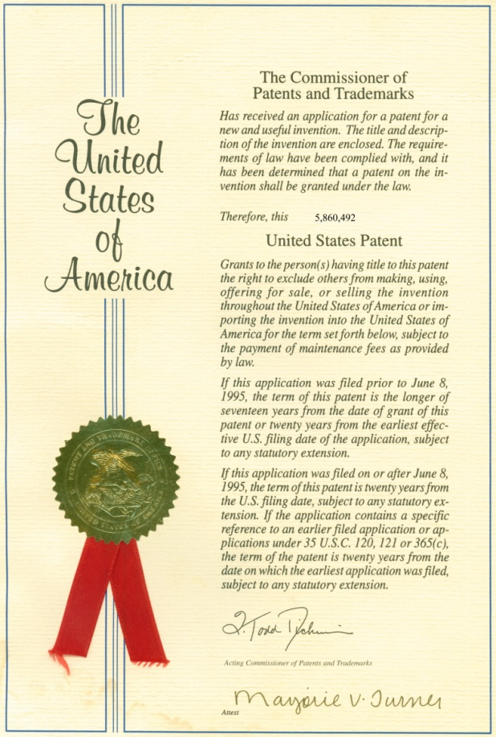

Slide 264
Process of Getting a Patent

Slide 265
Process of Getting a Patent

Slide 266
Process of Getting a Patent

Slide 267
Process of Getting a Patent
Conception

Slide 268
Process of Getting a Patent
Conception

Slide 269
Process of Getting a Patent
Conception

Slide 270
Process of Getting a Patent
Reduction to Practice
Conception

Slide 271
Process of Getting a Patent
Reduction to Practice
Conception

Slide 272
Process of Getting a Patent
Reduction to Practice
Conception

Slide 273
Process of Getting a Patent
Draft
Reduction to Practice
Conception

Slide 274
Process of Getting a Patent
Draft
Reduction to Practice
Conception

Slide 275
Process of Getting a Patent
Draft
Reduction to Practice
Application
Conception

Slide 276
Process of Getting a Patent
Draft
Reduction to Practice
Application
Conception

Slide 277
Process of Getting a Patent
Draft
Reduction to Practice
Application
Conception

Slide 278
Process of Getting a Patent
Draft
Reduction to Practice
Application
Conception
PTO

Slide 279
Process of Getting a Patent
Draft
Reduction to Practice
Application
Conception
PTO

Slide 280
Process of Getting a Patent
Draft
Reduction to Practice
Application
Conception
PTO

Slide 281
Process of Getting a Patent
Draft
Reduction to Practice
Application
Conception
PTO

Slide 282
Process of Getting a Patent
Draft
Reduction to Practice
Application
Conception
PTO

Slide 283
Process of Getting a Patent
Draft
Reduction to Practice
Application
Conception
PTO

Slide 284
Process of Getting a Patent
Draft
Reduction to Practice
Application
Conception
PTO
Prosecution

Slide 285
Process of Getting a Patent
Draft
Reduction to Practice
Application
Conception
PTO
Prosecution

Slide 286
Process of Getting a Patent
Draft
Reduction to Practice
Application
Conception
PTO
Prosecution

Slide 287
Process of Getting a Patent
Draft
Reduction to Practice
Application
Conception
PTO
Prosecution

Slide 288
Process of Getting a Patent
Draft
Reduction to Practice
Application
Conception
Licensing
PTO
Prosecution

Slide 289
Where is the Money in Patents
Application preparation ($7,000-$10,000)
Application prosecution ($5,000-$15,000)
  International: several times as big

Slide 290
Where is the Money in Patents
Application preparation ($7,000-$10,000)
Application prosecution ($5,000-$15,000)
  International: several times as big
Opinion Preparation
  Patentability ($2,000)
  Freedom to Operate ($10,000)
  Patent Infringement ($10,000)
  Patent Invalidity ($10,000)

Slide 291
Where is the Money in Patents
Application preparation ($7,000-$10,000)
Application prosecution ($5,000-$15,000)
  International: several times as big
Opinion Preparation
  Patentability ($2,000)
  Freedom to Operate ($10,000)
  Patent Infringement ($10,000)
  Patent Invalidity ($10,000)
Interpartes Proceedings ($350,000)
Litigation ($600,000 - $5,000,000)

Slide 292
How Can a Scientist/Engineer Help with Patent Application Preparation
Limited opportunities in normal circumstances
Special circumstances
  Very large application
  Time constraint or budget constraint
  Highly efficient preparation process
  Complex technology well understood by the consultant
Being a Patent Agent is preferred

Slide 293
How Can a Scientist/Engineer Help in Patent Application Prosecution
Generally in cases with big budgets or with complex problems
Answer very specific highly technical questions posed by the attorney based on Examiner’s rejections
Familiarity with patents is preferred

Slide 294
How Can a Scientist/Engineer Help with a Patentability Opinion
A client wants to find out if an invention is patentable; “Can we patent this?”
Search patent and open literature for similar products
Excellent opportunity for consultants
Most technically/least legally demanding opinion of the 4 opinions for consultants

Slide 295
How Can a Scientist/Engineer Help with a Freedom to Operate Opinion
A client wants to find out if a product is covered by someone else’s patent: “Can we market this, or are we going to get sued?”
Usually before entry into a new business
Search patents for similar products
Excellent opportunity for consultants
Need working knowledge of patents

Slide 296
End of Part 3
Patent Procurement

Slide 297
Opportunities in
Litigation

Slide 298
Part 4
Opportunities in
Pre-Trial
Patent Litigation

Slide 299
Summary of Patent Litigations
Patent Owner vs Competitor
  (Plaintiff) (Defendant)
Patent Owner files a suit:
  “You are infringing my patent!”
Competitor has two defenses:
  “No, we don’t. We are outside of your claims.”
  “Your patent is no good.”

Slide 300
How an Expert Can Help with an Infringement Defense
The “We are outside your Claims” defense
Attorney constructs the patent claims, compares the accused product to such claims, and renders an opinion that the product infringes (if plaintiff) or does not infringe (if defendant)
Limited opportunities for consultants

Slide 301
How an Expert Can Help with an Invalidity Defense
The “Your Patent is No Good” defense
The Defense Attorney argues that the patent is not enforceable, not valid
  There are problems with 101, 102, 103, 112, inventorship, ownership, inequitable conduct, etc.
Great opportunities for consultants
  Extremely thorough prior art searches
  Extremely well connected consultants

Slide 302
End of Part 4
Pre-Trial
Patent Litigation

Slide 303
Part 5
Opportunities as
an Expert Witness

Slide 304
How an Expert Can
Further Help with Litigation
Educate attorney, analyze evidence
Act as Expert Witness
  Draft reports, technical opinions
  Deposed by opposition prior to trial
  Give a testimony at trial
Expert Witness has a potential for great money

Slide 305
Expert Opinion
An Expert Opinion Contains
An Expert Opinion Is Not
Basis for Opinion
Sufficient explanation to allow reproduction of calculations by a qualified individual
Assumptions & their basis
A collection of technicalities
A group of unsupported declarations
Derived from unsupported facts

Slide 306
How do Lawyers Find and Select Expert Witness?
The Lawyer needs to know the Expert’s abilities.
The Lawyer needs to know how the Expert looks, and sounds.
The Expert needs to have a clean record
  LinkedIn, Google, Facebook, YouTube, etc.
Can the Expert deliver?

Slide 307
How do Lawyers Select
An Expert Witness
Technical Prowess
Experience
Personality
Demeanor
Integrity
Credibility

Slide 308
How do Lawyers Select
An Expert Witness
Technical Prowess
Experience
Personality
Demeanor
Integrity
Credibility
These are listed in
REVERSE
order of importance!

Slide 309
How Expert Witness’
Traits Are Ranked
By Lawyers
By Juries
Education
Experience
Likeability
Likeability
Experience
Education

Slide 310
Required Expert Witness Traits
Everything revolves around credibility
  Have excellent communication skills
  Be consistent, both internally & externally
  Self-confidence, tenacity
  No skeletons in the closet
  Be a leader in your field (publish, teach, etc.)
  Have an advanced degree, certification
It is what it is
  Get bad facts out, so that they can be explained away

Slide 311
Expert Witness Credibility
An expert is not an advocate
  let the attorney lead
An expert does not need to win the case with the answer
A concession may be the honest answer on cross examination
Understand the “CSI Effect”

Slide 312
Communication Skills
Answer the questions
Answer fully
Answer concisely
Avoid jargon
Speak up as needed
Non-verbal communication is also important
Don’t try to impress how smart you are
Don’t argue on cross

Slide 313
Qualification of Expert Witness through Voir Dire
Before the Expert Witness can testify, the Expert Witness needs to be qualified
But also use Voir dire to establish trust, role, tone
This is a chance for the Expert to sell self

Slide 314
End of Part 5
Litigation

Slide 315
Peter D. Mlynek, Ph.D., MBA, Esq.
peter@mlyneklaw.com
856-787-0880

Slide 316
Witness: Lay or Expert
Rule 701. Opinion Testimony by Lay Witnesses
  If the witness is not testifying as an expert, the witness' testimony in the form of opinions or inferences is limited to those opinions or inferences which are (a) rationally based on the perception of the witness, and (b) helpful to a clear understanding of the witness' testimony or the determination of a fact in issue, and (c) not based on scientific, technical, or other specialized knowledge within the scope of Rule 702.
Rule 702. Testimony by Experts
  If scientific, technical, or other specialized knowledge will assist the trier of fact to understand the evidence or to determine a fact in issue, a witness qualified as an expert by knowledge, skill, experience, training, or education, may testify thereto in the form of an opinion or otherwise, if (1) the testimony is based upon sufficient facts or data, (2) the testimony is the product of reliable principles and methods, and (3) the witness has applied the principles and methods reliably to the facts of the case.

Slide 317
Testimony by Expert Witness
Rule 703. Bases of Opinion Testimony by Experts
  The facts or data in the particular case upon which an expert bases an opinion or inference may be those perceived by or made known to the expert at or before the hearing. If of a type reasonably relied upon by experts in the particular field in forming opinions or inferences upon the subject, the facts or data need not be admissible in evidence in order for the opinion or inference to be admitted. Facts or data that are otherwise inadmissible shall not be disclosed to the jury by the proponent of the opinion or inference unless the court determines that their probative value in assisting the jury to evaluate the expert's opinion substantially outweighs their prejudicial effect.

Slide 318
Types of Law
Corporate Law
Consumer Protection
Contract
Bankruptcy
Criminal Law
Human Rights
Environmental
Energy Law
Family
Intellectual
Property
Torts
Aviation
National
Security
Real Estate
Administrative
Product Liability
Labor
Tax Law
Commercial
Health
Admiralty
Business Law
Immigration
Banking
Constitutional
Drug
Insurance

Slide 319
Intellectual
Property

Slide 320
Intellectual
Property

Slide 321
©
Intellectual
Property

Slide 322
©
Intellectual
Property

Slide 323
©
Intellectual
Property
®

Slide 324
©
Intellectual
Property
®

Slide 325
Patents
©
Intellectual
Property
®

Slide 326
Patents
©
Intellectual
Property
®

Slide 327
Patents
©
Intellectual
Property
®
Trade Secrets

Slide 328
Work Protected
Patents
©
Intellectual
Property
®
Trade Secrets

Slide 329
Work Protected
Patents
©
Expression
Intellectual
Property
®
Trade Secrets

Slide 330
Work Protected
Patents
©
Expression
Intellectual
Property
®
Symbols, Names
Trade Secrets

Slide 331
Work Protected
Patents
Inventions
©
Expression
Intellectual
Property
®
Symbols, Names
Trade Secrets

Slide 332
Work Protected
Patents
Inventions
©
Expression
Intellectual
Property
®
Symbols, Names
Trade Secrets
Information

Slide 333
Patents
©
Intellectual
Property
®
Trade Secrets

Slide 334
Cost to get protection
Patents
©
Intellectual
Property
®
Trade Secrets

Slide 335
Cost to get protection
Patents
©
Intellectual
Property
®
Trade Secrets
Nada

Slide 336
Cost to get protection
Patents
©
$
Intellectual
Property
®
Trade Secrets
Nada

Slide 337
Cost to get protection
Patents
©
$
Intellectual
Property
®
$$
Trade Secrets
Nada

Slide 338
Cost to get protection
Patents
$$$$
©
$
Intellectual
Property
®
$$
Trade Secrets
Nada

Slide 339
Patents

Slide 340
Patents

Slide 341
Patents
Mechanical

Slide 342
Patents
Mechanical

Slide 343
Patents
Chemical
Mechanical

Slide 344
Patents
Chemical
Mechanical

Slide 345
Patents
Chemical
Mechanical
Electrical

Slide 346
Patents
Chemical
Mechanical
Electrical
Hardware
Software

Slide 347
Patents
Chemical
Mechanical
Electrical
Biotech
Hardware
Software
Pharmaceutical

Slide 348
Patents
Chemical
Mechanical
Electrical
Biotech
Hardware
Software
Pharmaceutical
Business methods

Slide 349
Patents
Chemical
Mechanical
Electrical
Biotech
Medical Devices
Hardware
Software
Pharmaceutical
Business methods

Slide 350
What is a Patent?

Slide 351
What is a Patent?

Slide 352
What is a Patent?

Slide 353
What is a Patent?

Slide 354
What is a Patent?

Slide 355
What is a Patent?

Slide 356
What is a Patent?

Slide 357
What is a Patent?
Full Disclosure of an Invention

Slide 358
What is a Patent?
Full Disclosure of an Invention
Exclusive Right

Slide 359
Exclusive Right

Slide 360
Exclusive Right to…

Slide 361
Exclusive Right to…

Slide 362
Exclusive Right to…

Slide 363
Exclusive Right to…

Slide 364
Exclusive Right to…

Slide 365
Exclusive Right to…

Slide 366
Exclusive Right to…

Slide 367
Exclusive Right to…
Competitors

Slide 368
Exclusive Right to…
Competitors

Slide 369
Exclusive Right to…
Competitors

Slide 370
Exclusive Right to…
Competitors

Slide 371
Exclusive Right to…
Competitors

Slide 372
Exclusive Right to…
Competitors

Slide 373
Exclusive Right to…
Competitors

Slide 375
What is a Patent?

Slide 376
What is a Patent?
Monopolistic Tool

Slide 377
What is a Patent?
Monopolistic Tool
Capital Raising Tool

Slide 378
What is a Patent?
Monopolistic Tool
Capital Raising Tool
Marketing Tool

Slide 379
What is a Patent?
Monopolistic Tool
Capital Raising Tool
Marketing Tool
Cross Licensing Tool

Slide 380
What is a Patent?
Monopolistic Tool
Capital Raising Tool
Marketing Tool
Cross Licensing Tool
A tool to make money

Slide 382
How Much to Get a U.S. Patent?

Slide 383
How Much to Get a U.S. Patent?

Slide 384
How Much to Get a U.S. Patent?

Slide 385
How Much to Get a U.S. Patent?

Slide 386
How Much to Get a U.S. Patent?

Slide 387
How Much to Get a U.S. Patent?

Slide 388
How Much to Get a U.S. Patent?

Slide 389
How Much to Get a U.S. Patent?

Slide 391
Why so much?

Slide 392
Law Firm Organization
1M+ lawyers in 50,000 law firms in US
  Conflicts, no economy of scale, easy to move

Slide 393
Tests for Obviousness
KSR v. Teleflex, 550 U.S. 398 (2007)
(A) Combining prior art elements according to known methods to yield predictable results;
(B) Simple substitution of one known element for another to obtain predictable results;
(C) Use of known technique to improve similar devices (methods, or products) in the same way;
(D) Applying a known technique to a known device (method, or product) ready for improvement to yield predictable results;
(E) "Obvious to try" – choosing from a finite number of identified, predictable solutions, with a reasonable expectation of success;
(F) Known work in one field of endeavor may prompt variations of it for use in either the same field or a different one based on design incentives or other market forces if the variations are predictable to one of ordinary skill in the art;
(G) Some teaching, suggestion, or motivation in the prior art that would have led one of ordinary skill to modify the prior art reference or to combine prior art reference teachings to arrive at the claimed invention.

Slide 394
Requirements to Obtain a Patent
Useful
Generally, a low hurdle to overcome in cases of chemical, pharma, and mechanical hardware inventions.
Questions about patentability with respect to usefulness come up in
Biological technology
Computer programs
- Finance
Whoever invents or discovers any new and useful process, machine, manufacture, or composition of matter, or any new and useful improvement thereof, may obtain a patent therefor,
AIA: Tax strategies are no longer patentable;
Human organism is not patentable

