Slide 1
SENSORS: PAST, PRESENT AND FUTURE
Opportunities for Consultants
John Newport February 7, 2018
jflnewport@chemventive.com

Slide 2
OVERVIEW
Some definitions
A little history
The present day –an explosion of interest in sensors
What the future might hold

Slide 3
Sensor Definitions
A device that responds to a physical stimulus (as heat, light, sound, pressure, magnetism, or a particular motion) and transmits a resulting impulse (as for measurement or operating a control)
Merriam Webster [Misses chemical]
A device that detects and responds to some type of input from the physical environment. The specific input could be light, heat, motion, moisture, pressure, or any one of a great number of other environmental phenomena. ... In a mercury-based glass thermometer, the input is temperature. From WhatIs.com
A mechanical device sensitive to light, temperature, radiation level, or the like, that transmits a signal to a measuring or control instrument. Dictionary.com

Slide 4
Sensor Definitions
In the broadest definition, a sensor is an electronic component, module, or subsystem whose purpose is to detect events or changes in its environment and send the information to other electronics, frequently a computer processor. A sensor is always used with other electronics, whether as simple as a light or as complex as a computer. Wikipedia
A device which detects or measures a physical property and records, indicates, or otherwise responds to it. OED
[ small, low cost, chemical, biological]

Slide 5
Sensors through History
Weights and Measures
Time (Calendars~ 4000 -3000 BC , Sundials, Obelsiks, Clocks 2000 BC)
Navigation (Compass Han Dynasty ( 206 BC – 220 AD )
Temperature (0 AD - )
Seismic (123 AD)
Humidity (1480 AD)

Slide 6
Sensors through History
Compound Microscope ~ 1600
Optical Telescope (1608)
Pressure (barometric) ~ 1640
Litmus paper 1800s (Gay Lussac?)
Photosensitivity (1800)
Electromagnetic & photovoltaic (1820 - )
Piezoelectric (1880)
Radio &Photoelectric (Hertz 1887)
Radioactivity (1897)

Slide 7
Sensors through History 20th Century
Chemical instrumentation: pH meter , Spectroscopy ir uv, Chromatography, Mass spec, NMR
Safety: Smoke , CO , hydrocarbon detectors (~ 1970 for personal use)
MEMS (accelerometers) (position and movement sensors in video games and cell phones)

Slide 8
Some Early Sensors
A QUICK LOOK AT
SOME EXAMPLES

Slide 9
Some Early Sensors
The easterly orientation of Mnajdra, Malta 4th millennium BC temple suggests that the temple may have served as one of the world’s oldest solar calendars. On the Equinox days, a ray of sun enters the temple and lights up its main axis. On the Solstices, sunlight illuminates the entrance chamber’s megaliths.

Slide 10
Some Early Sensors
3000 – 2000 BC INDICATES SUMMER SOLSTICE

Slide 11
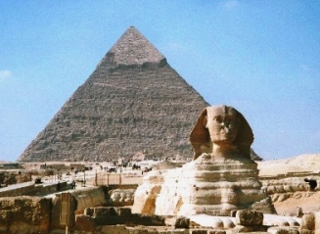
Some Early Sensors
(8000) – 2500 BC SPHINX GAZES DUE EAST TO WHERE THE SUN RISES ON THE MORNING OF THE SPRING EQUINOX

Slide 12
Some Early Sensors
Angkor Wat, Cambodia 12TH Century AD
Spring Equinox

Slide 13
Some Early Sensors
The ancient Egyptians divided the day into 2 12 hour periods and used large obelisks to track the movement of the sun.
They developed water clocks and the Zhou dynasty in China used them around the same time in 2000 BC
Other timepieces included sundials ,candle and hour glasses
First accurate mechanical clocks invented in Europe in the 14th Century
Pendulum clock and pocket watches in the 17th Century
Quartz oscillators and atomic clocks in the 20th Century

Slide 14
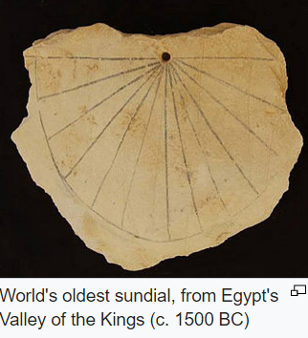
Some Early Sensors

Slide 15
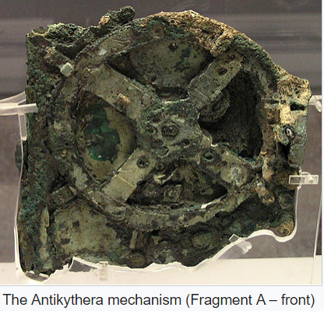
Some Early Sensors
The Antikythera mechanism is an ancient analog computer and orrery used to predict astronomical positions and eclipses for calendrical and astrological purposes as well as the ancient Olympic Games. Found housed in a 13 in × 7.1 in)× 3.5 in wooden box, the device is a complex clockwork mechanism composed of at least 30 meshing bronze gears. Its remains were found as one lump. 205 – 100 BC

Slide 16
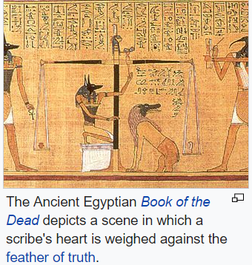
Some Early Sensors - SCALES
The oldest evidence for the existence of weighing scales dates to c. 2400–1800 B.C. in the Indus River valley (from weights that have been found). Relative scales predate them

Slide 17
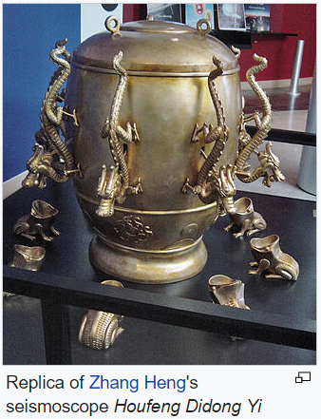
Some Early Sensors
AD 132

Slide 18
Sensors – During 20th Century
Temperature
Pressure-barometric
Photoelectric
Burglar alarms
Smoke, Carbon Monoxide
Hydrocarbon
Accelerometers - airbags

Slide 19
Present Day Sensors
Smart phone fitness aps and bracelets, Fitbit
Lots of activity in the medical area (Dermal, Ocular, Breath devices)
Biosensors
Explosion of interest in sensors in general

Slide 20
Open Innovation
Innocentive.com
Idea Connection.com
Nine Sigma (https://ninesights.ninesigma.com/projects
Challenge.gov
SBIR, STTR, SBV

Slide 21
Recent Sensor Challenges
https://www.sbir.gov/Sensor-technology-for-the-21st-century
Sensor Technology for the 21st Century
This web page on sensor technology is designed to help sensor developers locate SBIR and/or STTR funding opportunities across federal agencies. The U.S. Government is a significant driver of sensor innovation: investing in low cost, portable, easy-to-use technologies to facilitate the collection of real time, reliable measurement information.

Slide 22
Recent Sensor Challenges
WILDLAND FIRE SENSOR
Chemistry Computer Science/Information Technology Engineering/Design EnvironmentPhysical Sciences Public Good RTP
AWARD: $60,000 USD
DEADLINE: Nov 22 2017 23:59 EST
ACTIVE SOLVERS: 112
POSTED: Apr 06 2017
SOURCE: InnoCentive
The solution is a field-ready prototype system that includes one central data receiving unit and at least two sensor nodes measuring fine particulate matter (PM_{2.5}), carbon monoxide (CO), ozone (O₃), and carbon dioxide (CO₂) that communicates data wirelessly and measures a wide dynamic range of concentration levels expected during wildland fires (EPA)

Slide 23
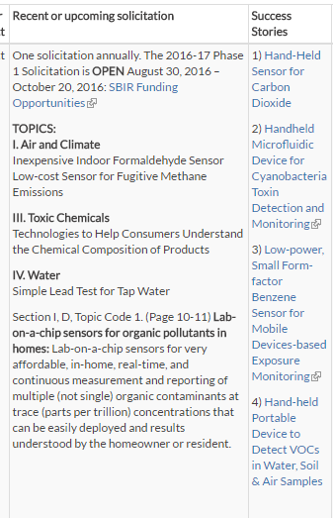

Slide 24
Recent Sensor Challenges
The U.S. Environmental Protection Agency (USEPA) (the Seeker) in collaboration with the U.S. Geological Survey (USGS) and The Nature Conservancy (TNC) seeks to identify and spur development of technologies to monitor nitrogen concentration in effluent from advanced Onsite Wastewater Treatment Systems (OWTS). Phase I of this Challenge program is an Ideation Challenge to gain a better understanding of low cost sensor technology that could be utilized to detect and measure nitrate and ammonium, or total nitrogen in the effluent of advanced OWTS. If this initial Ideation is successful, future phases of the Septic Challenge program will include prototype development and testing.

Slide 25
Recent Sensor Challenges
EPA identified arsenic as a high priority water quality parameter in urgent need of sensor technology advancement. Arsenic in drinking water is associated with several public health risks including cancer and non-cancer effects. EPA and a number of partner agencies and organizations undertook a detailed process to learn from users about their performance specifications and functionality requirements for a new arsenic sensor.

Slide 26
Recent Sensor Challenges
AWARD: $15,000 USD
DEADLINE: May 03 2017 23:59 EDT
ACTIVE SOLVERS: 240
POSTED: Apr 03 2017
SOURCE: InnoCentive
The Challenge is to design a sensor that gives engine oil health in real time.

Slide 27
Recent Sensor Challenges
Asset Tracking Proximity Sensor
RFP Description
NineSigma, representing a multinational company, invites proposals for a hand-held proximity sensor that permits a user to accurately and quickly identify and locate a tagged and potentially mobile asset.
Background
NineSigma’s client markets mobile asset tracking systems that utilize active radio frequency identification (RFID) tags. Assets are mobile, at velocities < 2 mph, within confined areas less than 100 yd x 100 yd. It is important to be able to find one particular asset amongst many (100-200) within this confined area.

Slide 28
Recent Sensor Challenges
https://sbir.defensebusiness.org/topics#topic28735
Component: ARMY
Topic #: A17-129
Title: Interchangeable Ballistic Dynamic Pressure-Temperature Sensor
Technology Areas: Weapons
OBJECTIVE: Design, Fabricate and qualify a compact sensor that can be used to acquire either ballistic pressure or ballistic temperature profiles with the same form factor, that can be used in already ported gun tubes being tested.
Notes:
Wearable Flexible and Stretchable Glove Biosensor for On-Site Detection of Organophosphorus Chemical Threats

Slide 29
Recent Sensor Challenges
The Seeker owns technology that can detect the close proximity of a human hand based on capacitance. It works quite well, but has failure problems with outdoor conditions such as rain (moisture), snow, dirt and dust. The Seeker would like Solvers to design a new sensor system to accomplish the proximity detection that can also withstand the outdoor ambient conditions without failure. The new system cannot be based on capacitance.

Slide 30
Recent Sensor Challenges
Haier posted this Technology Call
Seeking for bacteria detection method used in closed spaceNowadays, consumers are more and more concerned about food safety and health. Food even stored properly may still grow bacteria with time goes on. So now we are seeking for technologies or solutions that can detect the total microbial counts in a closed space that can be integrated with refrigerator.
On innoget.com

Slide 31
Recent Sensor Challenges
Novel sensors with applications in wearable technologies and/or in clinical research
GSK are always looking for novel ways to support the clinical research process, developing new medicines more efficiently, proving their worth more effectively and supporting patients in every way possible. As we all become more familiar with technology in our lives from wearable sensors to smart phone apps, expectations for the use of technology in clinical research is increasing. This expectation comes both from patients and their healthcare professionals taking part in the clinical research. GSK are looking for collaborative partners to work to deliver new ways to use sensors and “wearables” to move the clinical research paradigm forward. (current NineSigma request)

Slide 32
ACS Journal of Sensors (begun 2016)
Wearable Flexible and Stretchable Glove Biosensor for On-Site Detection of Organophosphorus Chemical Threats
Detection of Methanol with Fast Response by Monodispersed Indium TLabel-Free Detection of Small Organic Molecules by Molecularly Imprinted Polymer
Functionalized Thermocouples: Toward In Vivo Applicationsngsten Oxide Ellipsoidal Nanospheres
Mechanistic Challenges and Advantages of Biosensor Miniaturization into the Nanoscale
In Search of the Ultimate Benzene Sensor: The EtQxBox Solution
Highly Enriched, Controllable, Continuous Aerosol Sampling Using Inertial Microfluidics and Its Application to Real-Time Detection of Airborne Bacteria

Slide 33
Some Technologies
Nano chemistry (U of Penn)
Surface science/adsorption
Microfluidics(transport, mixing, light and electrically controlled surface chemistry drivers)
MEMS (microelectromechanical systems)
Paper based (Whitesides & Others)
Printable, flexible electronics
iOT/ LoRa

Slide 34
Some Technologies
So, new sensors are likely to require the marriage of a number of technologies and disciplines which creates opportunities for us.

Slide 35
Sensors - Future
SMART CLOTHING
https://www.wareable.com/smart-clothing/best-smart-clothing
Much more than strapping gadgets to our wrists, faces, ears and feet, smart clothing can constantly track our heart rate, monitor our emotions and even pay for our Starbucks. All without grabbing a phone or even tapping a smartwatch screen.
Reviews available for products for athletes, sunbathers, babies.

Slide 36
Sensors - Future
"Chemiluminescence is considered one of the most sensitive methods used in diagnostic testing," said Doron Shabat of TAU's School of Chemistry, who led the research.
"We have developed a method to prepare highly efficient compounds that emit light upon contact with a specific protein or chemical. These compounds can be used as molecular probes to detect cancerous cells, among other applications."

Slide 37
Sensors - Future
“Neural dust", which tracks nerve signals and muscles in real time, opening up a wide array of potential applications that range from checking internal organs to wirelessly controlling prosthetics with your mind. Neural dust is more than just a catchy name. Scientists, have managed to squish the sensors into 1 mm cubes around the size of a large grain of sand, and implanted them into the muscles and peripheral nerves of rats.
These cubes house piezoelectric crystals that turn ultrasound vibrations (applied from outside the body) into electricity. This provides a power source for a miniature on-board transistor that rests in contact with the nerve to measure electrical activity.

Slide 38
Sensors – Future
Nail varnish that detects date rape drugs set for release after getting millions in investment
If a common date rape drug such as rohypnol,
Xanax or GHB is present the nail will change
color, according to the creators.

Slide 39
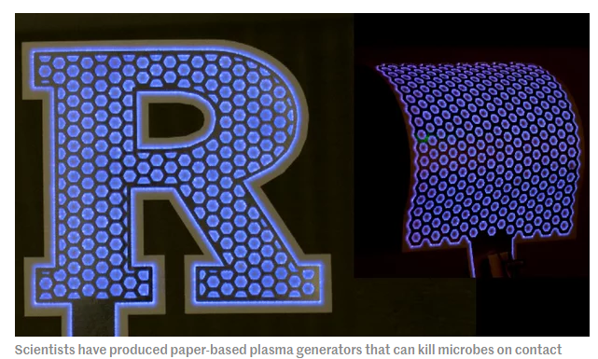
(Sensors) – Future
Paper-based plasma generators zap bacteria
With some strains of bacteria becoming increasingly resistant to antibiotics, contamination by touching infected surfaces or coming into contact with airborne microbes is fast becoming a real threat to public health.
Scientists at Rutgers University have come up with a way to produce paper-based plasma generators. These could be worn on clothing or fitted to equipment, to zap any bug they come into contact with cheaply and easily.

Slide 40
Sensors – Future
Bio-sensing Contact Lens Could Someday Measure Blood Glucose, Other Bodily Functions
“Transparent biosensors embedded into contact lenses could soon allow doctors and patients to monitor blood glucose levels and a host of other telltale signs of disease without invasive tests.”.

Slide 41
Sensors – Future
Forget shots – diabetes smartphone app tells cells when to produce insulin
But what if there was a way to trigger the body to produce insulin on demand? That's exactly what a team of scientists from China has done by creating a system that uses a smartphone to direct engineered cells to produce insulin when needed.
Led by East China Normal University's Haifeng Ye, the solution is inspired by smart home systems and marries telecommunications technology with two emerging fields of medicine: cell-based therapy and optogenetics, a technique that makes use of light to regulate cellular activity and one that has been used in a variety of novel experiments to restore heart rhythms, reverse blindness

Slide 42
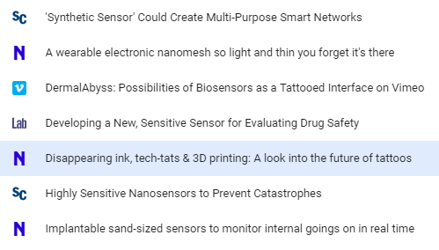
Sensors – Bookmarks

Slide 43
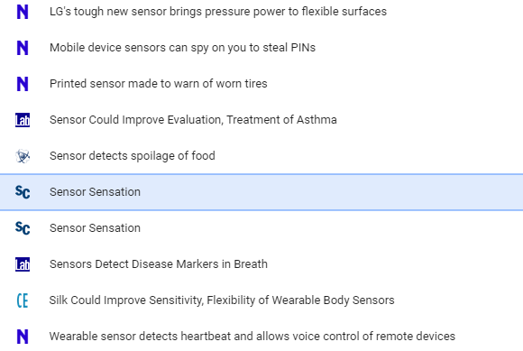
Sensors – Bookmarks

Slide 44
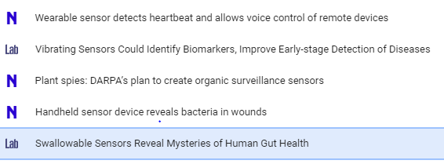
Sensors – Bookmarks

Slide 45
Sensors – Bookmarks

Slide 46
Sensors – Future
Neuralink’s “whole brain interface” will use tiny brain electrodes that will eventually allow us to communicate wirelessly with the world, and to share our exact thoughts and visions without having to use spoken or written language. The brain could also learn faster and have access to all the world’s knowledge.
“I think we are about eight to ten years away from this being usable by people with no disability,” Musk said (I hope not!)

Slide 47
Sensors – Future for you
?

