Slide 1


Flow Chemistry
- an overview
Presentation to the
Chemical Consultants Network
Jan 9, 2019
Peter J. Joyce
Systems Integration Director
Sentinel Process Systems
Hatboro, PA
pjj@kilolabs.com
215-528-2079

Slide 2
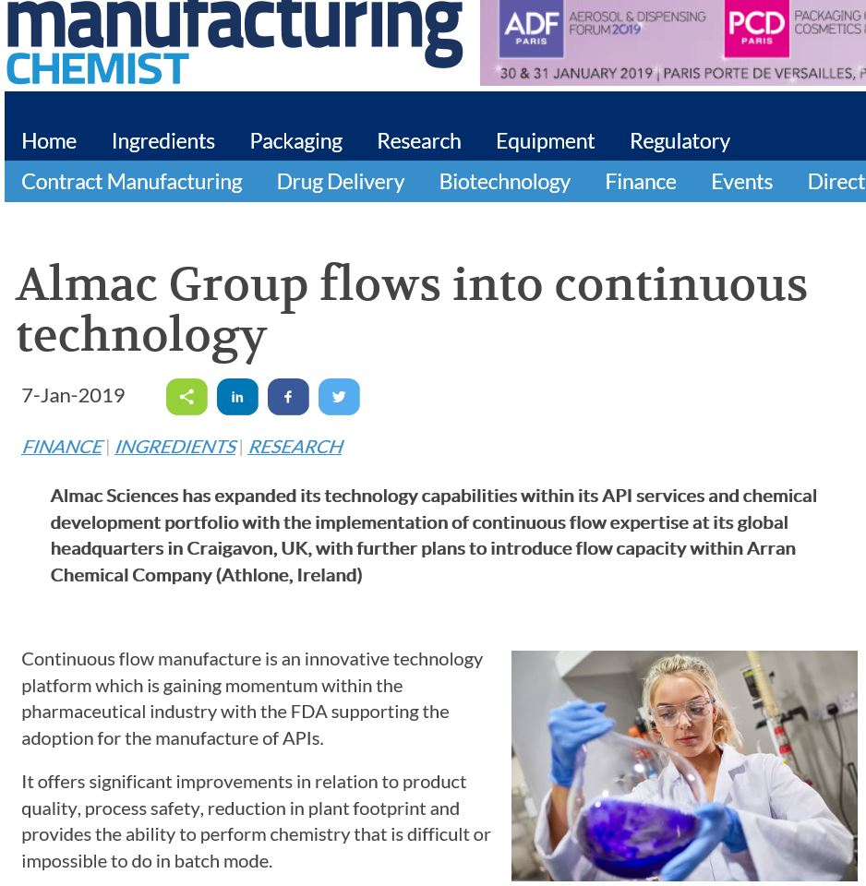

Slide 3

Batch vs Continuous Operation – Simple Comparison
10cc Reactor Volume - Surface Area / Volume Ratio
Volumetric Flask 1.8
Coiled Reactor 25.1
Heat Removal in an Exothermic reaction
Q = U x A x ΔT
Q - Heat Release – Kcal/hr
U – Heat transfer coefficient – Kcal/(M²-Hr-deg C)
A – Heat transfer area – M²
ΔT - Differential Temp between reactants and heat transfer fluid, deg C
Result - needed ΔT plummets!

Slide 4
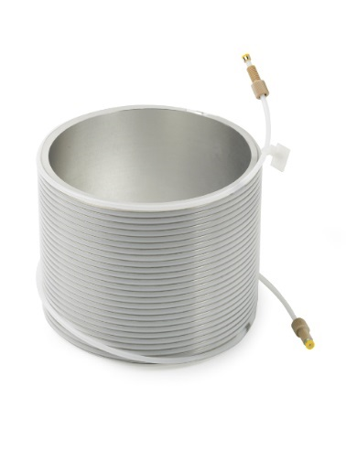

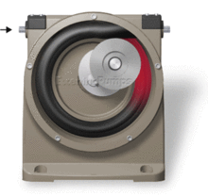

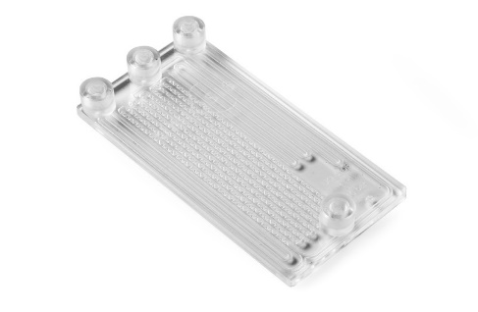
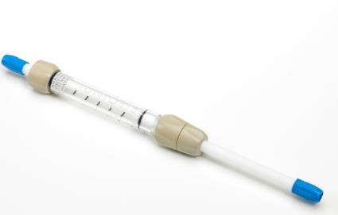

What is flow (tube) chemistry?
Performing a reaction continuously, small > large scale
through either a coil, static mixer or fixed bed reactor.
OR
Product collection
Pump reactants
Reactor

Slide 5
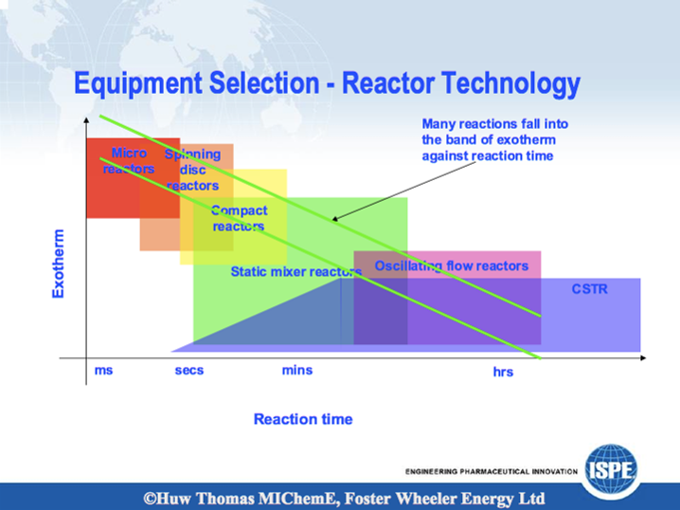

Slide 6
Reactor Types and Strategies
Flow Tube
Homogeneous, non-precipitating, reaction screening, low pressure drop
Micro Channel Reactor – Integral Static Mixers
Direct Scale up path to tons/day, High Mixing, non-precipitating, excellent heat transfer
(External) Agitated Reactors
Good for slurries/ solids, plug flow at low throughput, no seals or drive shaft
Spinning Disk Reactors
Extremely high shear mixing, highly exothermic reactions, at short residence times.

Slide 7
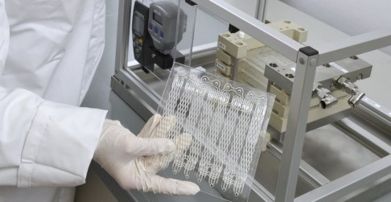
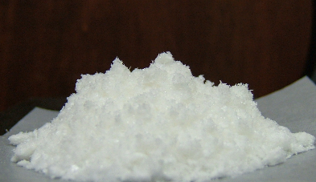
Production using KiloFlow®:
Synthesis of (Z)-Ethyl-2-cyano-3-phenylacrylate
Prior to production, the reaction was optimised in Labtrix® (10 μl);
Base stoichiometry (0.2 eq.)
Reaction time (1.5 min)
Equal solution flow rates
Reactor temperature 90 ºC
Under these pre-defined conditions, KiloFlow® was used to produce the condensation product;
Operating for 3 h, 89.31 g of (Z)-ethyl-2-cyano-3-phenylacrylate was obtained in high yield;
  Upon precipitation with DI H₂O (98.7 % yield)
x 7300
Notes:
7

Slide 8
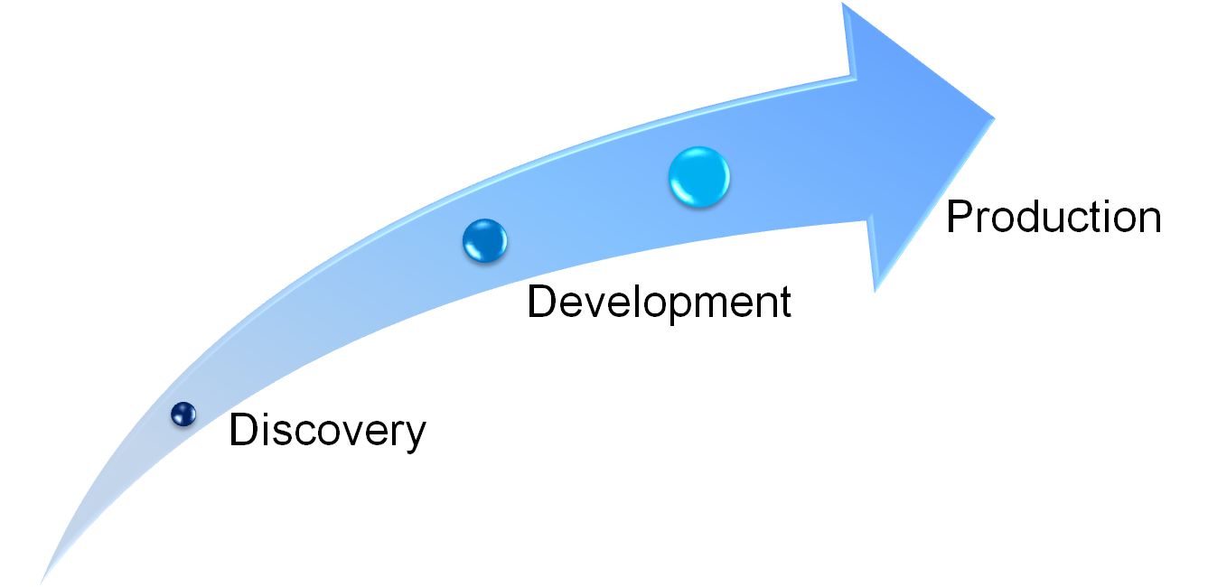
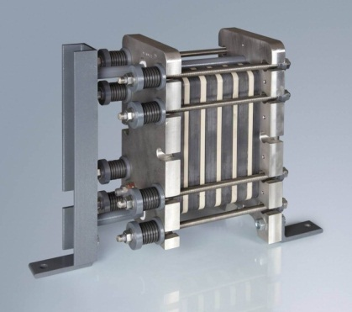
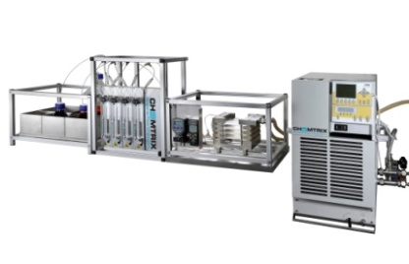
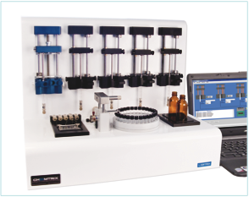
Scalability is Key at all Stages
KiloFlow™
g to kg
1mm channel width
Labtrix™
µg to mg
300µm channel width
Plantrix EKasic® Industrial Reactor
kg to tonnes,
(2-5 mm channel width)

Slide 9

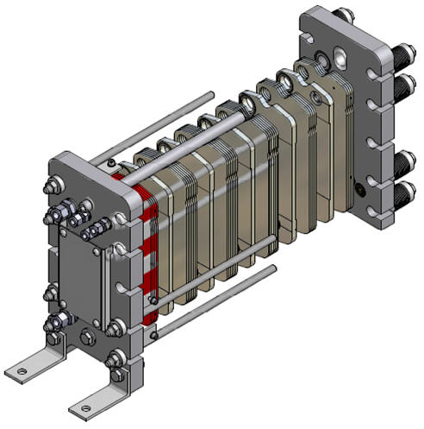
Plantrix®:
Flexible Reactor Set-up
Example system setup
Flow guided between modules by Teflon interconnections
2 temperature zones
Mixer (red) & residence or Quench modules (blue) can be at different temperatures
1X (Quench)
1X (Residence I)
3X (Residence II)
1X (Mixer)
Notes:
9

Slide 10

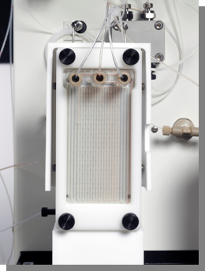
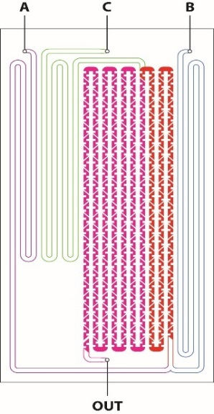

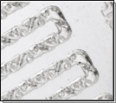

Glass Static Mixer/Reactor Chips
Efficient mixing essential in flow chemistry
Static glass mixers – can also be used as reactors
Made from borosilicate glass with pre-tempering channels and extended mixing domain.
Temperature range -80⁰ to 260⁰C
Can withstand up to 40bar
‘Easy’ standard HPLC screw connectors with Perlast ‘O’-ring sealing system
Different sizes (1.6, 1.0 and 0.27 mL)
2 input [A+B] and 3 input [(A+B)+C] options
Residence time chips available 15 ml and 20 ml
© Uniqsis Ltd 2017.

Slide 11
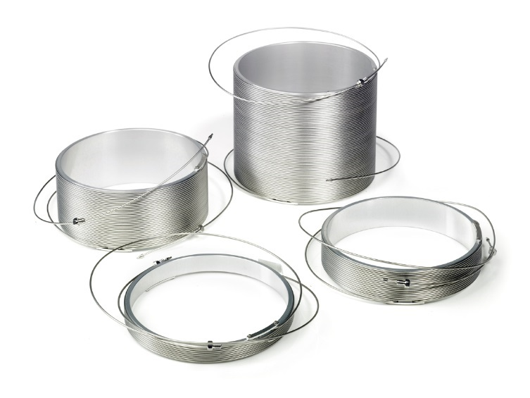
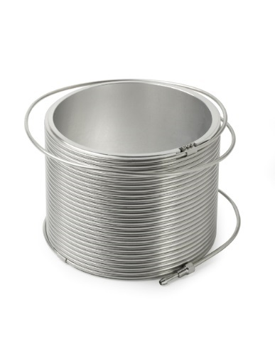
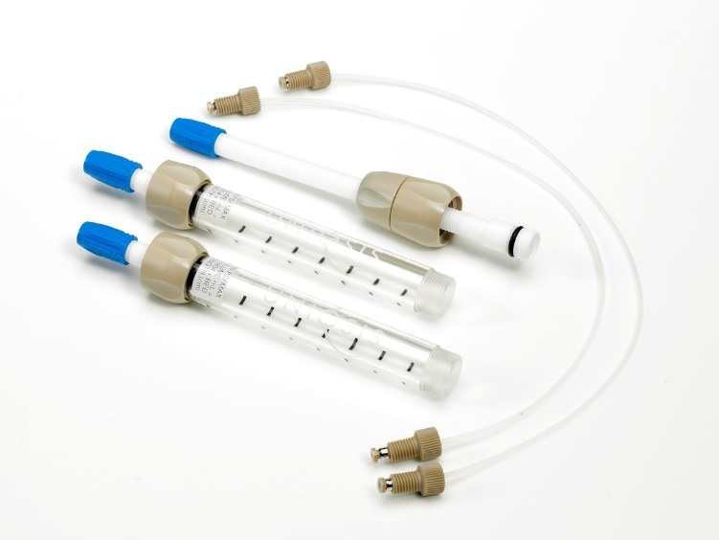
Coil and fixed bed column reactor options
Wide selection of coil reactors
Sizes: 2.0ml to 60 ml
Materials: PTFE, PFA, 316L SS, Hastelloy C, Copper
1/16” or 1/8” tubing options available, thin and thick wall options
Selection of Omnifit glass column reactors
Sizes: 10mm, 15mm, 20mm OD x100mm
Adjustable plunger, PTFE/PEEK construction (T_{max}=150ºC P_{max} 60 bar)
Stainless steel available on request
© Uniqsis Ltd 2017.

Slide 12

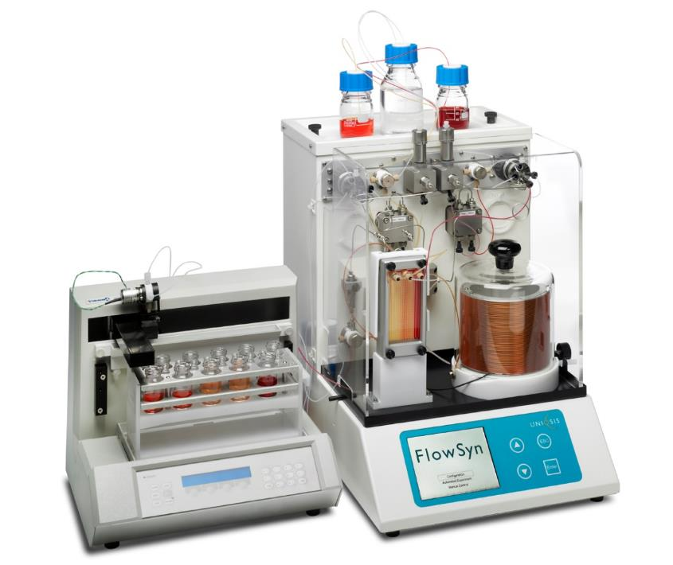
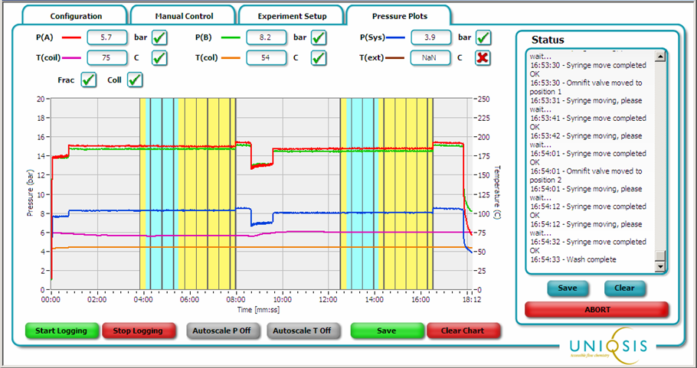
Uniqsis FlowSyn™ Multi-X flow reactor systems
Programs up to 10 separate experiments
Vary flow rates, temperatures, residence times
No additional computer required
‘fractionate’ & ‘optimise’ sample collection modes
© Uniqsis Ltd 2017
.

Slide 13
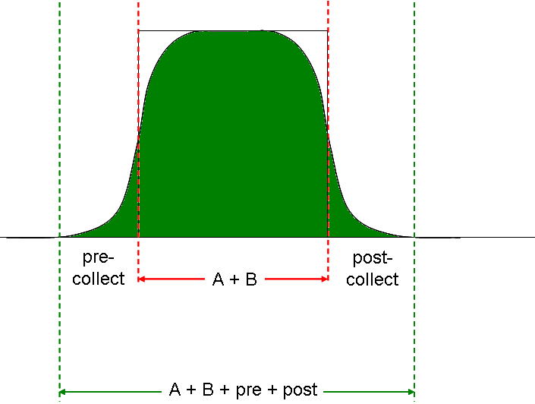

Collect All: Positive Pre- and Post-collect
Conc^{n}
Time
pre-
collect
post-
collect
A + B
A + B + pre + post
© Uniqsis Ltd 2017.

Slide 14
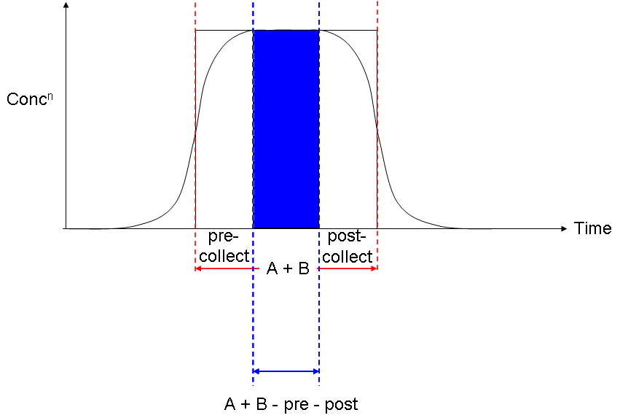
Collect Only Steady State: Negative Pre- and Post-collect
Conc^{n}
pre-
collect
post-
collect
Time
A + B
A + B - pre - post
© Uniqsis Ltd 2017.

Slide 15
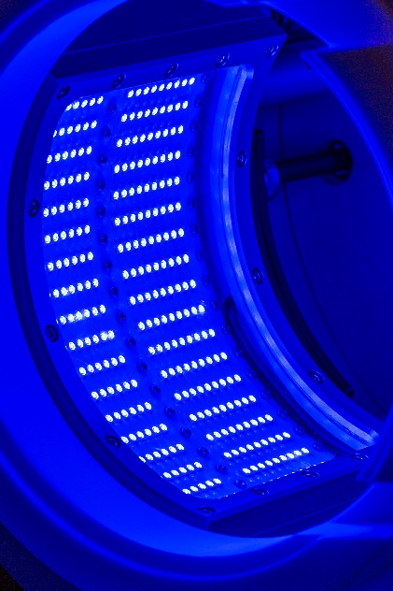
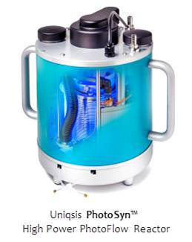
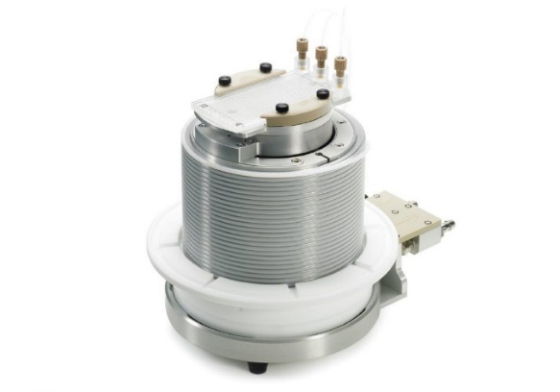
PhotoSyn Photochemical reactor
Blue light LED’s hemispherical arrays peaking 455 nm (range 330 to 550 nm) 720 W
Integral cooling for optics requires water line and input/output for chiller to cool reactor
Scale up route with larger reactor coil (high power)
Suitable for photoredox/photocatalysis applications
© Uniqsis Ltd 2017

Slide 16
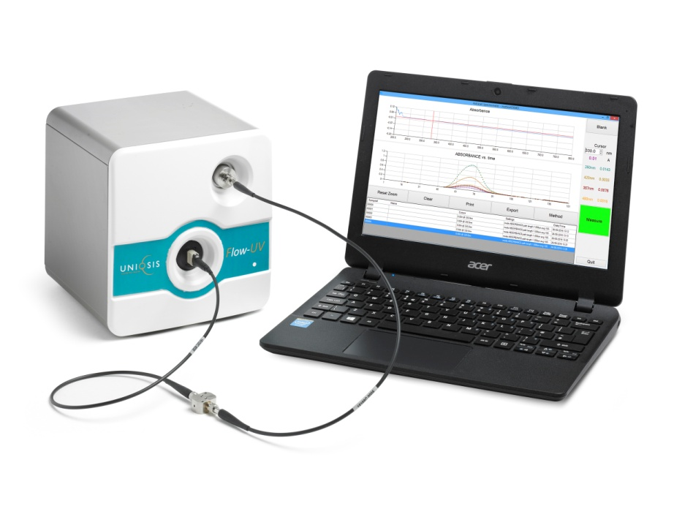
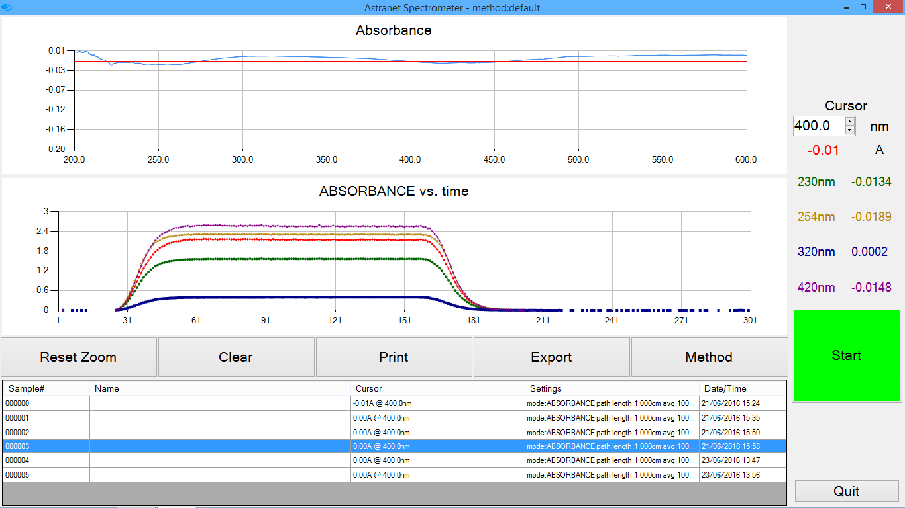
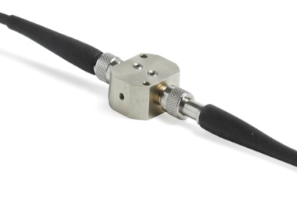
In-line UV-Vis detector – monitor steady state
Short path length, in-line high pressure flow cell uses PFA reactor tubing
Fibre optic connections permit positioning anywhere in the flow path
Range: 220-860nm, NIR option available to 1100nm (0.1 to 3A)
Enhanced 3648 CCD array detector (Full scan 2 seconds)
5 user selectable wavelengths to avoid detector saturation at typical reaction concentrations
Compact footprint, approx. 20 cm³
Essential for monitoring concentration to achieve steady state
© Uniqsis Ltd 2017.

Slide 17
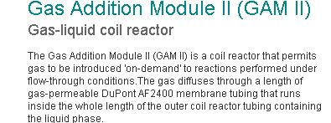
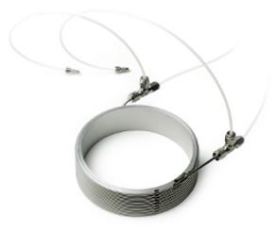

Slide 18
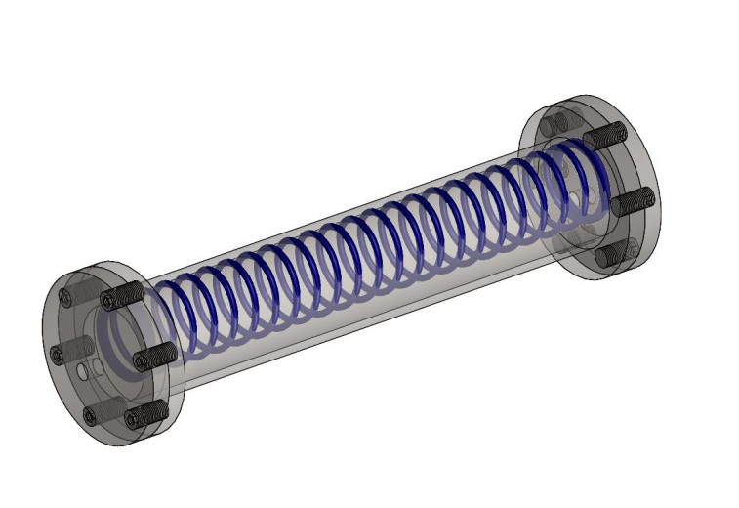
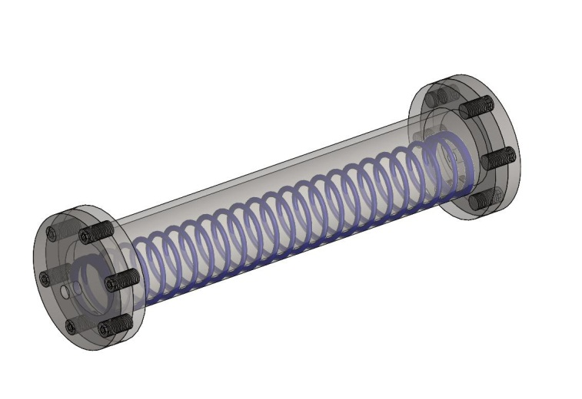
Coflore transverse mixing
Agitated Cell Reactor
Efficient radial mixing
No baffles (self baffling)
No seals or magnetic couplings
No centrifugal effects
No shaft stability problems
Agitated Tube Reactor
©AM Technology 2012
Patented technology

Slide 19
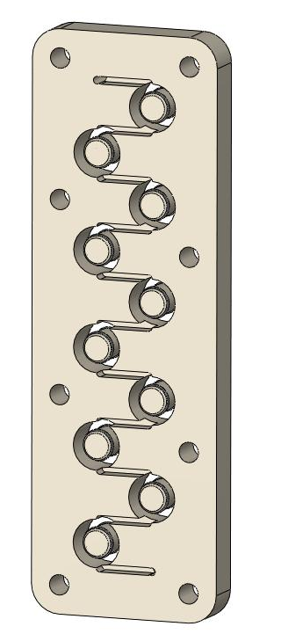
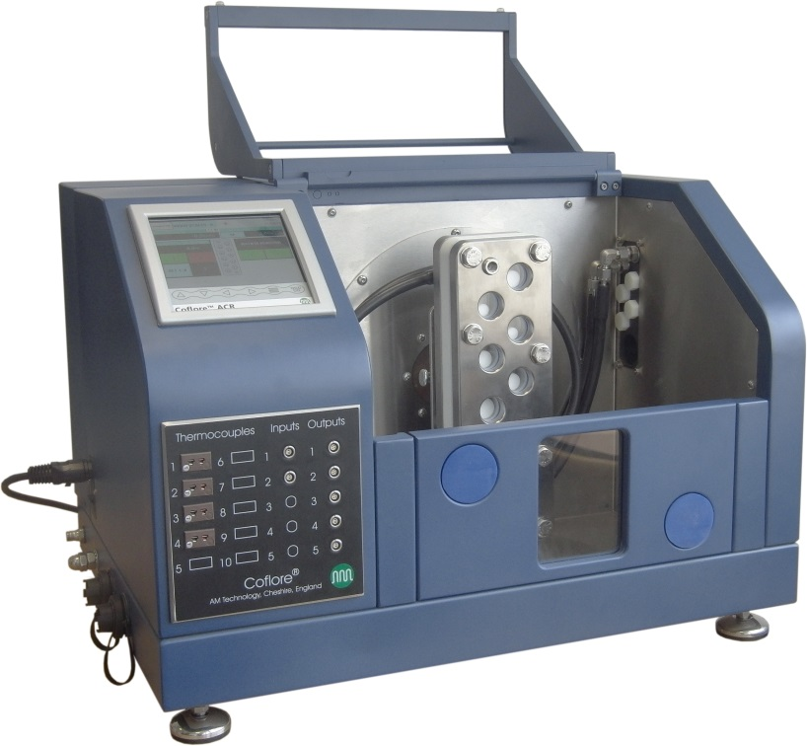
Coflore ACR – Lab scale
Lab scale
Ten reaction cells cut within a monolithic block
Discharge
Reaction cell
Inter-stage channel
Product flow
Feed
©AM Technology 2012
Patented technology

Slide 20
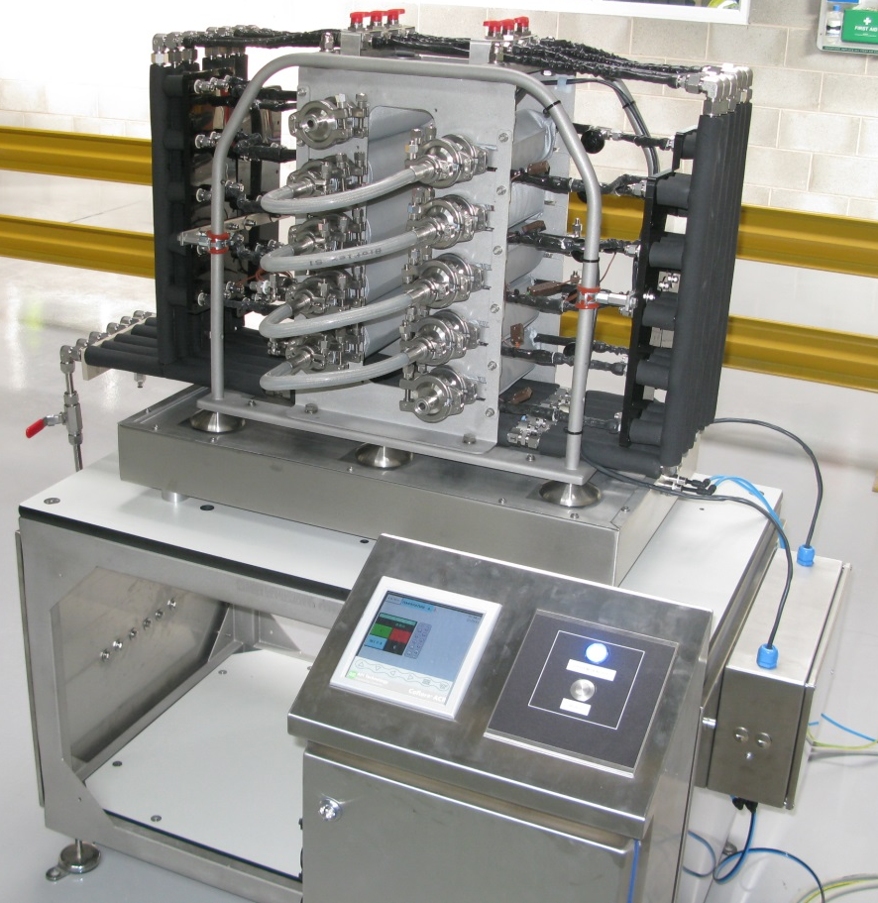
Coflore ATR – Industrial scale
Industrial scale Coflore systems use the same mixing technique but the reaction cells are expanded into long tubes
Operating capacity - 1 to 10 litres
10 temperature zones
Patents pending
©AM Technology 2012
Patented technology

Slide 21
Energy dissipation in Spinning Disk Reactors
Similar in Energy Dissipation to Microreactors
Heat Transfer is not tied to Mass Transfer
Mixing is not controlled by the net flow
Meeuwse, M., van der Schaaf, J. and Schouten, J. C. (2012), Multistage rotor-stator spinning disc reactor. AIChE J., 58: 247–255. doi: 10.1002/aic.12586

Slide 22


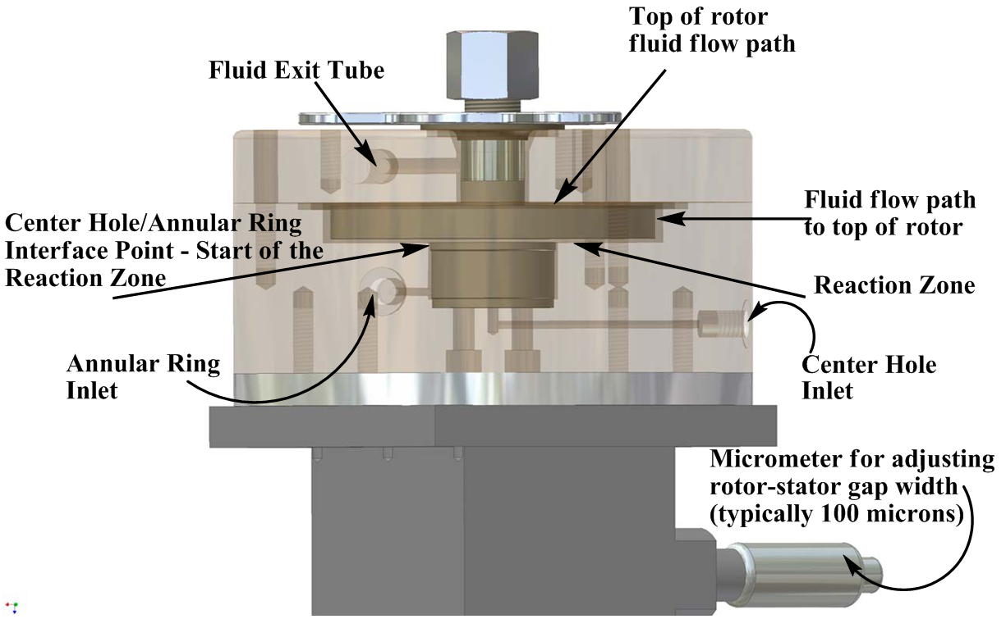
Synthetron ™ Spinning Disk Reactor

Slide 23
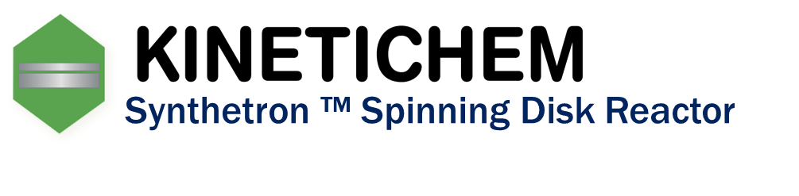
Reaction Examples: Halogen/Lithium Exchange
Batch | Synthetron
97% Yield | 98% Yield
-78 C required, slow addition | Scalable, room temp 2.7 Kg/hr
Feed reagent concentrations of 2.0M, lithium products were quenched with TMSCl and analyzed by GC.
Tet. Lett., 2010, 51, p. 4793.

Slide 24
Commercialization Review Articles
GSK doubles down on Singapore continuous processing plant
June 29, 2015 | By Eric Palmer
(http://www.fiercepharmamanufacturing.com)
Flow chemistry reaches manufacturing milestone
Lilly chemists make chemotherapy drug candidate in a multistep continuous flow process using current Good Manufacturing Practices
By Bethany Halford
Volume 95 Issue 25 | p. 7 | News of The Week
Issue Date: June 19, 2017 | Web Date: June 16, 2017 (C&E News)
Continuous Manufacturing: A Changing Processing Paradigm
Apr 01, 2015
By Randi Hernandez
BioPharm International

